Slide 2
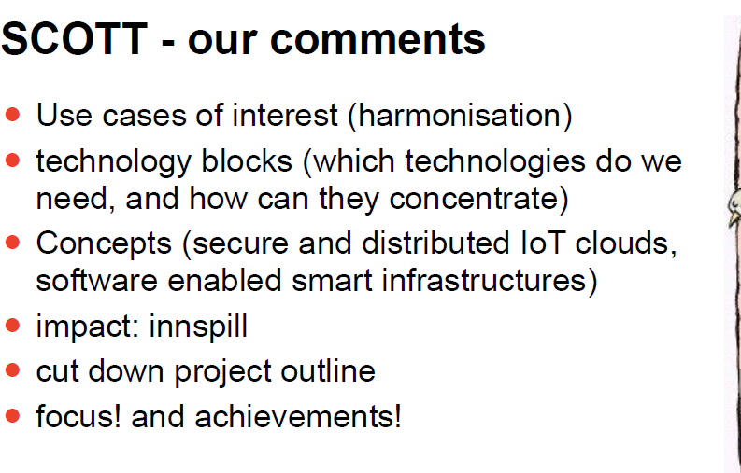

Slide 4
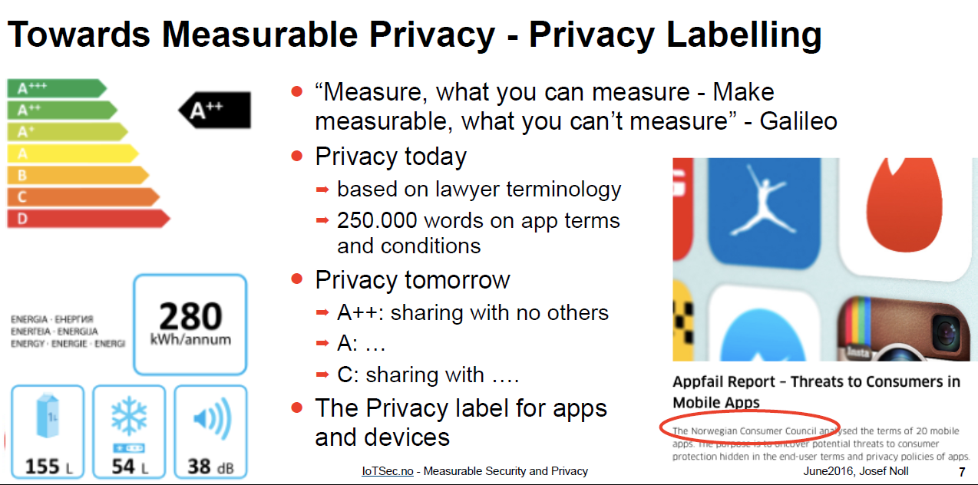

Slide 6
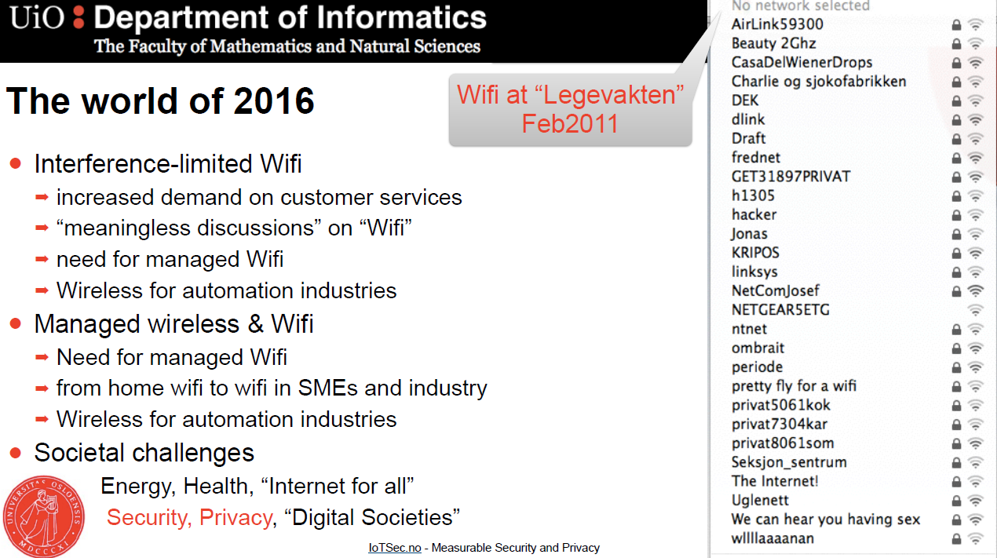

Slide 7
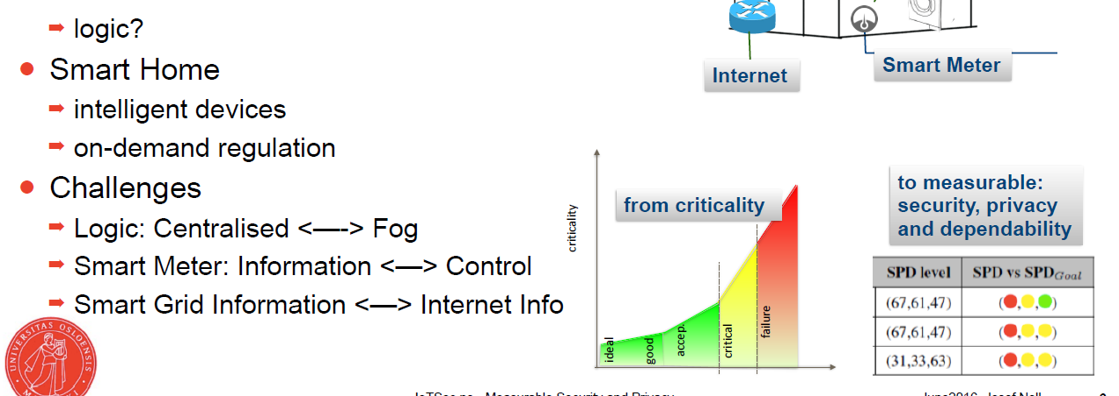

Slide 8
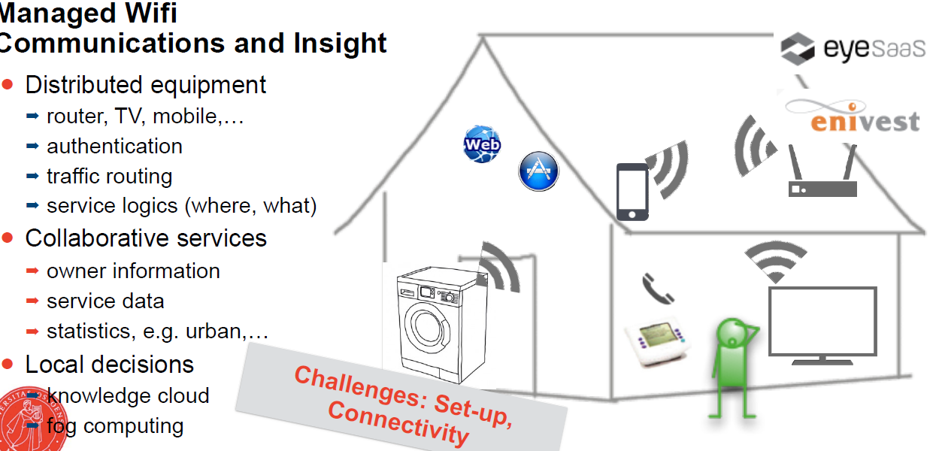

Slide 9
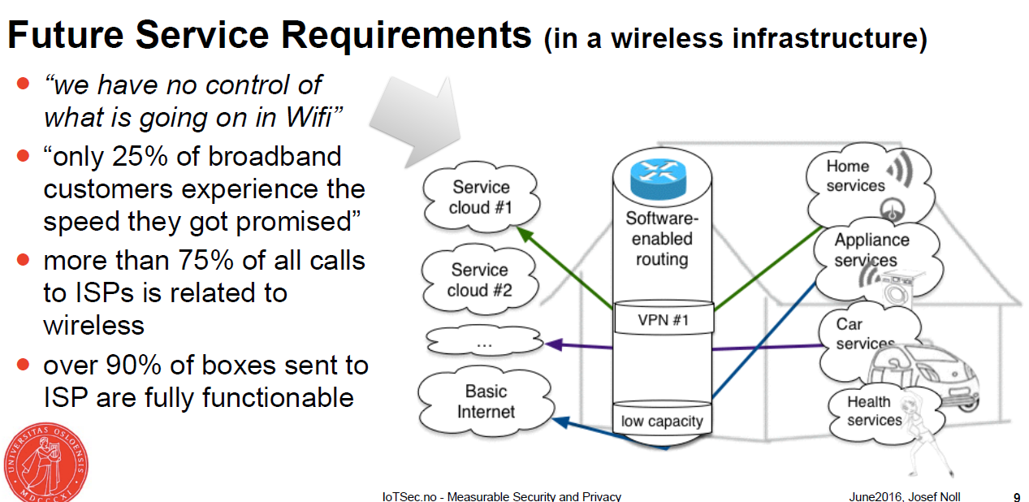

Slide 10


Slide 11
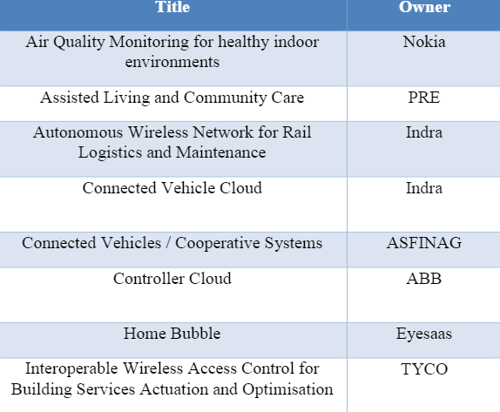
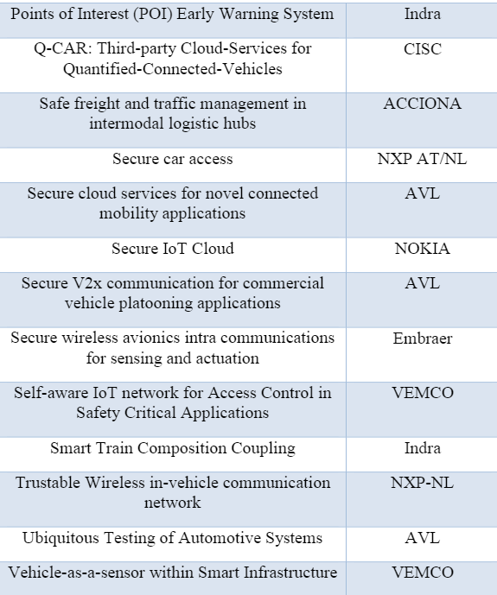

Slide 12
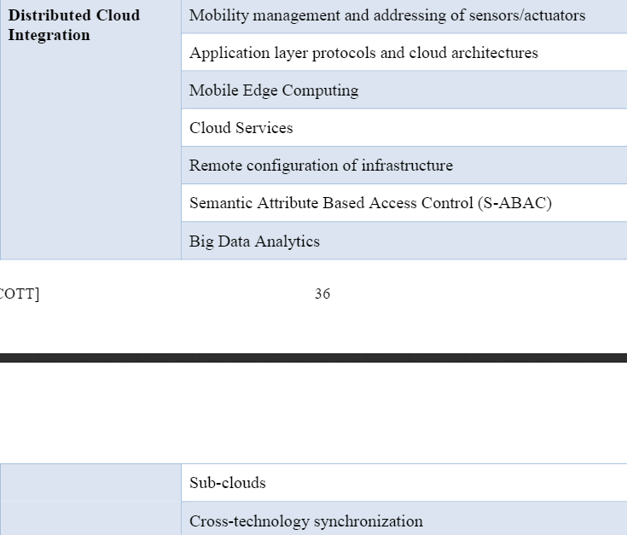

Slide 13
ECSEL - 6 impact points
p45 annual work plan
our impact, find one use case supporting it
- all other use cases, supportive...

Slide 14
Next actions (Norway)
- phone conf 29June 0900-1000
(submission: 20 Sep)
project start 1May2017

