Slide 1




Application Scenario
Consider a Transmission Scenario with a group of Receivers
Video files are transmitted from the transmitter side, through the AP, and to the receivers.
The declaration and handshake processes are not considered
IEEE 802.11
Portal
Portal
Distribution System
Transmitter
Declaration
uplink
Transmitter
downlink
Access
Point
Receiver

Slide 2
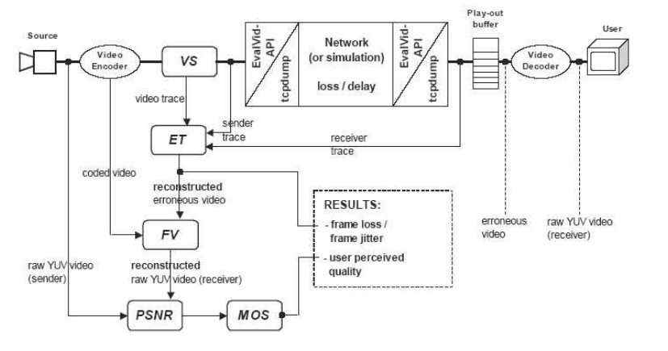
Overview of Evalvid

Slide 3
Encodes function
  H.263 (ffmpeg, DResearch)
  MPEG-4 (ffmpeg, XviD)
  H.264 (x264, JM 10.2)
The size of codecs file under 264 is 16413KB
Bit-rate 128kbps
Frames per second 30FPS
An I-frame every second 30GOP
Max. packet size 1472 MTU

Slide 4
Channel: wireless channel
Propagation model: tworay ground
Physics layer type: wireless pyh extension
Mac layer: 802_11extension
Queueing method at the interface: priority queue which gives priority to the routing protocol packets
Antenna: Omni-directional Antenna
Routing protocol: DumbAgent (it means the source and receiver are neighbours which can be touched within one hop)
802_11 datarate: 54Mb
Application layer traffic setting: packet size 1023 bytes, rate 256Kb

Slide 5
802.11a setting
CSThresh_ 6.31e-12 ;#-82 dBm Wireless interface sensitivity (sensitivity defined in the standard)
Pt_ 0.001
freq_ 5.18e+9
set noise_floor_ 2.512e-13 ;#-96 dBm for 10MHz bandwidth
L_ 1.0 ;#default radio circuit gain/loss
PowerMonitorThresh_ 1.259e-13 ;#-99dBm power monitor sensitivity
HeaderDuration_ 0.000020 ;#20 us
BasicModulationScheme_ 0
PreambleCaptureSwitch_ 1
set DataCaptureSwitch_ 0
SINR_PreambleCapture_ 2.5118; ;# 4 dB
SINR_DataCapture_ 100.0; ;# 10 dB
set trace_dist_ 1e6 ;# PHY trace until distance of 1 Mio. km ("infinty")
PHY_DBG_ 0
set CWMin_ 15
CWMax_ 1023
SlotTime_ 0.000009
set SIFS_ 0.000016
set ShortRetryLimit_ 7
set LongRetryLimit_ 4
set HeaderDuration_ 0.000020
set SymbolDuration_ 0.000004
set BasicModulationScheme_ 0
set use_802_11a_flag_ true
set RTSThreshold_ 2346
set MAC_DBG 0

