Slide 1
WI-FI VIDEO SYSTEM FOR
BICYCLE RACE
i Rena

Slide 2
INTRODUCTION
1. ESTABLISH SYSTEM BASED ON STANDARD IEEE802.11 (WI-FI) WHICH
WILL STREAM VIDEO TAKEN ON SOME POINTS ALONG THE ROAD TO
USERS CONNECTED TO INTERNET
USERS HAVE EITHER BROADBAND CONNECTION TO WEB AT HOME OR
OR USERS CAN BE LOCATED ALONG THE RACE TRACK,DELIVERING
VIDEO STREAMS TO THEM IS MAIN TASK
IN OUR CASE THE RACE TRACK IS FIRST 20km OF BIRKEBEINERRITTET
WICH STARTS IN THE TOWN OF RENA AND CONTINUES TROUGH
ROUGH TERRAIN TO NEXT TOWN

Slide 3
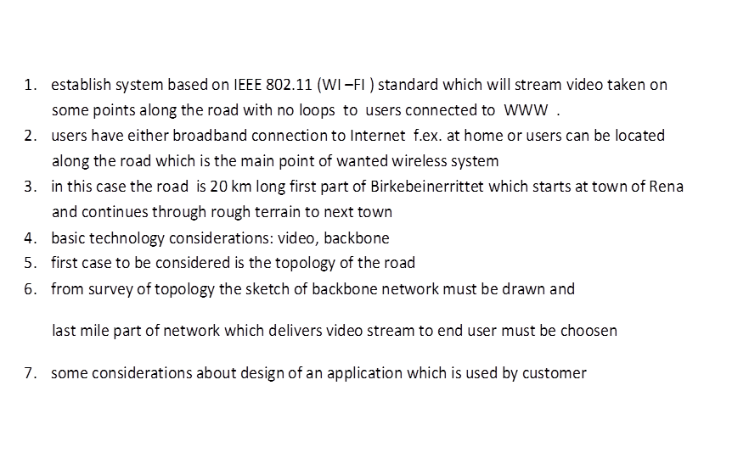
SHORT DESCRIBING

Slide 4

SHORT DISCRIBING
BACKBONE NETWORK
1TR 2TR 3TR 4TR
RACE TRACK 3AP
3VC
FINISH
1AP 2AP
1VC 4VC
2VC START

Slide 5
WHAT SHOULD BE CONSIDERED
TECHNOLOGY USED
SIMULATION RESULTS
TOPOLOGY OF RACE TRACK
4. RFID CONSIDERATIONS
5. SOME FEATURES OF AN APPLICATION FOR
END USER
6. ADDITIONAL EQUIPMENT

Slide 6
TECHNOLOGY ELEMENTS
VIDEO CAMERA and COMPRESSION
LOCAL DISTRIBUTION
BACKBONE NETWORK

Slide 7
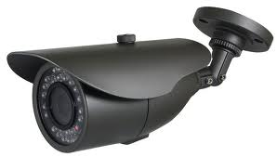
VIDEO
FOR VIDEO OUR ASSUMSIONS ARE :
RESOLUTION : 640X480 pixels
COLOUR DEPTH : 8 bits
NUMBER OF FRAMES : 24 fps
VIDEO CODEC : H.264
VIDEO STREAM BITRATE : ~1.5 Mb/s
+ IP OVERHEAD 40% : ~ 2 Mb/s

Slide 8
LOCAL DISTRIBUTION
1. WI-FI standard AP
2. 1 AP-access point
~500m-1km distance
3. Coverage 100-200m
4. # of spectators
5. # of video streams
Capacity reqvironments
RANGE
G
SPECTATORS ………

Slide 9
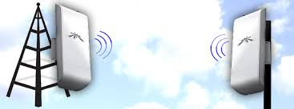
BACKBONE NETWORK
POINT – TO – PONT
CONNECTION
RADIO and ANTENNA
base from vendor -
‘ UBIQUITI’ – ‘NANOSTATION M5’
802.11ac STANDARD 5GHz
due to greater number
available channels and
non overlapping with
AP‘s on 2.4 HGz

Slide 10
LOCAL DISTRIBUTION
Number of users :
For AP choosen Wi-Fi on 2.4 GHz 802.11n no MIMO support
due to popularity
Maximum capacity : 54 Mb/s [ref. http://en.wikipedia.org/wiki/IEEE_802.11n-2009]
Number supported streams - 20
1 User gets 2Mb/s
Number = 54/2 * 3channels = ῀81 user for stream of SD quality
in the range of approximately 100m
Additionaly there are users who gets ½resolution of SD stream
that number is pretty difficult to calculate due to increasing path loss

Slide 11
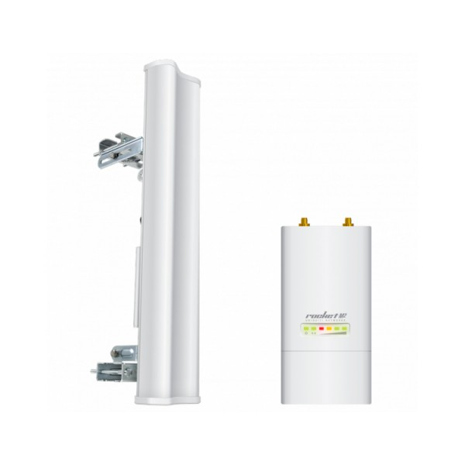
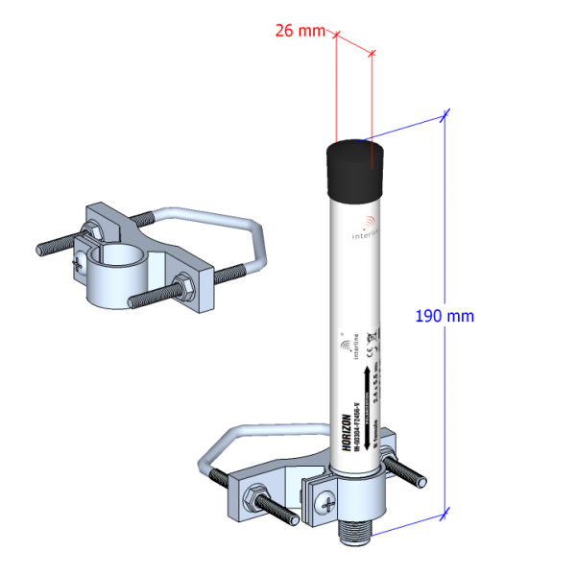
AP EQUIPMENT
RADIO AND ANTENNA : OMNIDIRECTIONAL ANTENNA :
ROCKET 2M + AM-15M-120 IH-G0304-F2456-V 2.4GHz

Slide 12
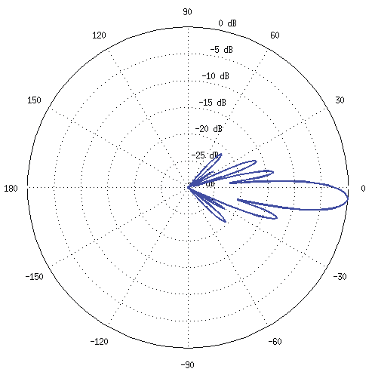
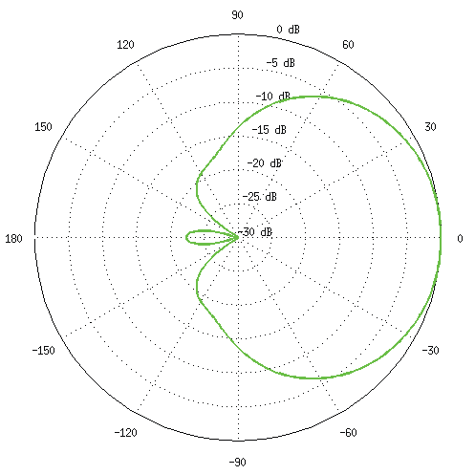
EQUIPMENT FOR AP
Sector antenna Ubiquiti AM-2G15-120 pattern
Horizontal Azimuth Vertical Elevation

Slide 13
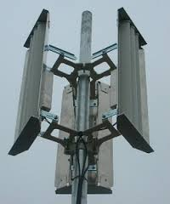
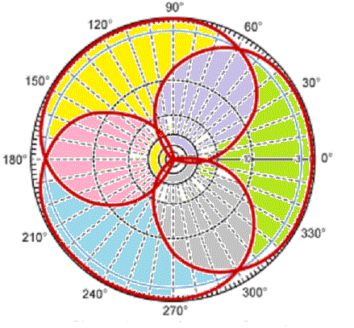
AP CHANNEL OVERLAPP
SEGMENTS OVERLAPP

Slide 14
DESIGN FOR AP
Variants :
3 sector anntennas ,each get its 2 sector antennas of 120 degree
Segment of 120 degrees or plus 1 omnidirectional antenna
there is possibility to adjust
according to lanscape
Place like road,square we need to cover
use of 3 non-overlapping channels in 2.4 GHz band
A
A

Slide 15
CALCULATIONS FOR AP
1. Use of radio UBIQUITI ROCKET M2
Tx – max 25dBm
2. Sector antenna UBIQUITI AM-2G15-120
gain 15 dBm
3. Sensitivity for handset
-66dBm - 54 Mb/s
-80dBm - 24 Mb/s

Slide 16
CALCULATIONS FOR AP
Comparing to isotropic antenna
Pr = Tx+Gt+Gr-L-AddL
E.I.R.P. =20dBm[ref.lovdata]
Gr = 0
L= 20log10(c/4*π*2.4GHz*D)– strongly
depends on distance
AddL=20dB on 2,4GHz - additional loss

Slide 17
CALCULATIONS FOR AP
we combine Tx+Gt = 20 dBm in any case [ref.lovdata]
20m
120m
difference = 100m hence - by exchange to sector antenna range is extended
we combine to get ERPI = 20 dBm = Tx(7dBm-2dBmLoss) +Gt(15dBm)
Range of omnidirectional antenna of 3dBi ῀50m [ref. en.wikipedia.org/wiki/IEEE_802.11n-2009]
 | Tx,dBm | Gt,dBm | Path loss FRIIS,dBm | AddL,dB | Pr,dBm
Isotropic | 20 | 0 | -66 | -20 | -66
Sectror | 20 | 15 | -66 | -20 | -51
 | Tx,dBm | Gt,dBm | Path loss FRIIS,dBm | AddL,dB | Pr,dBm
Isotropic | 20 | 0 | -81 | -20 | -81
Sectror | 20 | 15 | -81 | -20 | -66

Slide 18
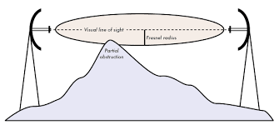
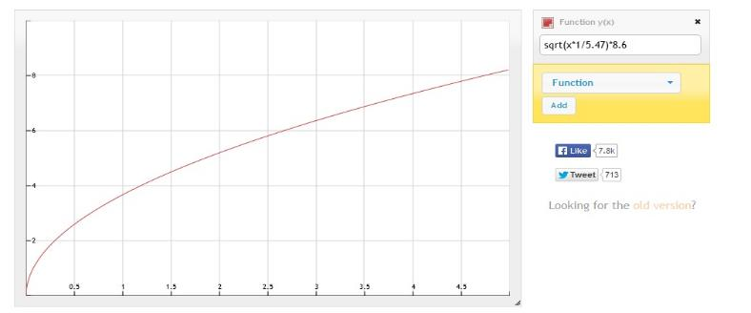
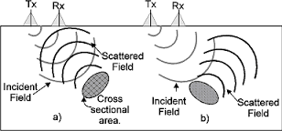
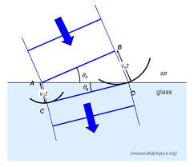
DESIGN FOR BACKBONE - OBSTACLES
FRESNEL ZONE +DIFFRACTION
hehheight,m
5m
hill trees distance between antennas,km
SCATTERING and REFLECTION REFRACTION

Slide 19
DESIGN FOR BACKBONE -OBSTACLES
B
keep Line Of Sight
Forest
Track
B
Mountain
B
B
B
B
B

Slide 20
SCHEME FOR BACKBONE
Distribution of streams
AP AP AP
2
2
BB1
BB2
BB3
3
1

Slide 21
CHANNELS FOR BACKBONE
4 Channels ,Max E.I.R.P. 40 dBm
Width 20 MHz [datasheet,lovdata]
Channel #, Frequency, MHz | Channel #, Frequency, MHz | Channel #, Frequency, MHz | Channel #, Frequency, MHz
149, 5745 | 153, 5765 | 157, 5785 | 165, 5825

Slide 22
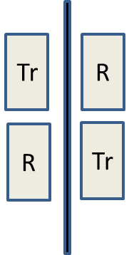
DESIGN FOR BACKBONE-CHANNEL COMBINATION
Full duplex
153 165 153 165
149 157 149 157
Tr
R
R
Tr

Slide 23
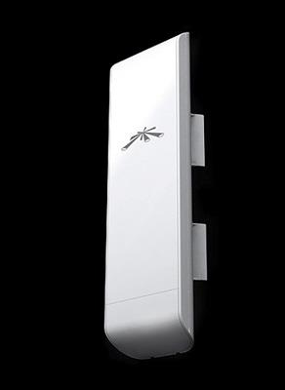
CHOICE OF TRANSMITTER-RECEIVER
UBIQUITI NANOSTATION M5
WORKS ON 5 GHz
USES MIMO 2x2
PRICE - 600Nok [ ref.www.proshop.no]

Slide 24
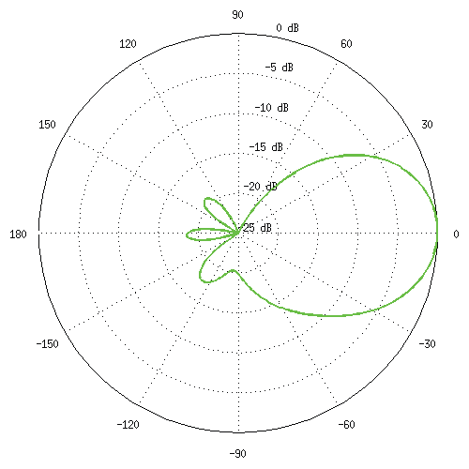
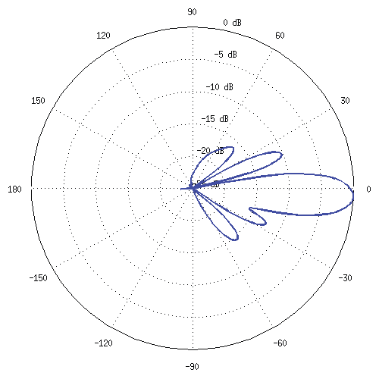
ANTENNA PATTERN M5
Horizontal Azimut Vertical Elevation

Slide 25
CALCULATIONS FOR BACKBONE
Coding | Capacity Mb/s | Spatial Strean,n | Output Power,dBm | Path loss, dBm,2km | Add to path loss, dBm | E.I.R.P. ,dBm,[ref] | Antenna Gain,dBi
MCS12MCS13 | 104 115 | 2 | 27 26 | -107 -117 | -25 | 40 | 15
 | Result path Loss Open Space,dBm | Spatial Stream Impruvement,dBm[ref] | Result, dBm | Sensitivity, dBm | Tolerance, dBm | Real Data rate, ½ ,Mb/s
 | -91 -102 | 15 | -76 -87 | -84 -79 | -/+ 2 | ῀50

Slide 26
CALCULATIONS FOR BACKBONE
1 . FRIIS + OPEN SPACE
Pr = Tx+Gt+Gr+L- Add - power on rec. side
L = 20log10(2/4*π*F*D) - free space loss
Add = 25dB on 5.4 GHz
Shannon
C = MIMO*B*log2(1+SNR)
SNR = 20dB
C= 2*20*10^^6*6.6 = ῀264 Mb/s >>

Slide 27
CONNECTION BACKBONE- AP
DISTRIBUTION OF STREAM AT LOCAL SERVER
From BB From VC to AP to AP to AP To BB
GUEST
OS
GUEST
OS
GUEST
OS
GUEST OS

Slide 28
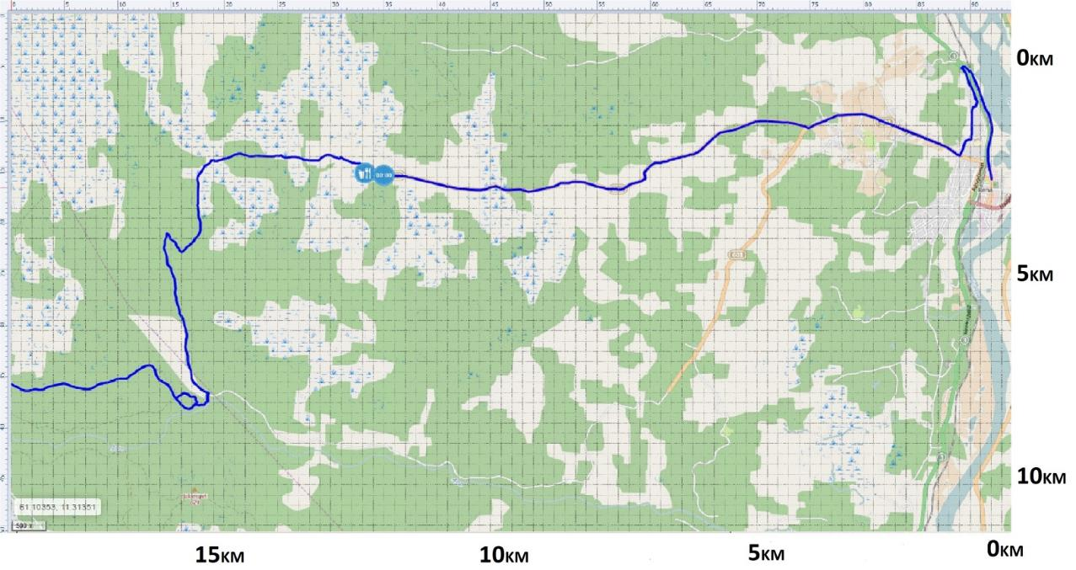
TRACK MAP
Track starts in urban area and continues through
rough terrain
Marsh and
forest
TOWN
start
finish
20 km

Slide 29
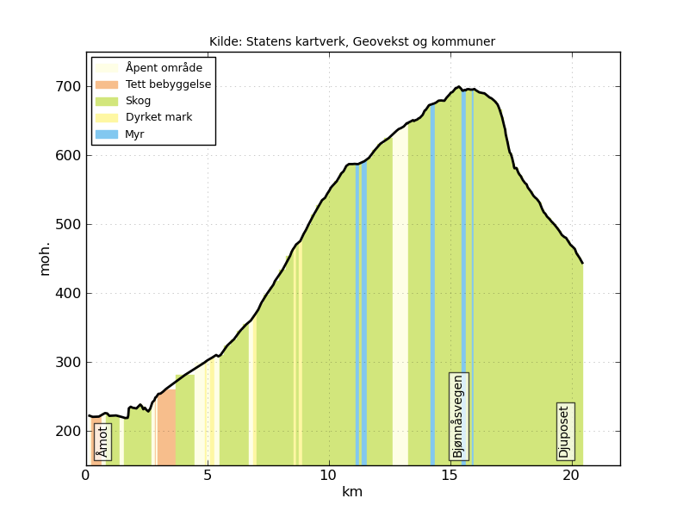
TRACK PROFILE

Slide 30
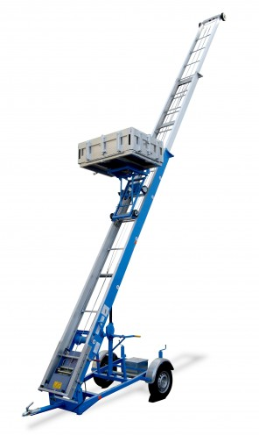
EQUIPMENT FOR AP SETUP
Elevator :
Max level : 20m

Slide 31
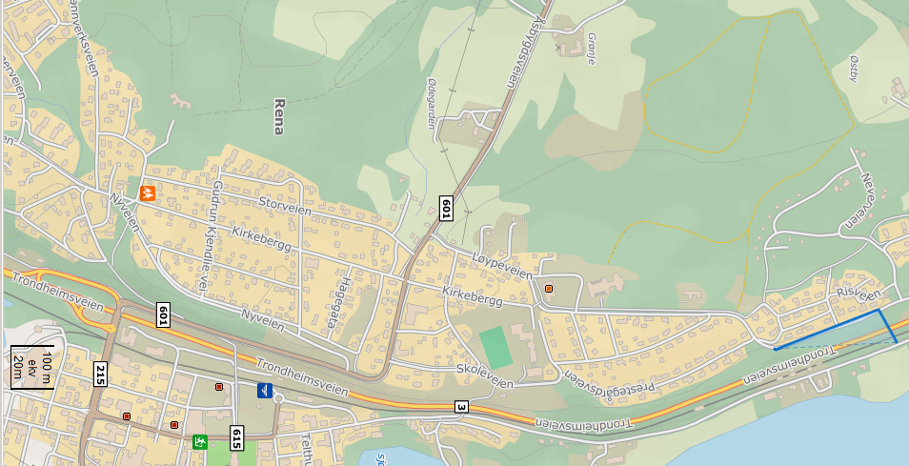
TOPOLOGY
1-2:400m 2-3: 600m 3-4: 600m 4-5: 100m 5-6: 500 6-7:600m 7-8:400m
6
8
5
4
start
7
6
5
4
1
2
3
2
1
3

Slide 32
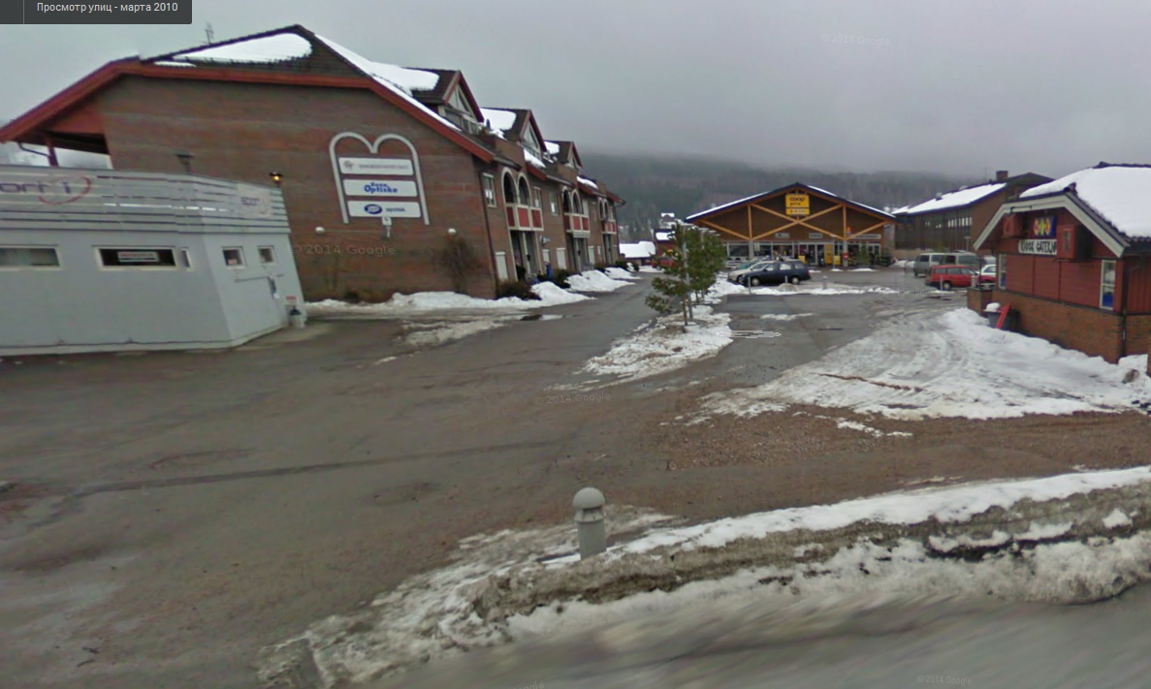
STREET PICTURE : SQUARE NEAR TO START
A
W

Slide 33
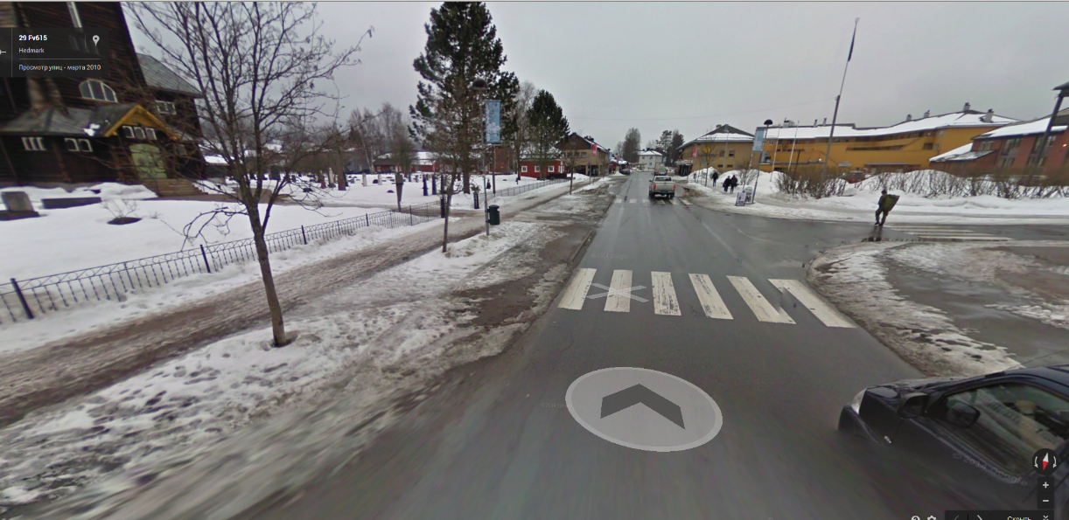
STREET PICTURE : START
vc
START

Slide 34
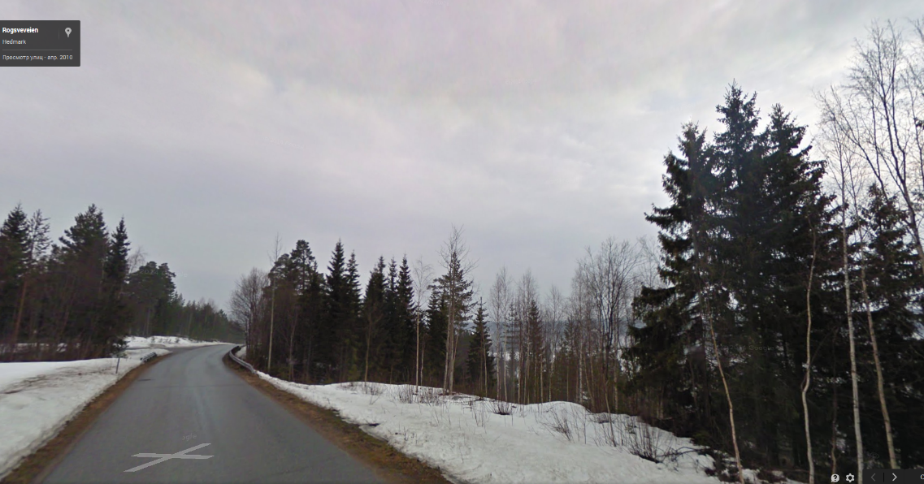
STREET PICTURE : POINT #5
vc

Slide 35
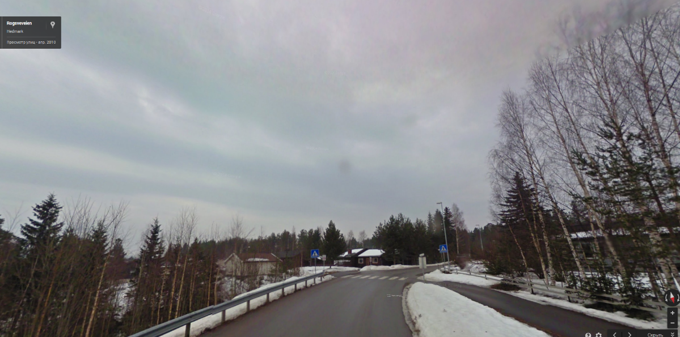
STREET PICTURE : POINT #6
VC

Slide 36
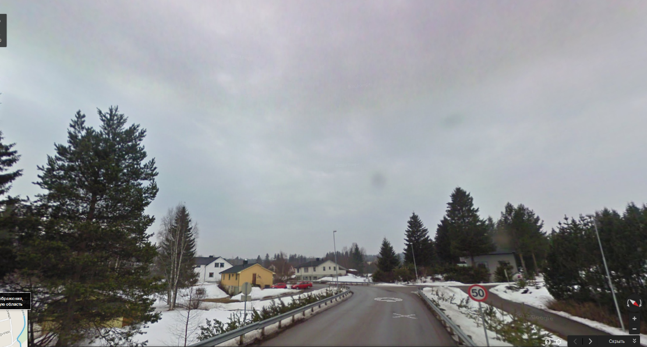
STREET PICTURE : POINT #7
VC

Slide 37
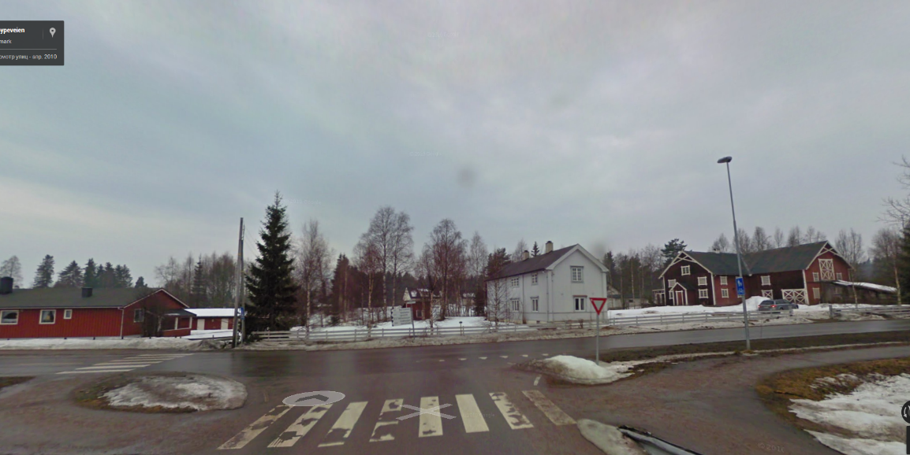
STREET PICTURE : POINT #8
VC

Slide 38
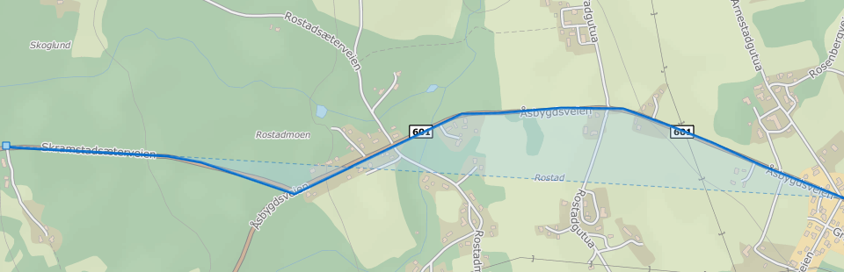
TOPOLOGY
Q
8-9: 800m 9-10:700m 10-11:400m 11-12:500m
12-13: 700m
11
10
13
12
11
10
13
8
7
12
9
9

Slide 39
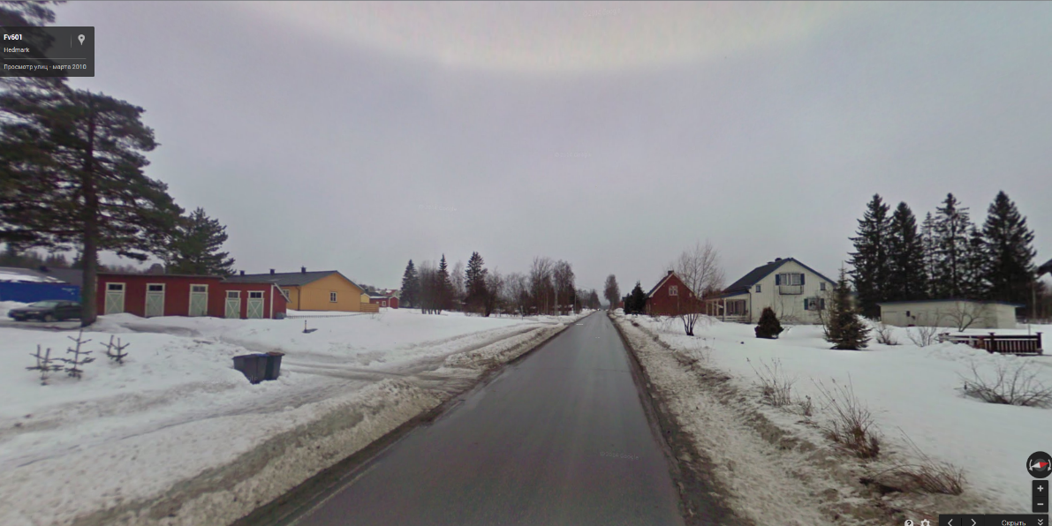
STREET PICTURE : POINT #9
VC

Slide 40
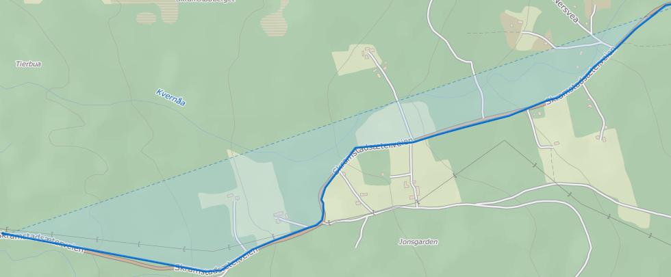
TOPOLOGY
2
13-14: 700m 14-15:500m 15-16:500m 16-17:800m 17-18: 800m
14
15
16
9
18
10
17

Slide 41
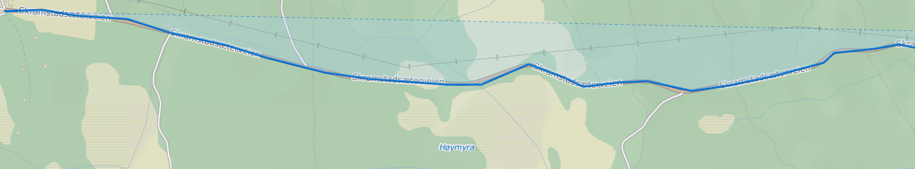
TOPOLOGY
Q
18-19: 800m 19-20: 500m 20-21: 500m
21-22: 800m
21
22
20
11
19

Slide 42
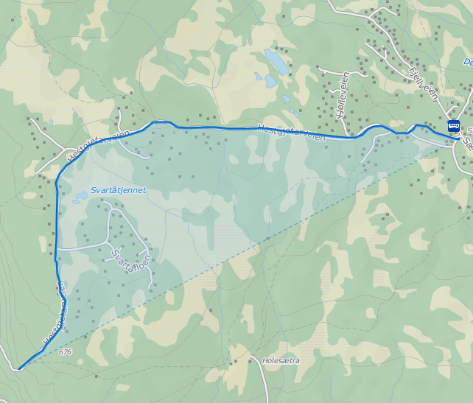
TOPOLOGY
1 22-23: 400m
23-24: 400m
24-25: 800m
25-26:500m
26-27:600m
27-28:400m
26
25
14
24
23
13
12
27
15
28
16

Slide 43
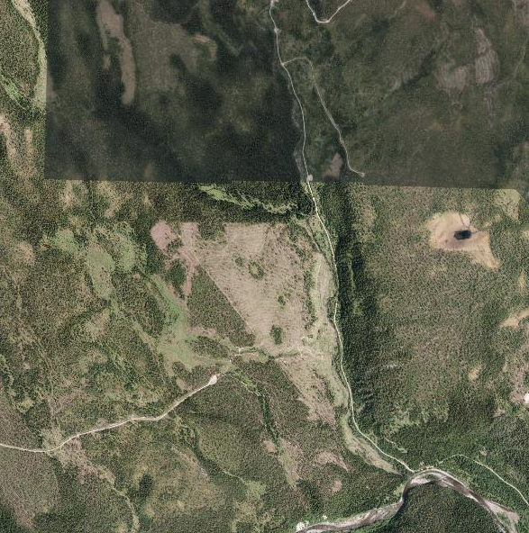
TOPOLOGY
28
1
28-29 : 400m
29-30 : 800m
30-31 : 900m
31-32 : 400m
29
4
17
30
18
3
31
19
finish
20
32

Slide 44
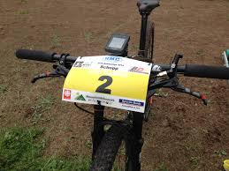
RFID PART
LOCAL SERVER
GATE IN GATE OUT
VIDEO CAMERA
AREA FILMED

Slide 45
APPLICATION FOR USER
1. Application helps user to find which videostream ‘ certain biker is shown
2. Predicts on which camera he will appear
-if there is no request for certain rider
it gives opportunity to choose among
all possible streams
Downshifts resolution in case of bandwidth
decrease

Slide 46
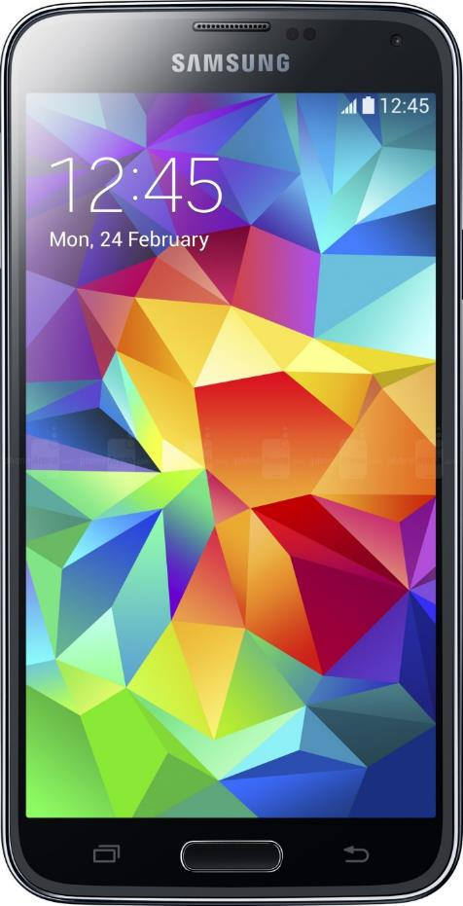
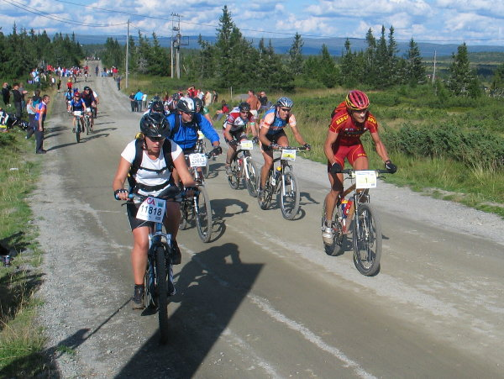
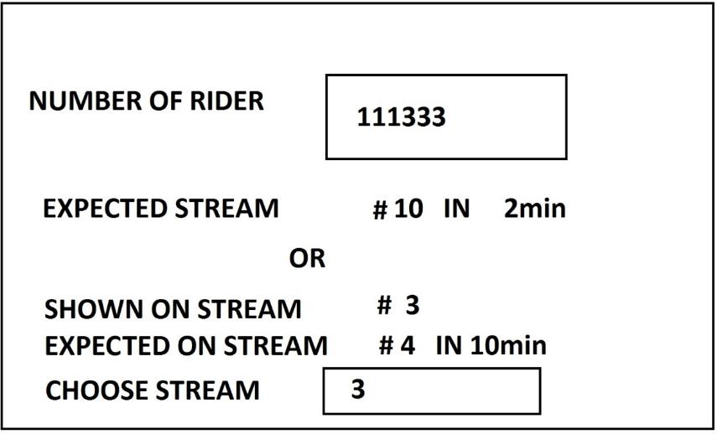
APPLICATION
EXPECTED SCREEN SHOT

Slide 47
ADDITIONAL EQUIPMENT
ELEVATOR
GENERATOR
UPS
REEL WITH CABLES
LIGHTENING DEFENCE

Slide 48
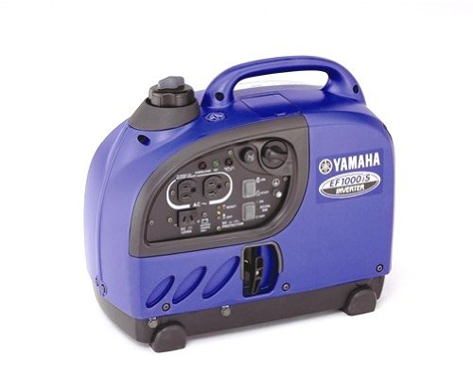
POWER SUPPLY
GENERATOR :
Frequency | 50 hz
Rated AC output | 900 VA
Max AC output | 1,000 VA
Voltage AC | 230 V
Rated current | 3.9 A
Operating hours without refill | 4.0 - 12.0* (*Economy Control on)

Slide 49
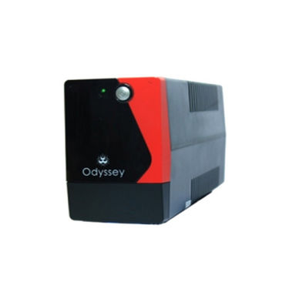
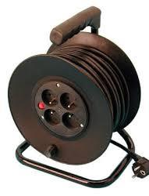
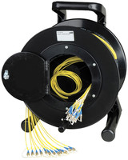
UPS
STABLE VOLTAGE SOURCE :
cca
EXTENTION WIRE :
VOLTAGE IN VOLTS | Input Voltage Range : 230 VAC
Output Power Capacity (Watts)) | 12 VDC
Output Voltage in Volts | 230
Battrey Recharge | 4 - 6 Hours (90% of full capacity)
Operating Temperature (ApproXimate) | 0 to +40 c
220v
cat5

Slide 50
MOVING ELEVATOR
EQUIPMENT FOR ANTENNA SETUP
Technical specifications
Engine: 230 V
Power rating: 1300 W
Weight: < 750 kg
Lifting capacity: 200 kg
Aluminium masts: 4 x 5,40 m

Slide 51
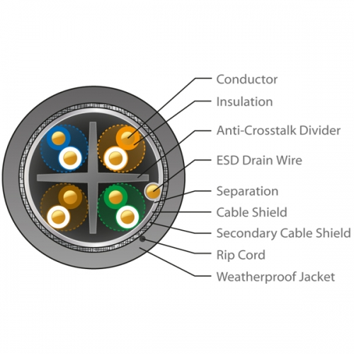
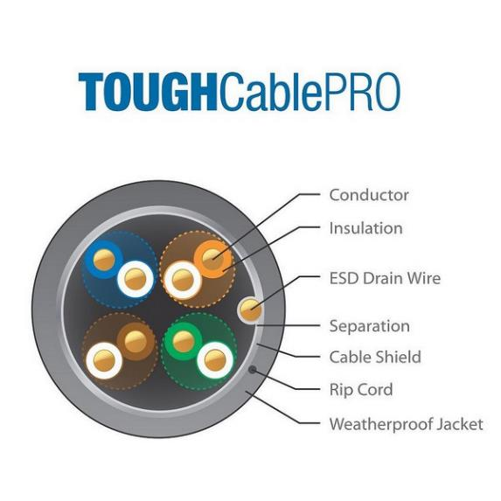
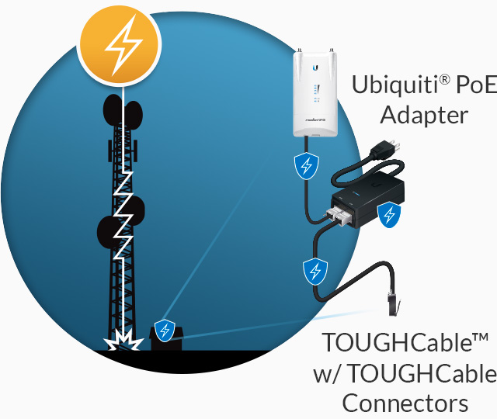
LIGHTENING DEFENCE
CABLE CONNECTORS
Ggrounddfdfa adgaagadont
Ground for system

Slide 52
REFERENCES
802.11(Wi-Fi) Networking Handbook.Neil Reid and Ron Seide.2003,McGraw-Hill/Osbourne.
Short-range Wireless Communication.Alan Bensky.2004,Elsevier.
Wireless Communications.Principles and practice.2002,Prentice Hall RTR
https://lovdata.no/dokument/SF/forskrift/2012-01-19-77#KAPITTEL_4
Electrical and Mechanical Downtilt and their Effects onHorizontal Pattern Performance.
White paper. By Louis (Lou) J. Meyer, P.E.
http://www.ubnt.com/airmax/ - datasheet
Introduction to MIMO: Antennas &Propagation aspects.Björn Lindmark.KTH vetenskap
och konst
EXPERIMENTAL CHARACTERIZATION OF A MIMO UNDERGROUND MINE CHANNEL AT 2.45GHz . Yacouba Coulibaly1, Bilel Mnasri1, Mourad Nedil1, Ismail B. Mabrouk2, Larbi Talbi2, and Tayeb . A. Denidni3. Progress In Electromagnetics Research B, Vol. 50, 219{234, 2013}
Antenna Patterns and Their Meaning.White paper .Cisco
http://en.wikipedia.org/wiki/IEEE_802.11n-2009

