Slide 1

Wifi interference
Site survey and Interference avoidence for wifi performance
By zyyad ali shah syed
Unik 4700
15-11-2016

Slide 2
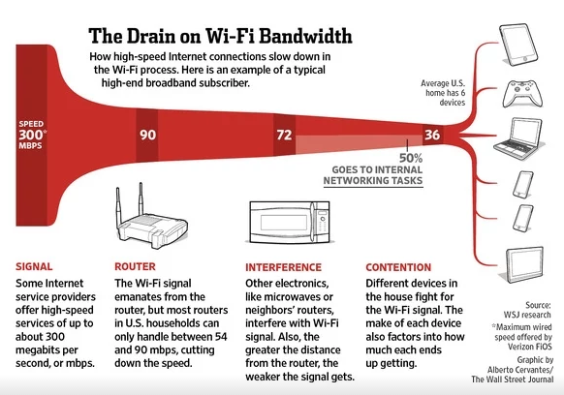
INTERFERENCE

Slide 3
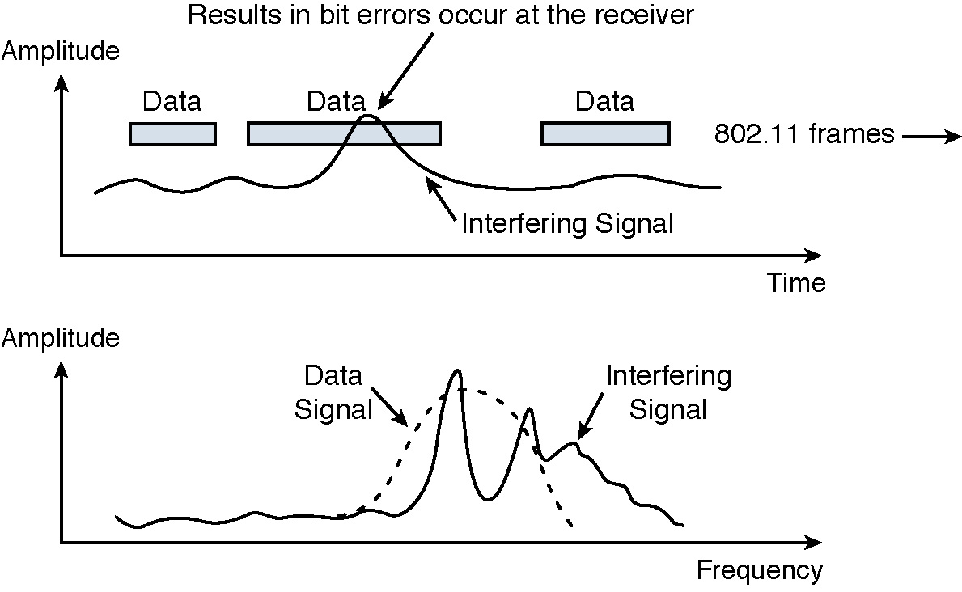
Radio signle interference

Slide 4
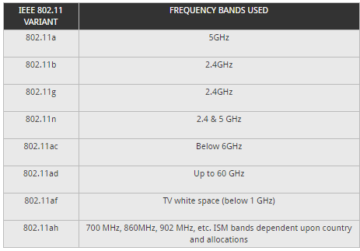
Wifi (802.11) frequency bands

Slide 5
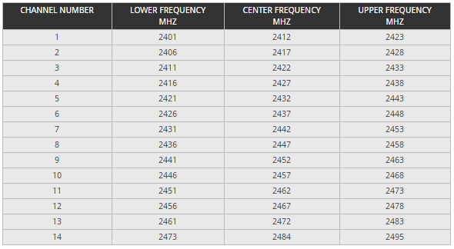
Wifi channel number and their frequency

Slide 6
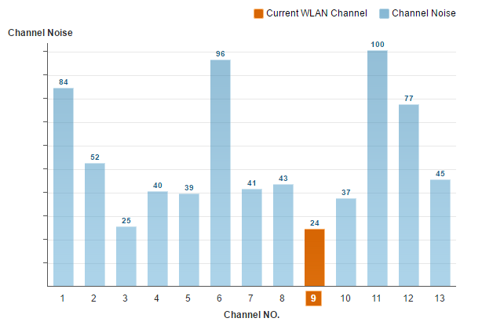
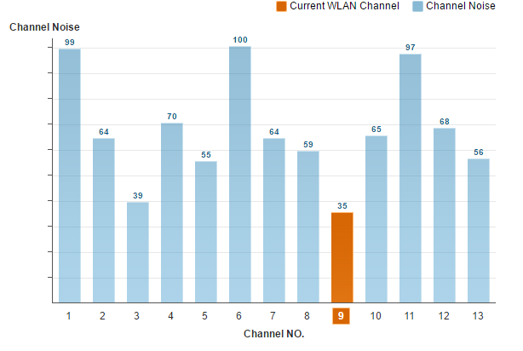
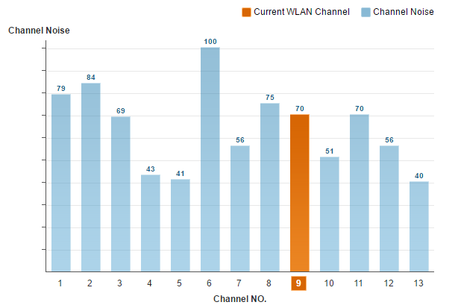
Standard wifi router channel noise

Slide 7
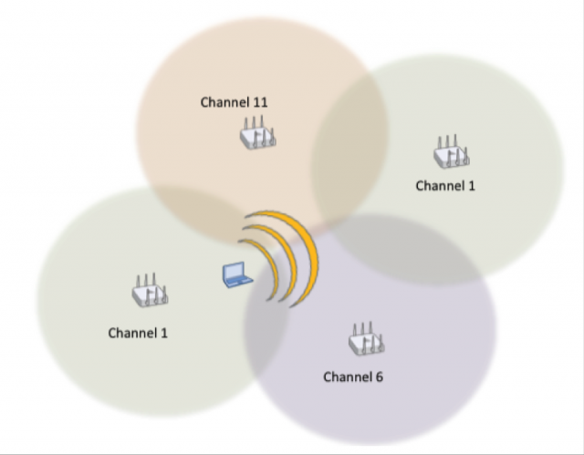
co-channel interference/cooperation
If a client is at the outer edges of a coverage cell, the client’s transmissions may propagate into another cell using the same channel.
All of the radios in the other cell will defer if they hear the original client’s transmissions from a different cell but on the same channel.

Slide 8
Channalyzer & Wi-spy
Wifi analysis tools

Slide 9
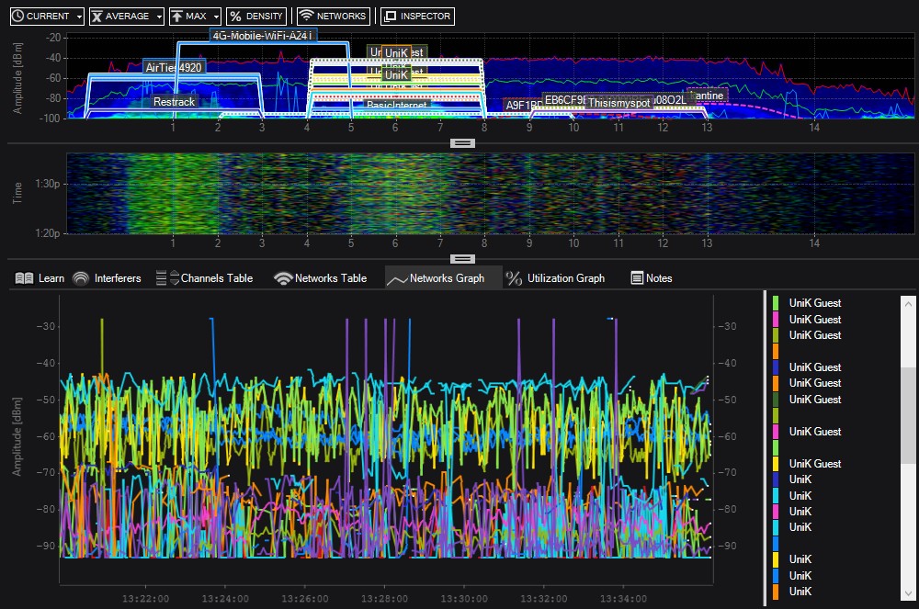
Site survey

Slide 10
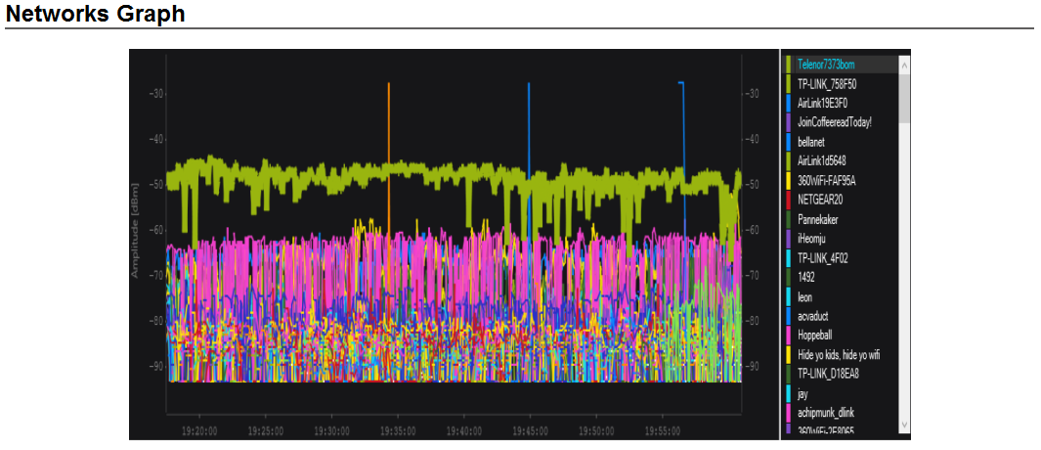
Interference caused by microwave
Interference caused by Microwave Oven and 9 other wifi access points on the same channel.

Slide 11
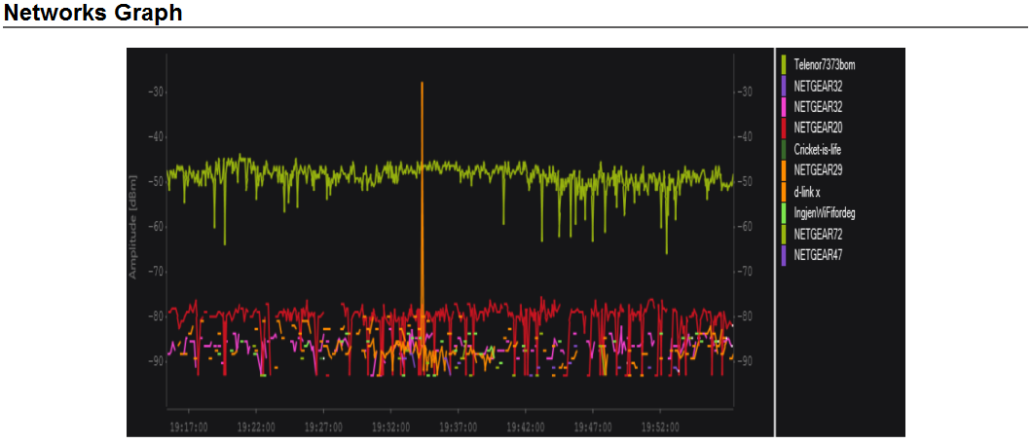
Interference caused by microwave
Interference caused by Microwave Oven and 2 other wifi access points on the same channel

Slide 12

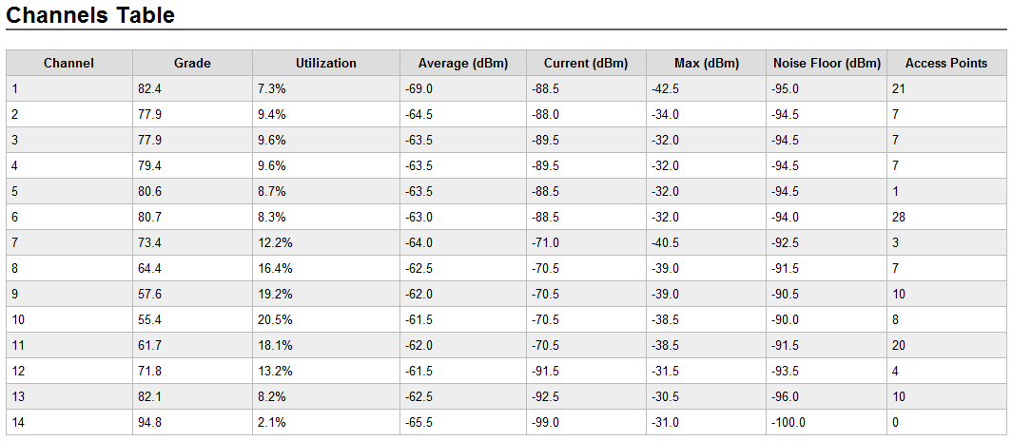
Signal, noise and access points on ch.9

Slide 13

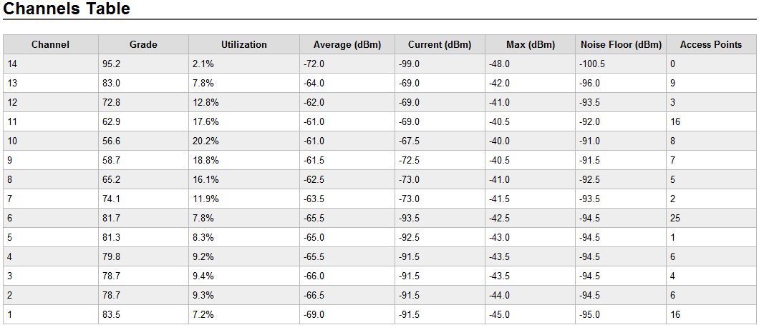
Signel, noise and access points on ch.9 cont...

Slide 14


Signel, noise and access points on ch.9 cont...

Slide 15
Snr for ch.9 with different ap count
Snr ch.9 with 10 ap
Snr ch.9 with 2 ap
Average SNR = Signel (dBm)/ Noise (dBm)
= -62 - (-90.2) = 28.2 db
Current SNR = Signel / Noise
= -70.5-(-90.2) = 19.7 db
Average SNR = Signel (dBm) / Noise (dBm)
= -62 –(-91.5) = 29.5 db
Current SNR = Signel / Noise
= -62-(-91.5) = 29.5 db
Snr ch.9 with 7 ap
Average SNR = Signel (dBm)/ Noise (dBm)
= -61.5 –(-91.5) = 30.0 db
Current SNR = Signel / Noise
= -72.5/-91.5 = 19.0 db
A ratio of 10-15dB is the accepted minimum to establish an unreliable connection; 16-24dB (decibels) is usually considered poor; 25-40dB is good and a ratio of 41dB or higher is considered excellent.

Slide 16
Industrial implementation of interference avoidence and band steering
Air ties 4920

Slide 17
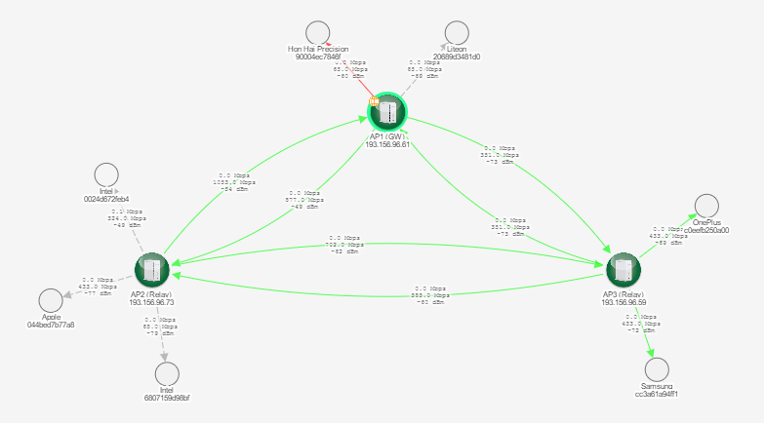
Mesh view of air ties

Slide 18
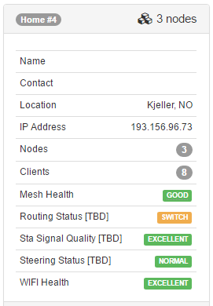
Home view

Slide 19
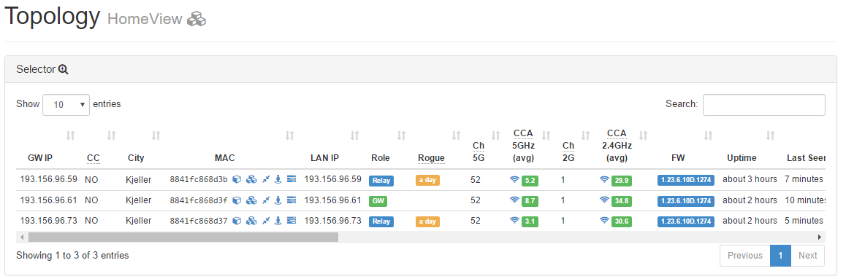
Air ties topology home view

Slide 20
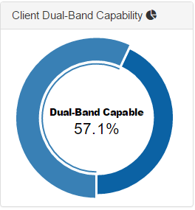
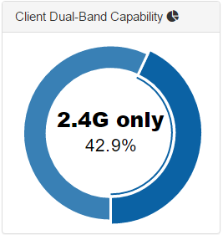
Dual-band capability

Slide 21
Band steering
Band steering is a technology that detects whether or not the wireless client is dual-band capable, and if it is, it will push the client to connect to the less congested 5GHz network. It does this by actively blocking the client's attempts to associate with the 2.4GHz network.

Slide 22
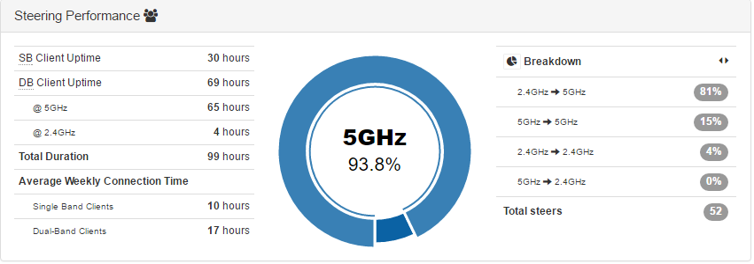
Steering performance 5 ghz

Slide 23
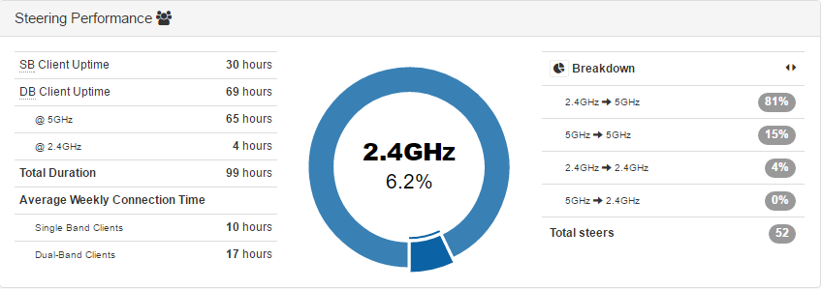
Steering performance 2.4 ghz

Slide 24
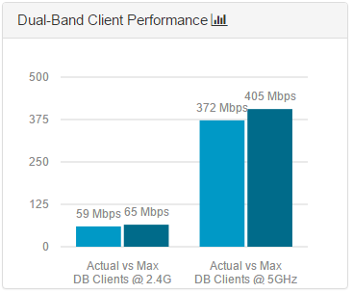
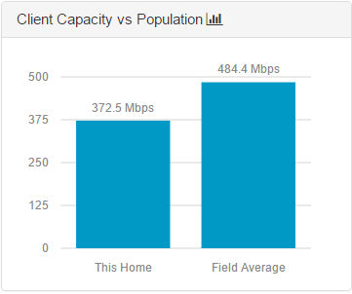
Performance vs capacity

Slide 25
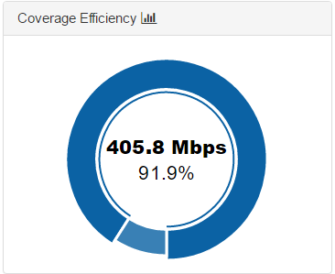
Coverage efficiency

Slide 26
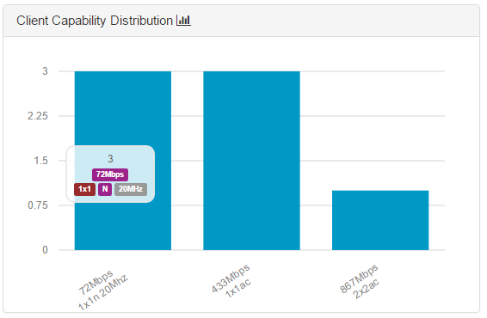
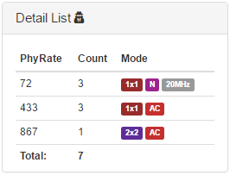
Client capacity and physical data rate

Slide 27
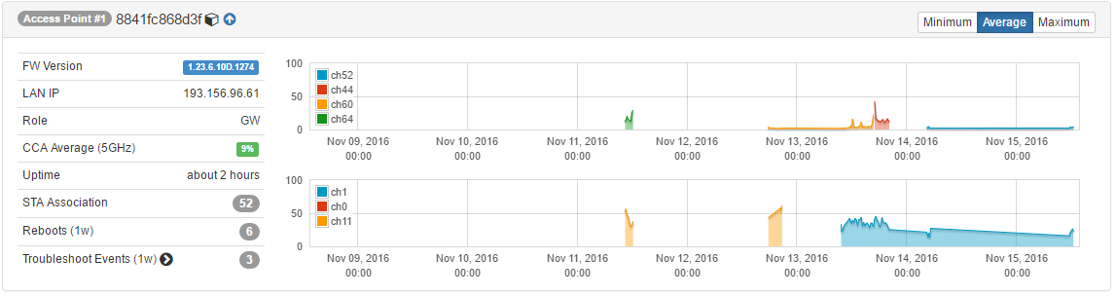
Average Channel utilization map ap1

Slide 28
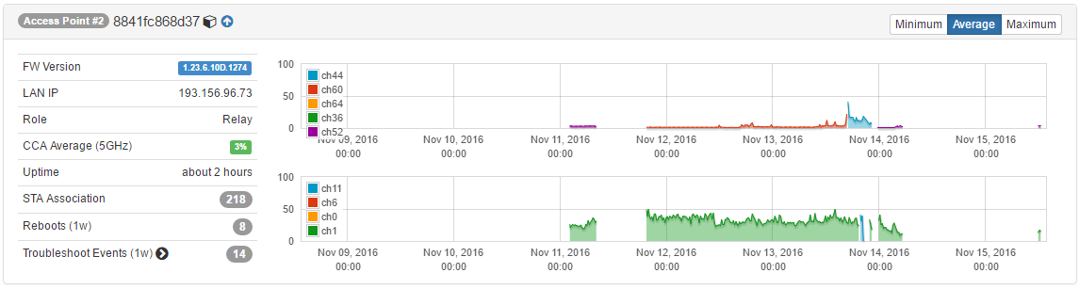
Average Channel utilization map ap2

Slide 29
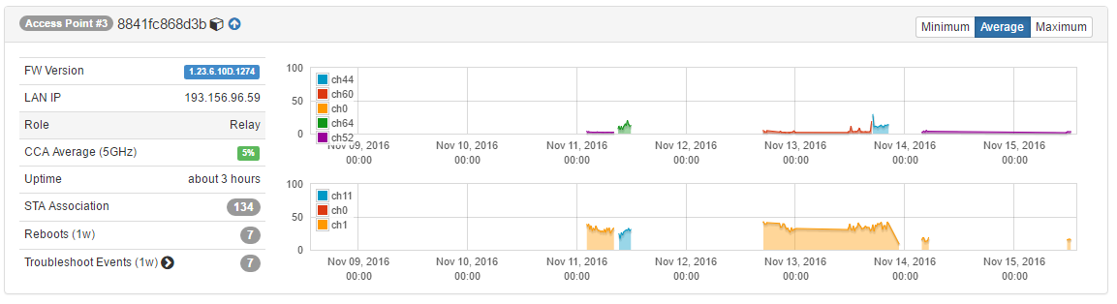
Average Channel utilization map ap3

Slide 30
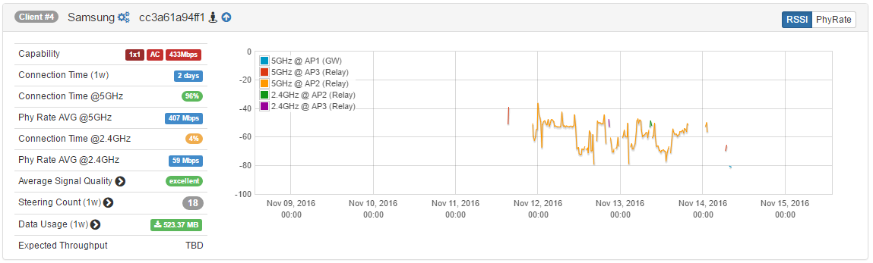
Client # 4 channel/band utilization

Slide 31
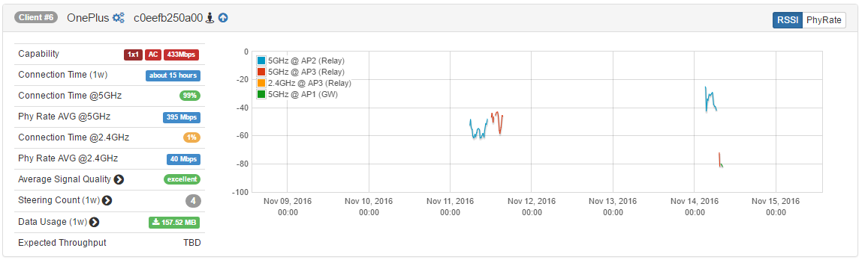
Client # 6 channel/band utilization

Slide 32
What is wireless ??????

Slide 33
Wireless basics
Wireless signals - what they are and how signals can differ.
Wireless devices - the differences and uses for receivers and transmitters.
Wi-Fi Modes - how networks are made up of clients, access points, or ad-hoc devices.
Wi-Fi Signals - the unique characteristics of Wi-Fi, and how signals are organized.
Power and Receiver sensitivity - how far each wireless device can go, and how well a router can listen and filter out interference and noise.
Antennas - how the type of antenna changes the way the router broadcasts.

Slide 34
What is a wireless signal?
Wireless signals are important because they can transfer information -- audio, video, our voices, data -- without the use of wires, and that makes them very useful.
Wireless signals are electromagnetic waves travelling through the air. These are formed when electric energy travels through a piece of metal -- for example a wire or antenna -- and waves are formed around that piece of metal. These waves can travel some distance depending on the strength of that energy.

Slide 35
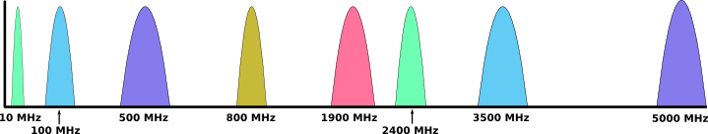
Frequency ranges
We can see the span of frequencies that are commonly used in communications. Broadcast transmitters for AM, FM and Television use frequencies below 1000 MHz, Wi-Fi uses two bands at higher frequencies - 2.4 and 5GHz. Cellular phones use many different frequencies.
AM Radio: Around 10MHz
The frequencies from left to right:
FM Radio: Around 100MHz
Television: Many frequencies from 470MHz to 800MHz, and others.
Cellular phones: 850MHz, 1900MHz, and others
Wi-Fi: 2.4GHz
Satellite: 3.5GHz
Wi-Fi: 5GHz

Slide 36
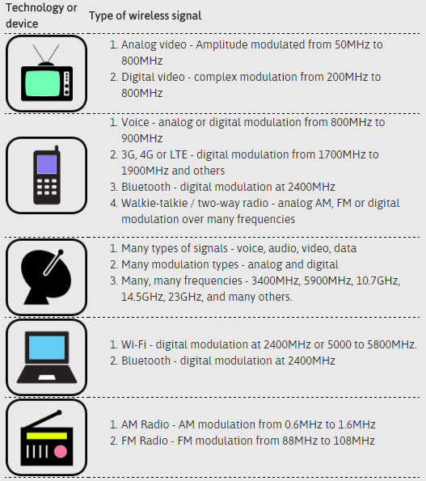
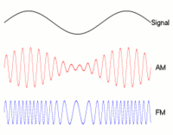
Modulation
In addition to having different frequencies, wireless signals can be different in the way they convey information. A wireless signal needs to be modulated--or changed--to send information. There are many types of modulation, and different technologies can use one or more types to send and receive information. In the two examples below -- AM and FM radio -- the M stands for modulation. The type of modulation is what makes them different.

Slide 37
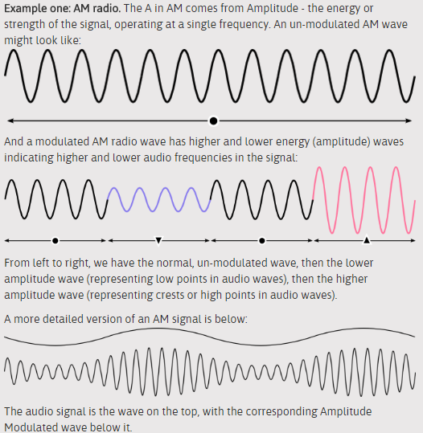
Am radio wave

Slide 38
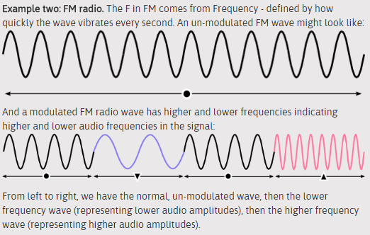
Fm radio wave

Slide 39
Type of Modulation compatibility
The type of modulation various technologies use to communicate can be very different, and are often not compatible. Satellite equipment cannot speak directly to your laptop or smartphone, which uses Wi-Fi to send and receive information. This is because the radios in different devices can listen only to certain types of modulations and frequencies.

Slide 40
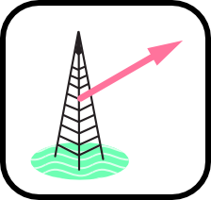
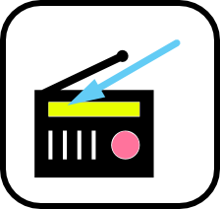
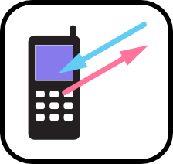
Receivers and Transmitters
Transmitter
receiver
tranceiver
When a device sends out a wireless signal, it is called a transmitter.
When another device picks up that wireless signal and understands the information, it is called a receiver.
When a device has both a transmitter and a receiver, it is sometimes called a transceiver.
Devices such as routers can both transmit and receive, which is what makes them useful for building networks--you probably want to be able to send messages to your neighbors and out to the world, as well as receive messages!

Slide 41
Wi-Fi bands
When building a network, we will be using Wi-Fi technology, which has some unique characteristics we will need to know.
There are two types of Wi-Fi signal, based on the frequencies they use:
2.4GHz
5GHz
A lower frequency, this is the more common Wi-Fi technology in use today. Many devices use it, so the signals can become more crowded and interfere with each other. It can pass through walls and windows fairly well.
This higher frequency technology is used by fewer devices, and can sometimes achieve higher speeds because the frequencies are less crowded. It cannot pass through walls and windows as well as the 2.4GHz band signals, so the range of 5GHz technology is often shorter.
These two types of Wi-Fi are called the Frequency Bands, or just Bands for short.

Slide 42
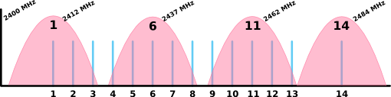
2.4GHz Band
For the 2.4GHz band, there are 14 channels total. Unfortunately, these channels overlap, so they aren’t all usable at the same time. If you are setting up a mesh network -- all of the mesh links will need to be on the same channel.

Slide 43
2.4Ghz available channels in the world
The available channels vary depending on where you are in the world.
in the United States channels 12, 13 and 14 are not allowed for Wi-Fi, as those frequencies are used by TV and satellite services.
If you are building networks in the United States, you can only use channels 1 through 11.
In the rest of the world, channels 1 through 13 are generally usable, and in a few places channel 14 is available.

Slide 44
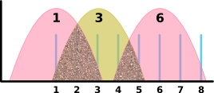
2.4ghz overlaping channels
the best channels in the United States and most of the world to use for 2.4GHz band equipment are channels 1, 6, and 11. This will minimize interference caused by partially overlapping Wi-Fi signals:
You could use other sets of Wi-Fi channels, as long as they are 5 channels apart - for instance 3, 8 and 13. This may not be optimal though, as channels 1 and 2 would be unused, and in many places in the world channel 13 is not available.

Slide 45

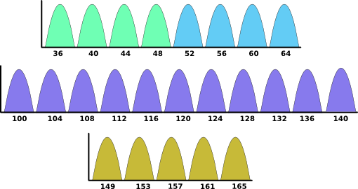
5GHz Band
The 5GHz frequency band is much wider and has more channels, so the diagram is a bit more extensive.
Fortunately, these channels do not overlap, so you don’t have to worry about picking non-standard channels like in the 2.4GHz band.

Slide 46
5ghz available channels in us
In the United States, only channels available for building mesh networks are 36, 40, 44, 48, 149, 153, 157, 161, and 165. There are other channels available for Access Points or other types of community networks, but those channels won’t work with mesh wireless.

Slide 47
Power and Receiver Sensitivity
Different Wi-Fi routers can have very different power levels.
Some are much stronger: they have more speaking or transmitting power than others.
Some are very good listeners: they have what is called a better receive sensitivity.
These two elements define how well wireless devices will connect, and how far away a receiving Wi-Fi router can be.

Slide 48
Power and Receiver Sensitivity …..
Manufacturers do not usually publish information about their router’s transmit power or receive sensitivity.
Instead, the manufacturer will give a generic “range” rating to their routers, usually relative to each other.
In some cases, usually with more business or professional oriented equipment you can find the information for transmit power and receive sensitivity.

Slide 49
Transmit power
A router’s transmit power can be measured with two scales -- milliwatts (mW) or dBm:
A milliwatt is one thousandth (that’s 1/1000) of a single watt - which is a generic measurement of power. For instance, a light bulb might be 40 watts. A router will have an output power of 100mW, which is 400 times less!
A dBm is a relative measurement using logarithms. One milliwatt is 0 dBm. 10 milliwatts is 10 dBm; 100 milliwatts is 20 dBm, and so on. This is the scale that many network designers use to calculate if longer wireless links will work.

Slide 50
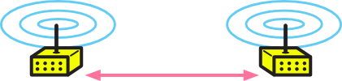
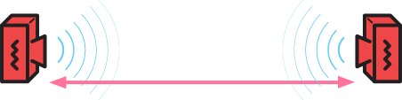
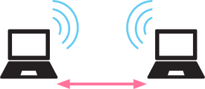
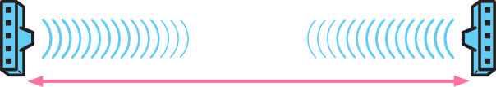
Transmit power level
10mW (10dBm)
100mW (20dBm)
100mW (20dBm):
Laptop or smartphone, or very low cost Wi-Fi router.
Indoor home or office router.
Outdoor sector router.
500mW (1/2 Watt or 27dBm)
Outdoor, long distance focused routers.

Slide 51
Received sensitivity
Wireless transmitter power is only one half of the connection.
The Wi-Fi receiver has a range of power levels it can hear--the “listen power”
This is also known as the receive sensitivity.
The receive sensitivity values are generally rated in dBm, and are usually in the range of -40dBm to -80dBm.
The negative number indicates a very small signal -- tiny fractions of a milliwatt.
the closer to 0 dBm, the better the signal is.

Slide 52
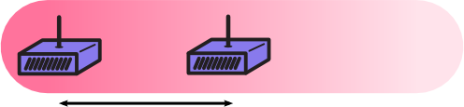
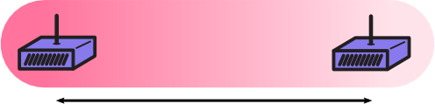
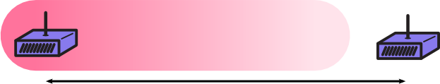
Receiver sensitivity and range
The optimal signal range for outdoor wireless equipment is between -40dBm and -60dBm. This will ensure the connection can maintain the highest bandwidth possible.

Slide 53
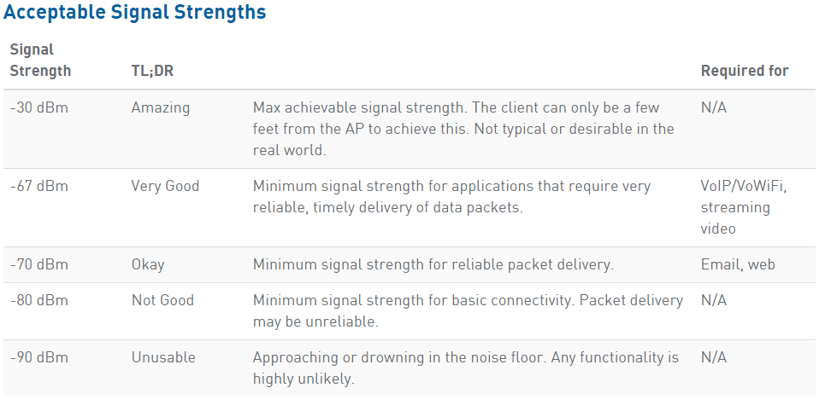
Acceptable signal strengths

Slide 54
Ekahau heat mapper
Site survay

Slide 55
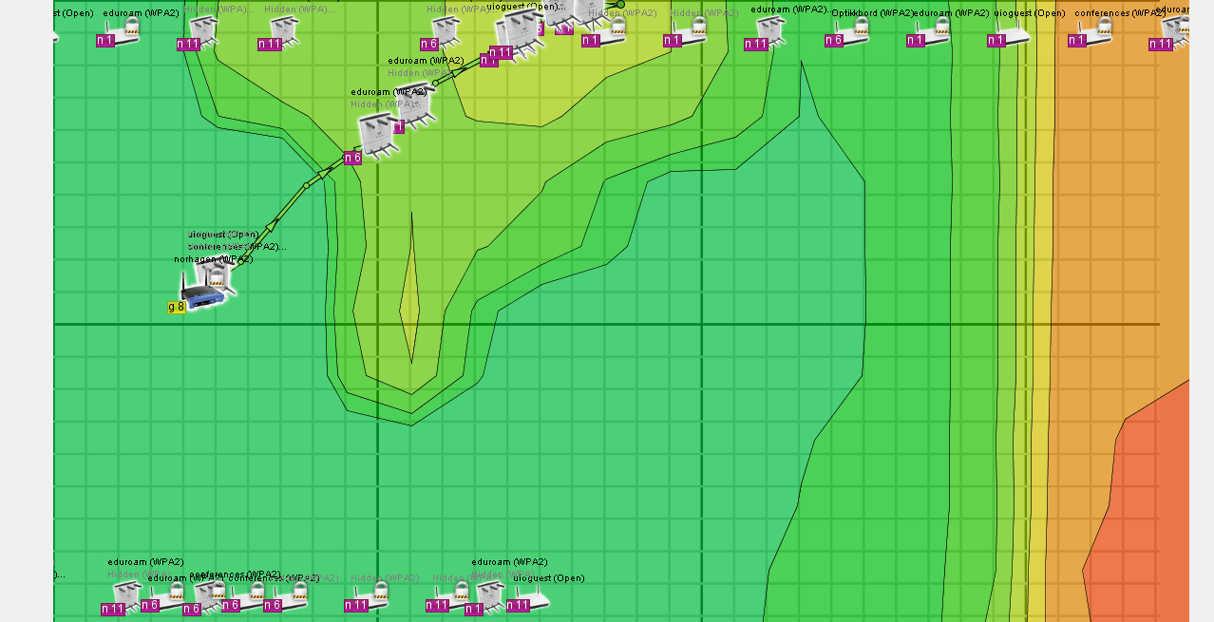
Access point survey heat map

Slide 56

Access point survey heat map cont...

Slide 57

Access point survey heat map cont.....

Slide 58
What can be done about RF interference?
Tips and tricks

Slide 59
Interference avoidence techniques
Analyze the potential for RF interference.
Provide adequate wireless LAN coverage.
Prevent the interfering sources from operating
Do the survey before implementation.
Talk to others at facility to know about other RF devices.
Turn off the interfering sources once you know they are on.
Disallow bluetooth and microwave ovens where there are 802.11 devices installed.
Ensure that wireless LAN have strong signals throuout the area.
Install sufficient devices according to survey to provide full coverage.

Slide 60

Real calculations

Slide 61

Frequency overlapping range
You could use other sets of Wi-Fi channels, as long as they are 5 channels apart - for instance 3, 8 and 13. This may not be optimal though, as channels 1 and 2 would be unused, and in many places in the world channel 13 is not available.

Slide 62


2.4 GHz four-channel reuse pattern of channels 1, 5, 9 and 13

Slide 63

Air ties 4920 mesh network

Slide 64

Interference avoidence enabled access points
AirTies (Propriorty Product) provides a solution for interference avoidence.

Slide 65

Chanalyzer for wifi and reports analysis

Slide 66

Wi-spy for wifi scanning and site survey

Slide 67

Site survey heat mapper

Slide 68

Wifi analyzer

Slide 69
references
http://www.wi-fiplanet.com/tutorials/article.php/953511/Minimizing-80211-Interference-Issues.htm
https://plus.google.com/+MichelleMarie/posts/GVcczQy4f4q
http://boundless.aerohive.com/experts/wi-fi-back-to-basics--24-ghz-channel-planning.html
http://www.wi-fiplanet.com/tutorials/article.php/953511/Minimizing-80211-Interference-Issues.htm
http://www.wirelesscommunication.nl/reference/chaptr03/indoor.htm
https://www.easycalculation.com/statistics/learn-signal-to-noise-ratio.php
https://www.easycalculation.com/statistics/signal-to-noise-ratio.php
http://www.radio-electronics.com/info/wireless/wi-fi/80211-channels-number-frequencies-bandwidth.php
https://www.netspotapp.com/help/what-is-the-signal-to-noise/
https://en.wikipedia.org/wiki/Shannon-Hartley_theorem
http://www.radio-electronics.com/info/rf-technology-design/rf-noise-sensitivity/receiver-signal-to-noise-ratio.php
https://commotionwireless.net/docs/cck/networking/learn-wireless-basics/

Slide 70
Questions ??????
Thank you!!!!!

