Slide 1
Modeling wireless propagation
THE CHALENGES OF INDOOR-TO-INDOOR PROPAGATION
by Aimé Maxime Itamba

Slide 2
WHAT IS A PROPAGATION MODEL?
Characterisation of the wireless channel, describes how the characteristics of the sent signal can be affected or how conditions of environment are, i.e., frequencies, obstacles
Different models
  Various characteristics of propagation mechanisms
    Different environmental characteristics (Outdoor/indoor/land/sea/space...)
    Different applications area (point-to-point/point-to-area...)
    Different frequency ranges
Some models include random variability

Slide 3
Basic radio propagation
The radio channel places fundamental limitations on the performance of wireless communication systems
  Three basic mechanisms of radio propagation
    Reflection
    Diffraction
    Scattering
  All these three phenomenon cause
    Radio signal distortion
    Give rise to fades
    Plus additional propagation losses
Radio channels are extremely random and do not offer easy analysis

Slide 4
Various propagation landscape

Slide 5
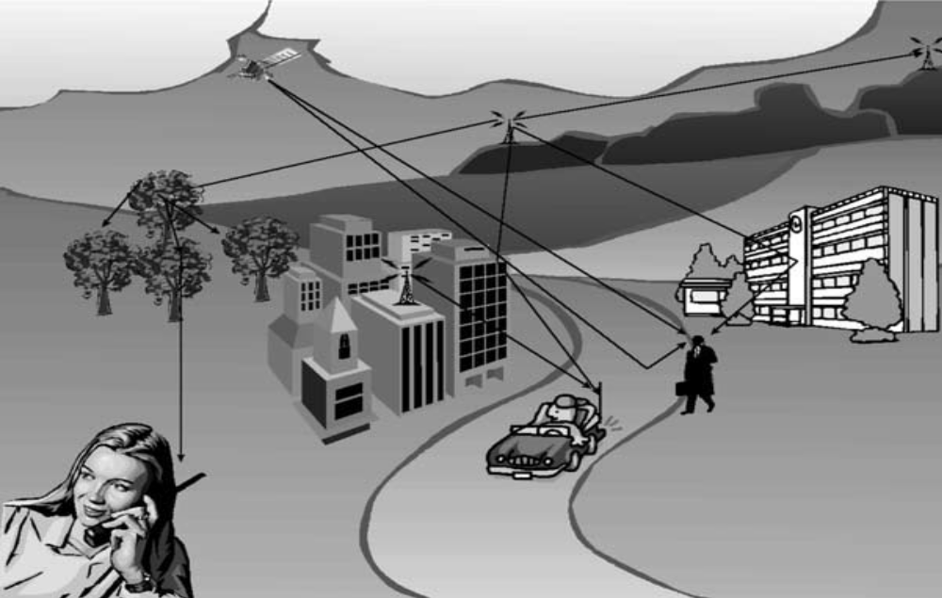
outdoor propagation landscape in urban area

Slide 6
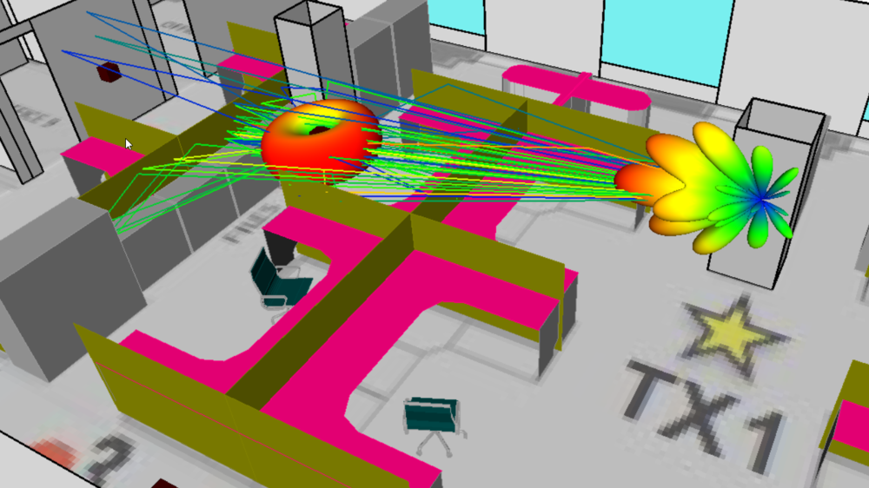
indoor propagation landscape

Slide 7
utility of propagation model
Modelling radio channel is important for:
  Determining the coverage area of a transmitter
  Finding modulation and coding schemes to improve the channel quality

Slide 8
Primary division of propagation models
Different models have been developed to meet the needs of simulating propagation behavior in different conditions
Type odf models for radio propagation include:
  Models for Output Applications
  Models for Indoor Applications

Slide 9
Indoor propagation model

Slide 10
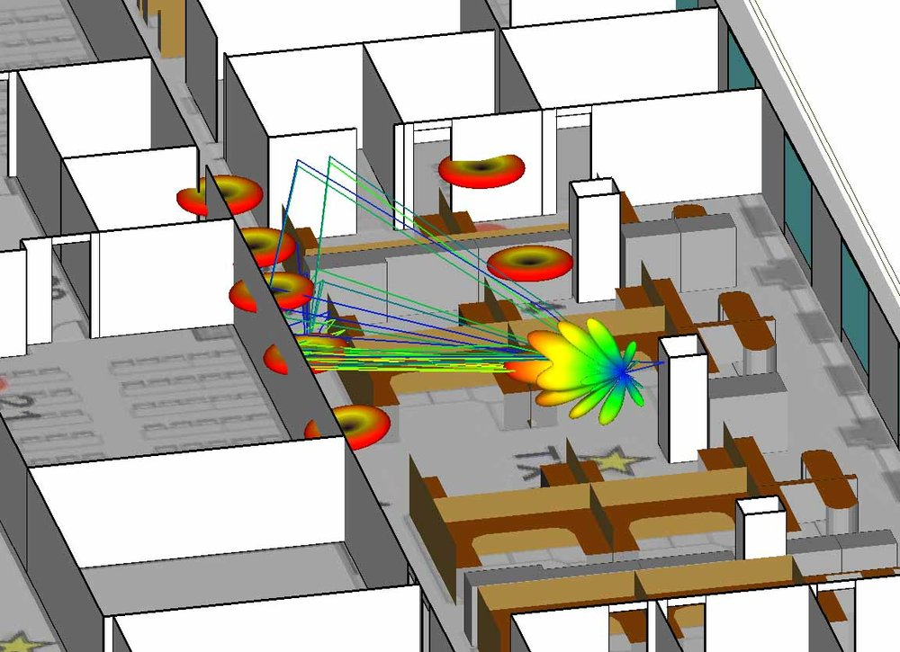
Characteristics of indoor propagation models
  The covered distances are much smaller
  The variability of the environment is much greater
  More clutter, scattering and less LOS

Slide 11
Indoor modeling techniques
ITU Indoor Path Loss Model
Log-Distance Path Loss Model

Slide 12
Itu inDoor path loss model
To predict propagation path loss inside buildings
The average path loss in dB is
    Where
    N is the distance power loss coefficient
    (f) is the frequency in MHz
    (d) is the distance in meters (d > 1m)
    Lf(n) is the floor penetration loss factor
    (n)Iis the number of floors between the transmitter and the receiver

Slide 13
Log-distance path loss model
This particular model is based on the assumption that path loss varies exponentially with distance
The model is described by the following formula:
    Where
    PL(d0)is the path loss at the reference distance, usually taken as (theoretical) free-space loss at 1 m
    Xs is a Gaussian random variable with zero mean and standard deviation
    10N is the path loss distance exponent

Slide 14
Thanks!

