Slide 1
3

Slide 4
Sustainable platform – CWI – Movation -

Slide 6
Getting too big – should be part of WP5 Trials….

Slide 7
Reinventing CSA: Pilot as a different form of a workshop

Slide 8
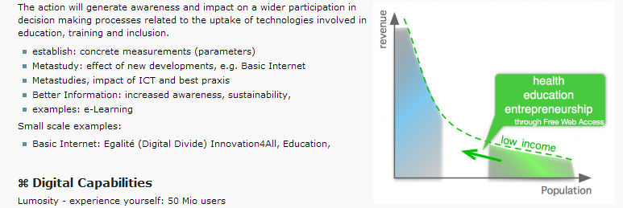

Slide 9
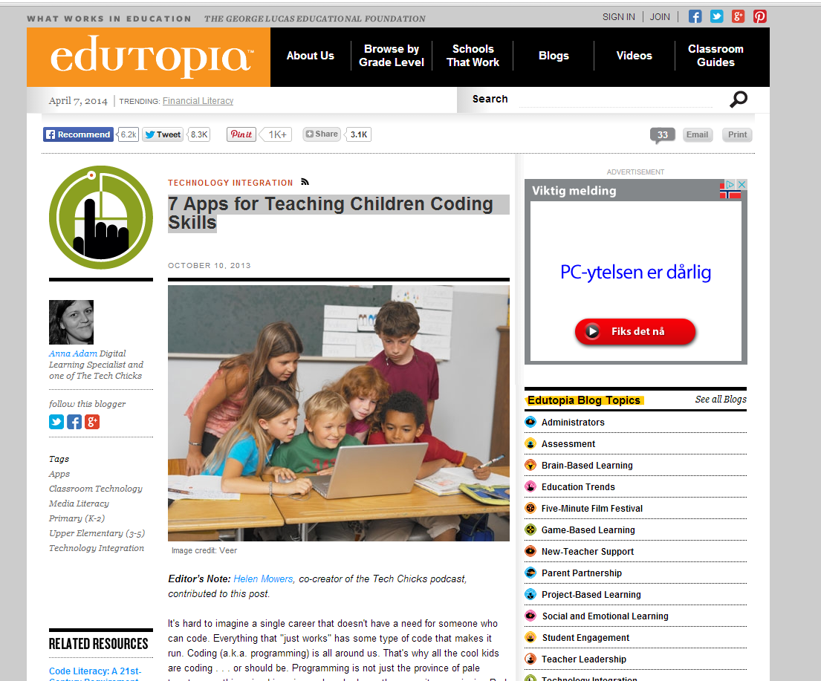

Slide 10
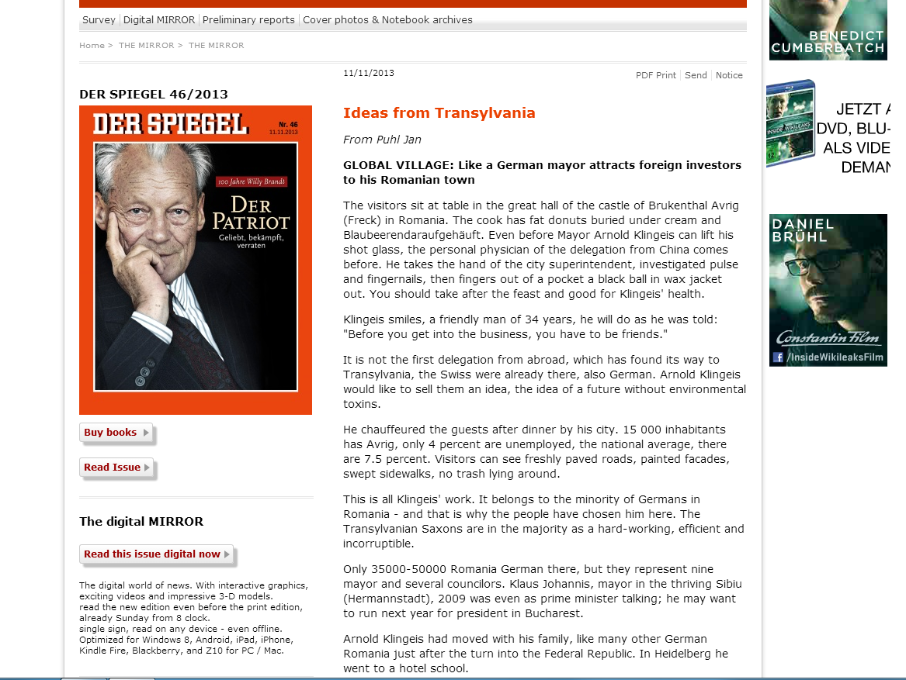

Slide 11
Sales pitch:
We will address representatives of all actors in the value chain
We will adopt, and extend current platforms for education and innovation
Through the global perspective with partners from USA, Russia, and Africa we will compare our approaches to best practices in the World

