Slide 1
Wireless Channel and Models
Yun AI

Slide 2
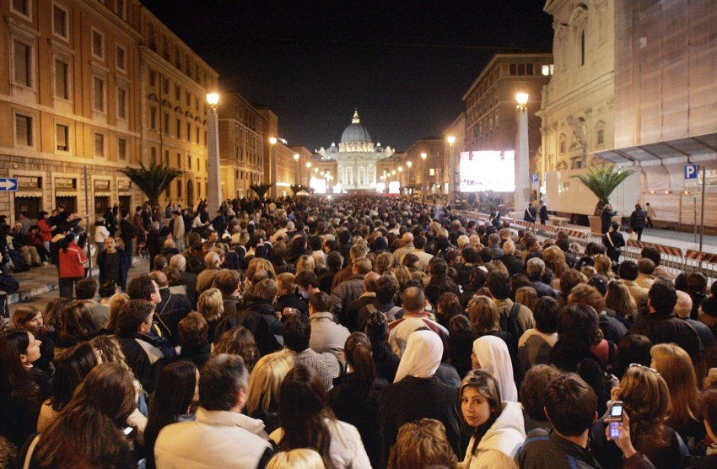
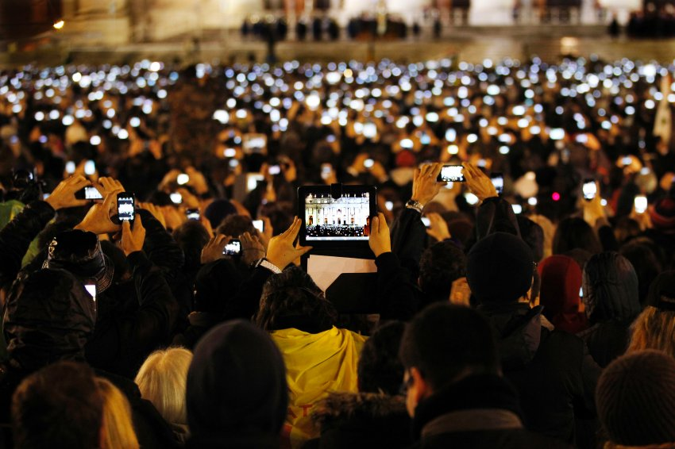
The ‘Mobile Age’
Vatican City, 2005/4/4 Vatican City, 2013/3/12
Source: http://www.spiegel.de/panorama/bild-889031-473266.html

Slide 3
Agenda
This presentation covers:
A brief view to wireless channel
Introduction to important channel parameters
Introduction to simulation methods

Slide 4
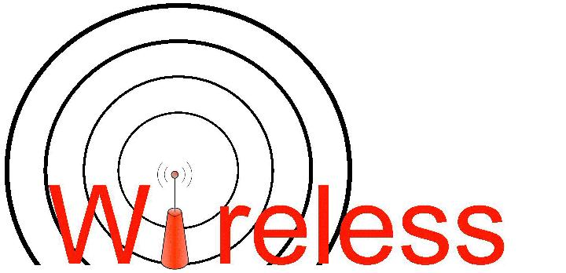

Wireless Channel is Different
Each cable is a different channel
No interference
Low signal attenuation
One media shared by all
High signal attenuation and variation
High interference
noise, co-channel interference, adjacent interference

Slide 5
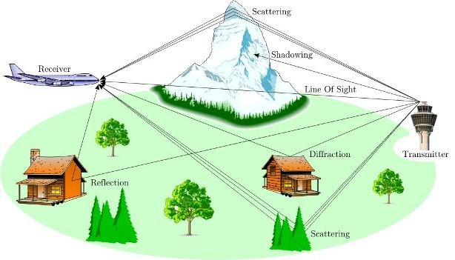
Wireless Multipath Channel
Channel Varies at two spatial scales:
Large scale fading: path loss, shadowing
Small scale fading: multi-path fading, doppler

Slide 6
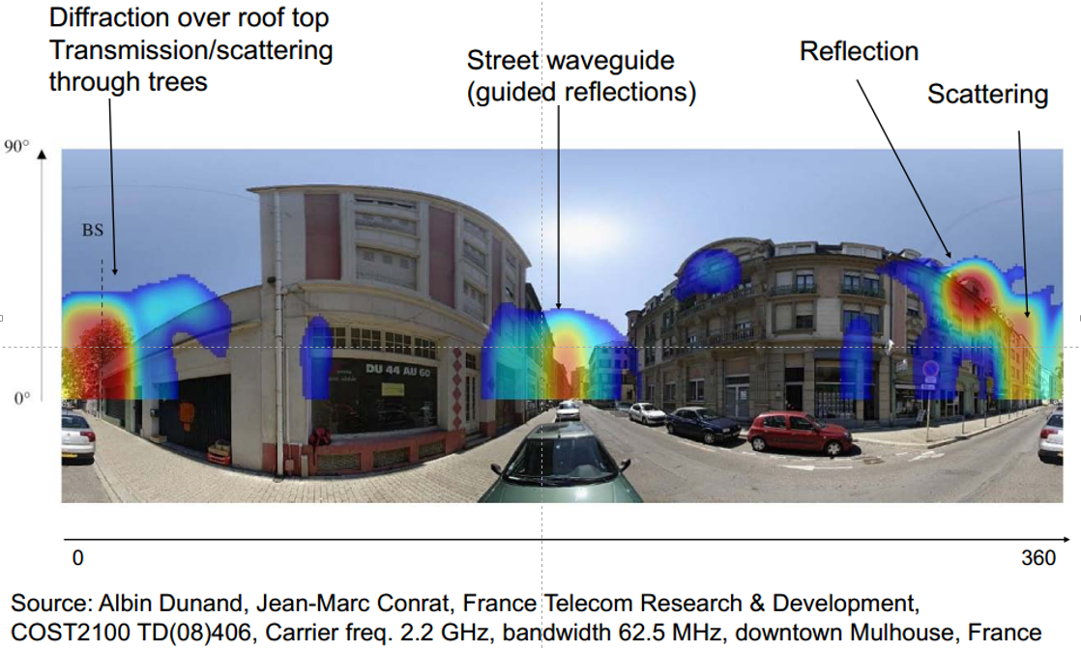
Wireless Channel

Slide 7
Various models
WINNER/IMT-Advanced
COST 2100
IEEE 802.11 for 60 GHz
METIS model
Various mathematical models

Slide 8
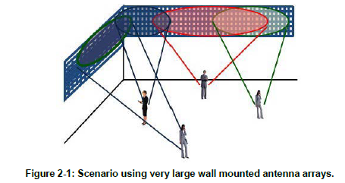
METIS Model requirement
Broader bandwidth, higher number of antennas, increasing delay and spatial resolution of receiver
Very large antenna arrays
High frequencies, from current cellular spectrum up to 86 GHz
Source: METIS project

Slide 9
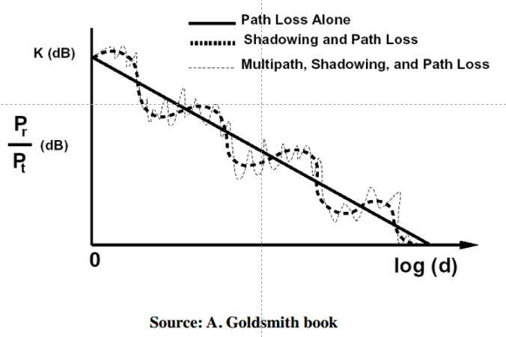
A big and simple picture
Path Loss, Shadowing and fading
Variable decay of signal due to environment, multipaths, mobility, etc.

Slide 10
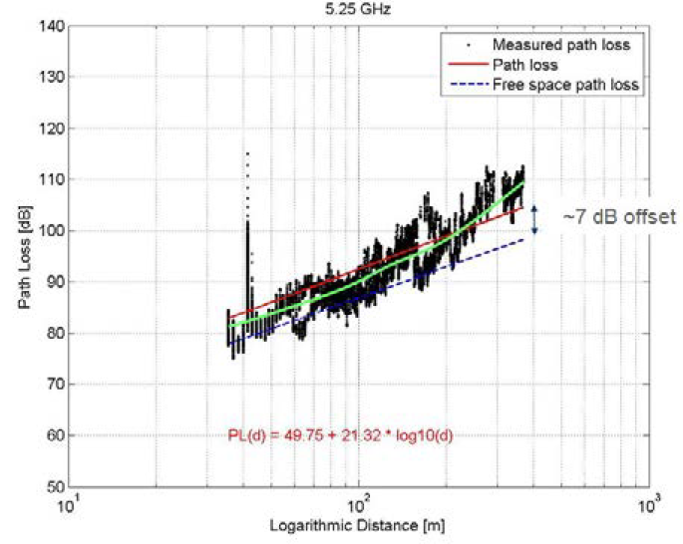
Path Loss modeling
Maxwell’s equations
- complex and impractical
Free space path loss model
- too simple
Ray tracing models
- requires site-specific information
Empirical models
- not always generalized to other environments
Simplified power falloff model
Simplified power falloff models
- Good for high-level analysis
A simple model for path loss is:
Source: METIS project

Slide 11
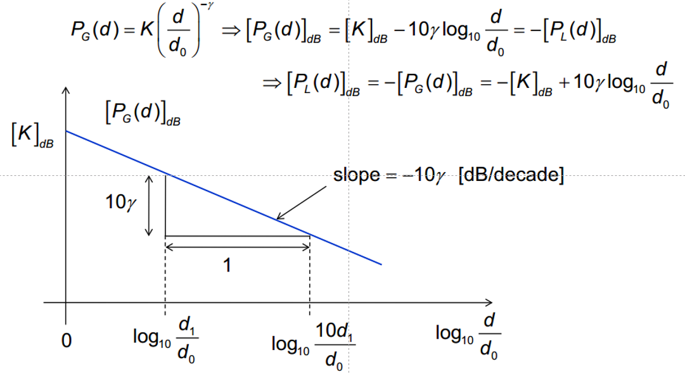
Log-distance path loss

Slide 12
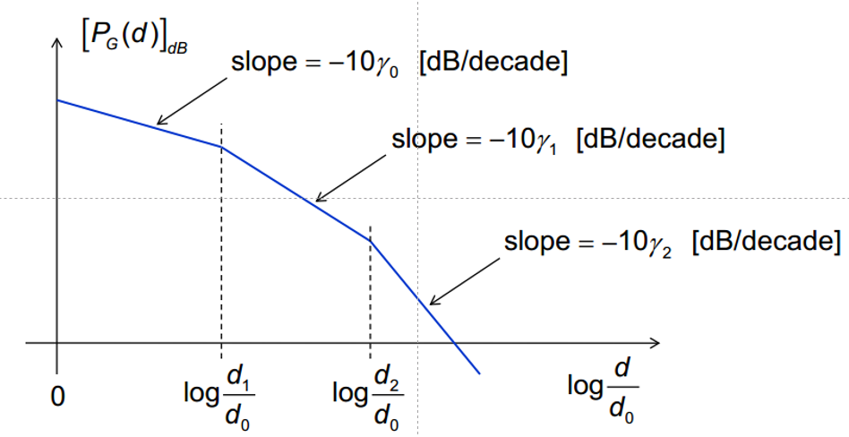
Piece-wise log-distance path gain

Slide 13
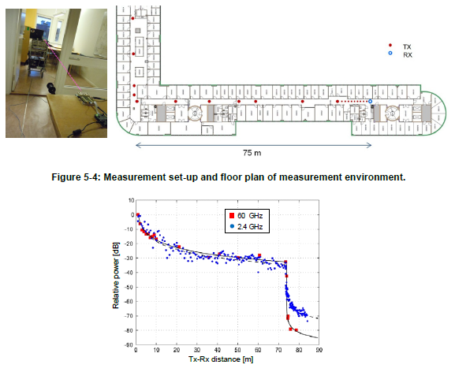
Source: METIS project (https://www.metis2020.com)

Slide 14

Empirical path loss models
For the models below, the path loss is of the form:
Okumura (1960’s)
- Based on extensive measurements
- Applicable for f: 150 – 1500 MHz, d: 1 - 100 km, ht: 30 - 100 meters, hr: 0 - 10 meters
Hata
- Analytical expression to approximate Okumura’s model
COST 231 (1990’)
- Extension to Hata’s model
- Applicable for f: 1.5 - 2 GHz, d: 1 – 20 km, ht: 30 – 200 m, hr: 1 - 10 m

Slide 15
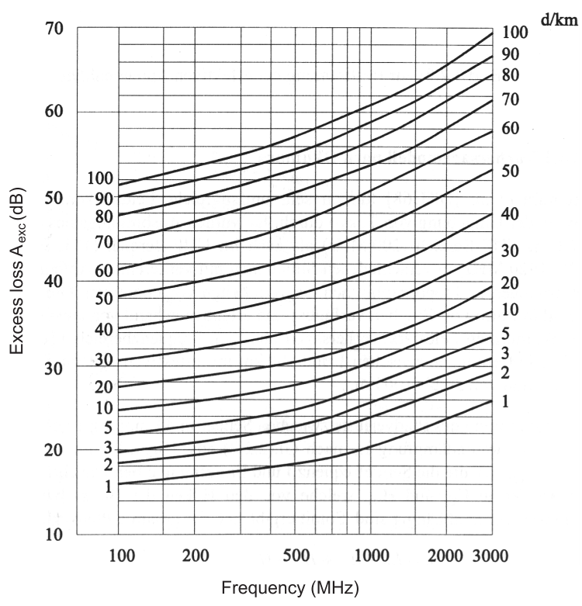
Path loss according to the Okumura-Hata model
Path loss vs. Frequency
Path loss vs. distance
Source: A. Molisch book

Slide 16
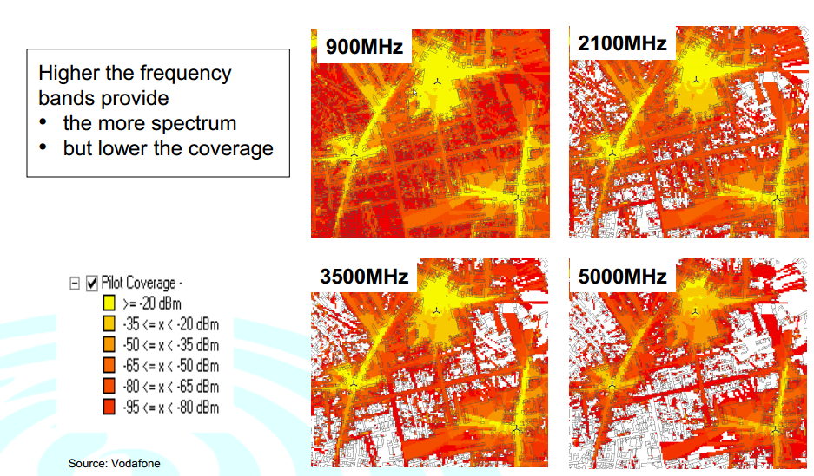
Coverage vs frequency

Slide 17
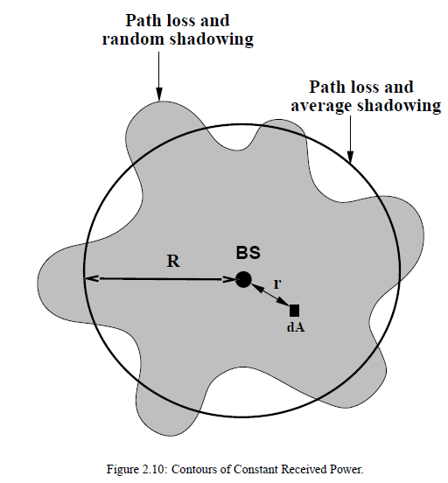
Shadowing
The received signal is shadowed by obstructions such as hills and buildings
Outdoor model, Indoor model, Outdoor – Indoor model,
This results in variation in the local mean received signal power
Pr(dB) = E[Pr(dB)] + X, X ~ N(0, δ)
Source: A. Goldsmith book

Slide 18
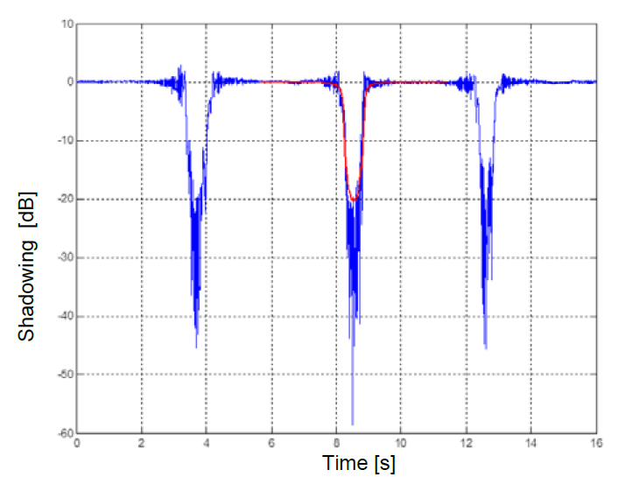
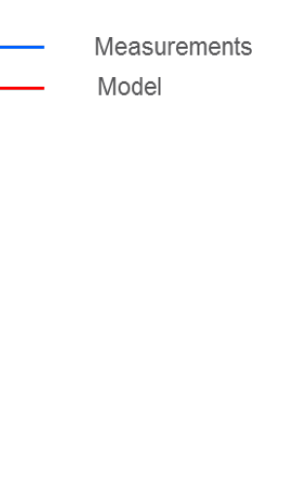
Body blocking loss for a LOS link (4 meter distance) at 60 GHz
Source: METIS project (https://www.metis2020.com)

Slide 19
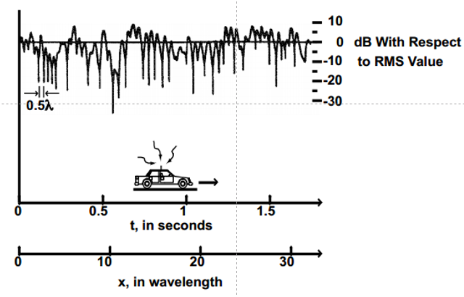
Small-scale multipath fading
Multipath fading due to constructive and destructive interference of the transmitted waves
Source: A. Goldsmith book

Slide 20
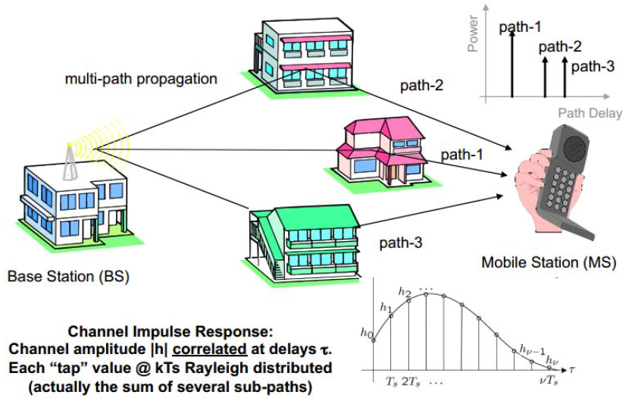
Multipath: power delay profile
Source: David Tse book

Slide 21
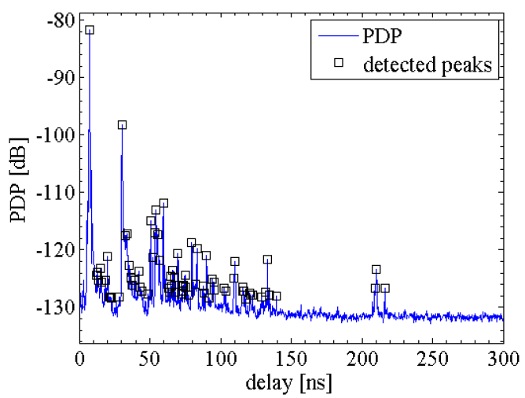
Example of LoS PDP with detected peaks
Source: METIS project (https://www.metis2020.com)

Slide 22
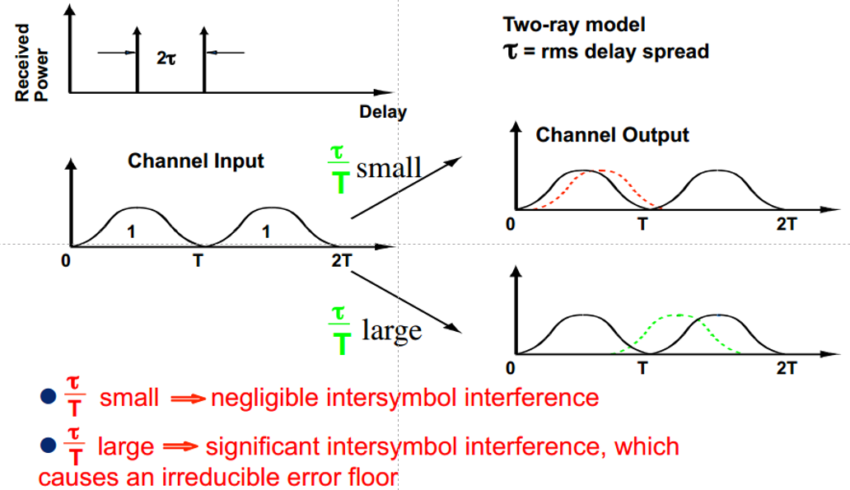
Delay spread

Slide 23
Summary
Wireless Channel
path loss
fading
shadowing
multipath
etc
Wireless Channel Models
modeling approaches
different scenarios

Slide 24


