Slide 1
WP30: Open Innovation and Stakeholder Engagement
Organising a Hackathon/Open Innovation Contest
Maunya D.Moghadam (UiO) – Christian Kaiser (VIF)

Slide 2
WP30: Open Innovation and Stakeholder Engagement
WP30 assists each partner to perform Open Innovation Contests/Hackathons:
  Idea Contests
  Security Contests
  Privacy Contests
  Trustability Contests
  etc
Source:medium.com

Slide 3
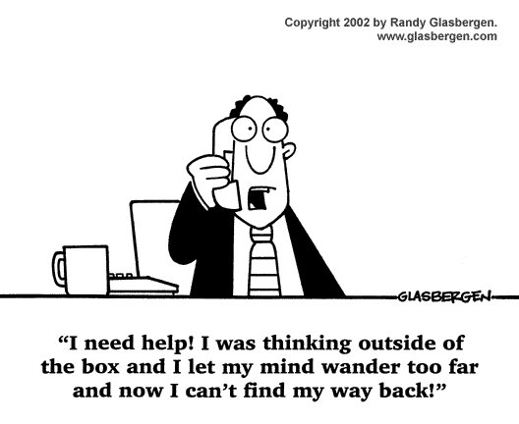
Success stories
Big Brand Hackathon with Kraft Foods and The Home Depot: 150 developers, produced 40 apps and the winner was a 17 yr high school student, was offered a Facebook internship the next day.
  Feedback from one executive: “I'm putting all agencies on notice, this event produced more value in 48hrs than a digital agency produces in a month.”
EasyTaxi was born out of the Startup Weekend Rio in 2011, where Creators Tallis Gomes and Dennis Wang started out with an idea of a bus monitoring app. After winning the hackathon, the duo launched the beta version of the E-hailing app and succeeded in raising close to $75 million from investors since its inception. The app covers a network of 30 countries and 420+ cities.

Slide 4

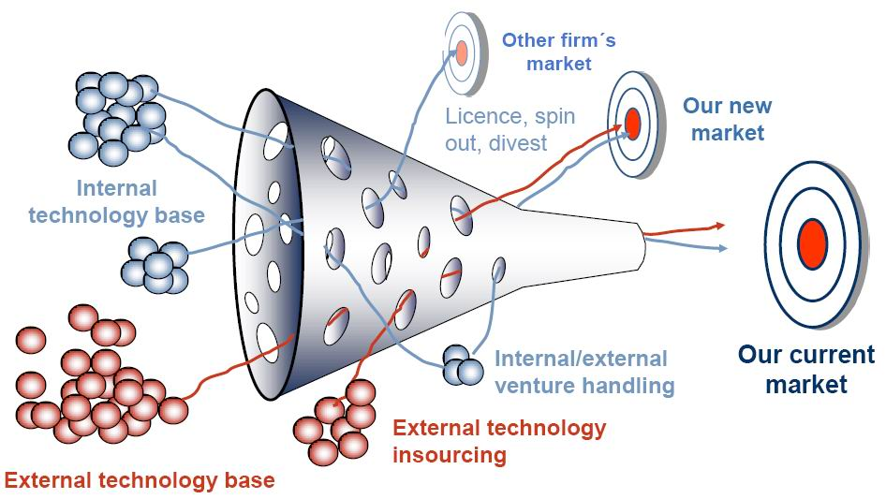
Success stories
In 2017, Porsche launched an open innovation competition to find new ways to leverage blockchain technology. The car maker didn’t reveal any details about the winning concept but put winning startup into an accelerator program.
In 2013, the motor giant Citroen built the UK’s first crowdsourced car. Members of the public were invited via Facebook to determine the look and other factors of the C1 Connexion model.
DHL: “With the views of others we can better identify the challenges and generate ideas for new logistics solutions. We are asking participants to really think outside of the box.”

Slide 5
WP30: Open Innovation and Stakeholder Engagement
The Hackathons may be executed in different ways:
  Hacking sessions as part of courses, meetings, seminars
  Specific hackathons with Universities, Research Organisations
  Public hackathons inviting people directly to your facilities
  Virtual hackathons through online contests

Slide 6
WP30: Open Innovation and Stakeholder Engagement
UiO has had two courses with the purpose of “Running Hackathon” for SCOTT
Measurable Security for the Internet of Things
Security and Privacy Analysis for a Smart Classroom
Smart Entry Control System
Smart Wearables for Health
Interception of Droning Communication
Smart Meters in an Industrial Perspectives
Building Mobile and Wireless Networks
Smart Green House
Smoke Detection and Air Quality Monitoring

Slide 7
WP30: Open Innovation and Stakeholder Engagement
UiO has established a Laboratory for Running Hackathons in the Department of Technology Systems

Slide 8
WP30: Open Innovation and Stakeholder Engagement
List of Equipments in UiO´s Hackathon Labratory
Development Boards:
10 x Pycom LoPy4 - LoRaWan development board
1 x Pycom FiPy - LTE Cat M1/NB1 + LoRaWan dev. board
5 x IoT LoRa node pHat for Raspberry Pi
5 x IoT LoRa node for Micro:Bit
1 x Nvidia Jetson Nano Development Kit
2 x Intel Neural Compute Stick 2
20 x Raspberry Pi 2/3/Zero
5 x Micro:Bit
Sensors:
5 x Pycom Pytrack - Accelerometer and GPS
2 x Pycom Pysense - Accelerometer, humidity, light, pressure and temperature
Gateways:
1 x RAK7249 DIY Outdoor Gateway
3 x RAK7258 Micro Gateway
1 x RAK2245 Pi-Hat Gateway
5 x The Things Network Indoor Gateway
Accessories:
8 x Universal IP67 Case
11 x Enclosure for IoT node
10 x Pycom Expansion Board
12 x LoRa Antenna Kit
11 x 18650 Lithium Battery
3 x Li-Po Battery 1000MaH

Slide 9

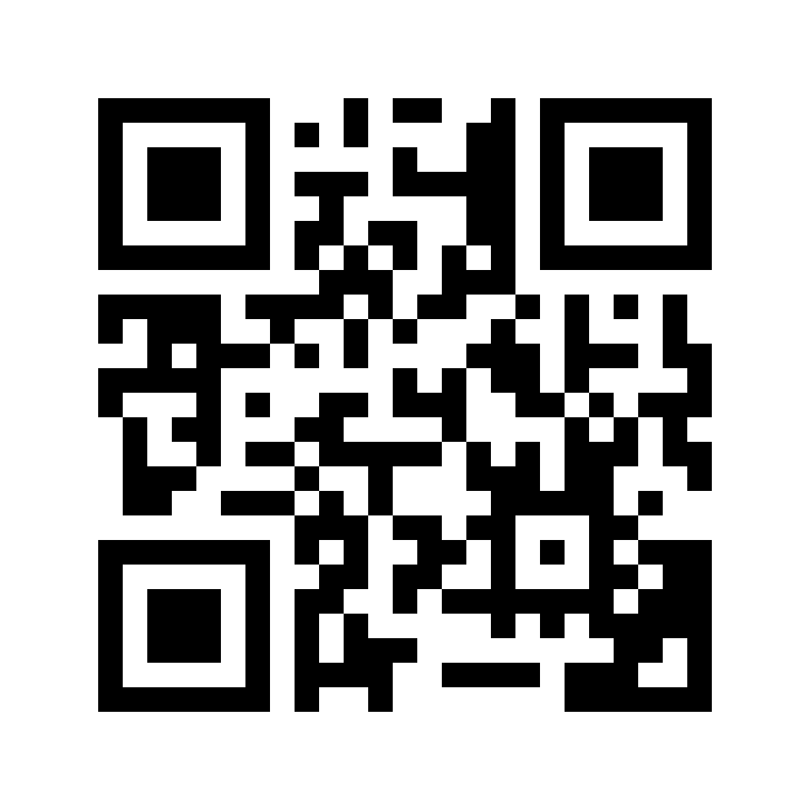
Vehicle Data Hackathon: May 2 – June 2, 2019
How to participate
Register at vehicle-data-hackathon@v2c2.at
On May 2, we’ll publish CAN bus vehicle data
You have 1 month to submit your idea
Prices
€ 1250
€ 500
1
€ 250
2
3
The prizes may be issued as vouchers.
Find out more at
https://goo.gl/mUhaar

Slide 10
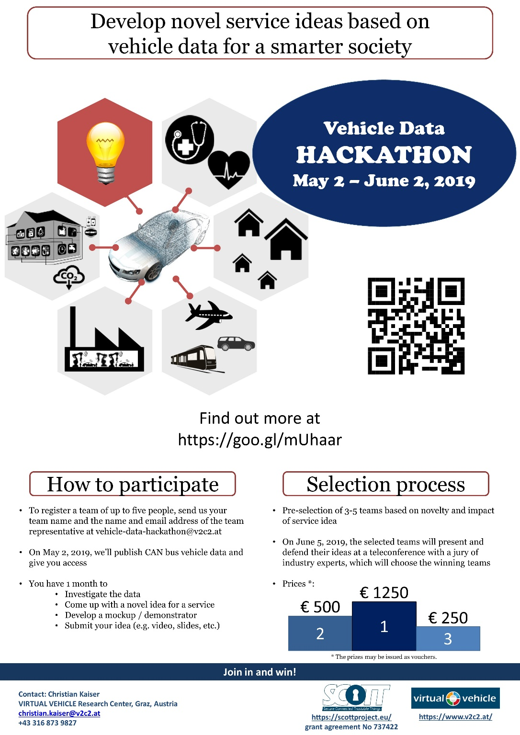
Poster

Slide 11
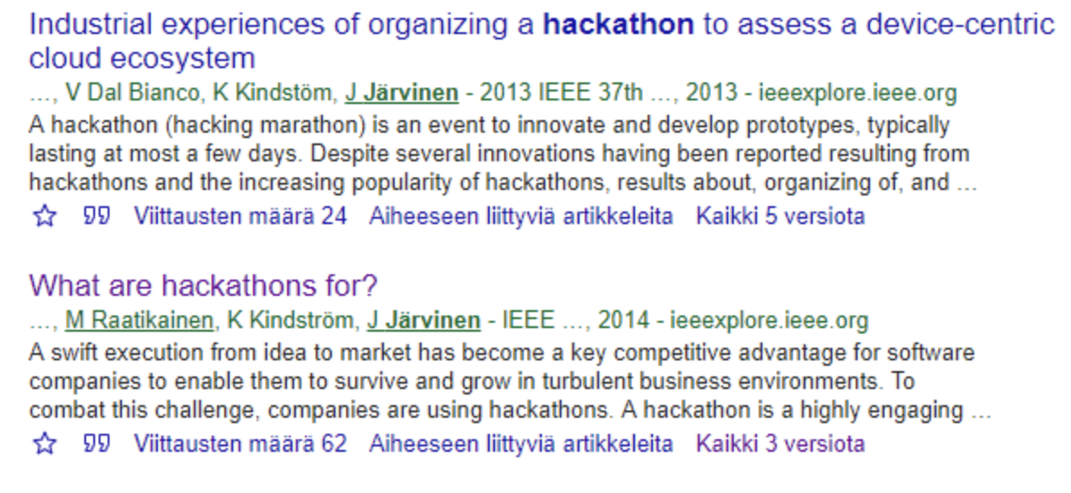

WP30: Open Innovation and Stakeholder Engagement
F-Secure, as a software product company, views hackathons as a possible solution to the fundamental business problem of how to make revenue from an idea.
The results indicate a hackathon as a promising new approach in software engineering, where speed of development, is becoming essential.

Slide 12
WP30: Open Innovation and Stakeholder Engagement
Now
Your Challenges and Ideas
Let´s Make it Concrete
How it can be organised?
When and What kind of hackathon?

Slide 13
Questions?
maunyad@its.uio.no
www.scottproject.eu

