Slide 1
Cloud Software Defined Radio (SDR)
Maghsoud Morshedi Chinibolagh

Slide 2
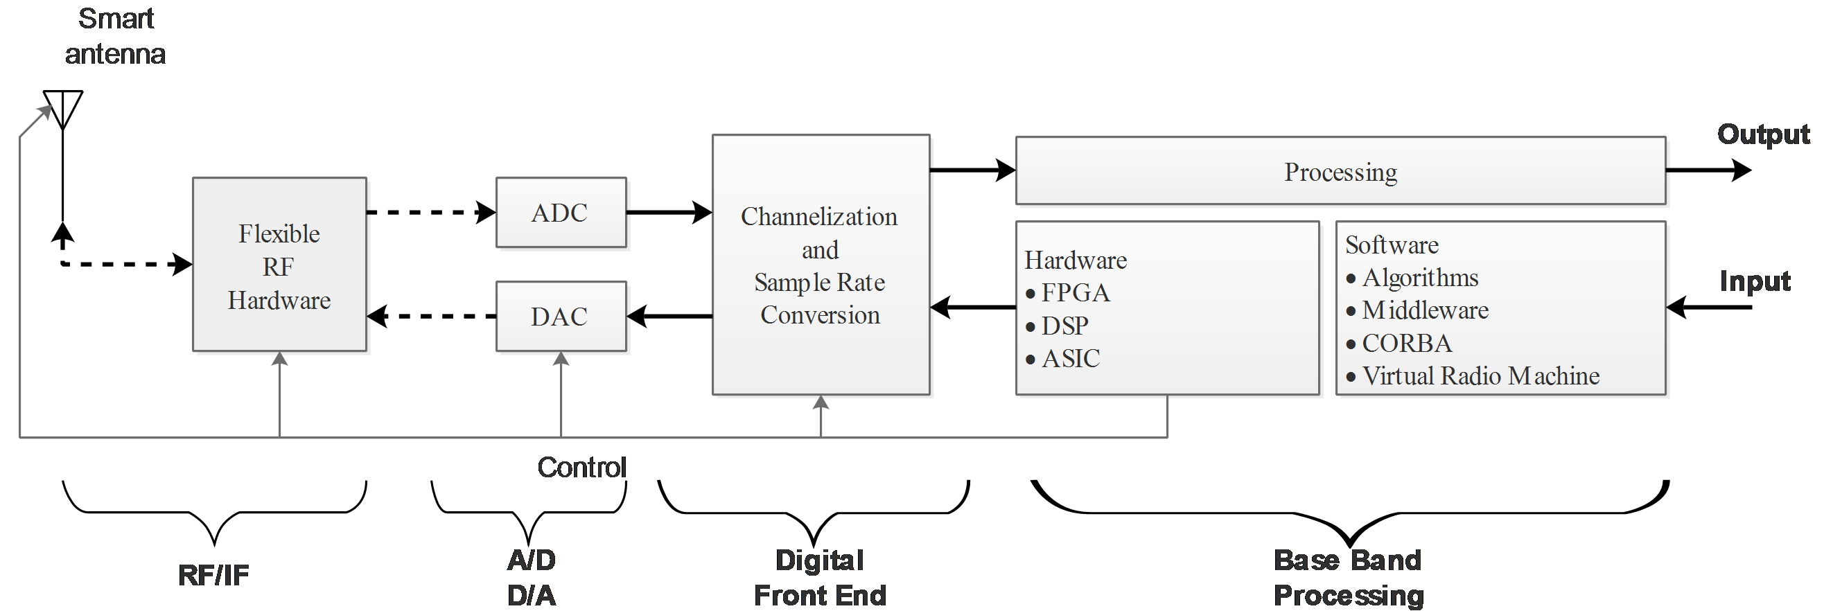
What is SDR?
SDR is a radio that some or all of the physical layer functions are defined by software
  The ideal SDR hardware should support any waveform at any carrier frequency!?
Notes:
Interoperability: communicate with multiple incompatible radios
Efficient use of resource under varying conditions: running low power waveform if the radio running low on battery
Opportunistic frequency reuse (cognitive radio): can take advantage of unutilized spectrum
Reduce Obsolescence: new cellular can rolled out by loading new software into an SDR base station

Slide 3
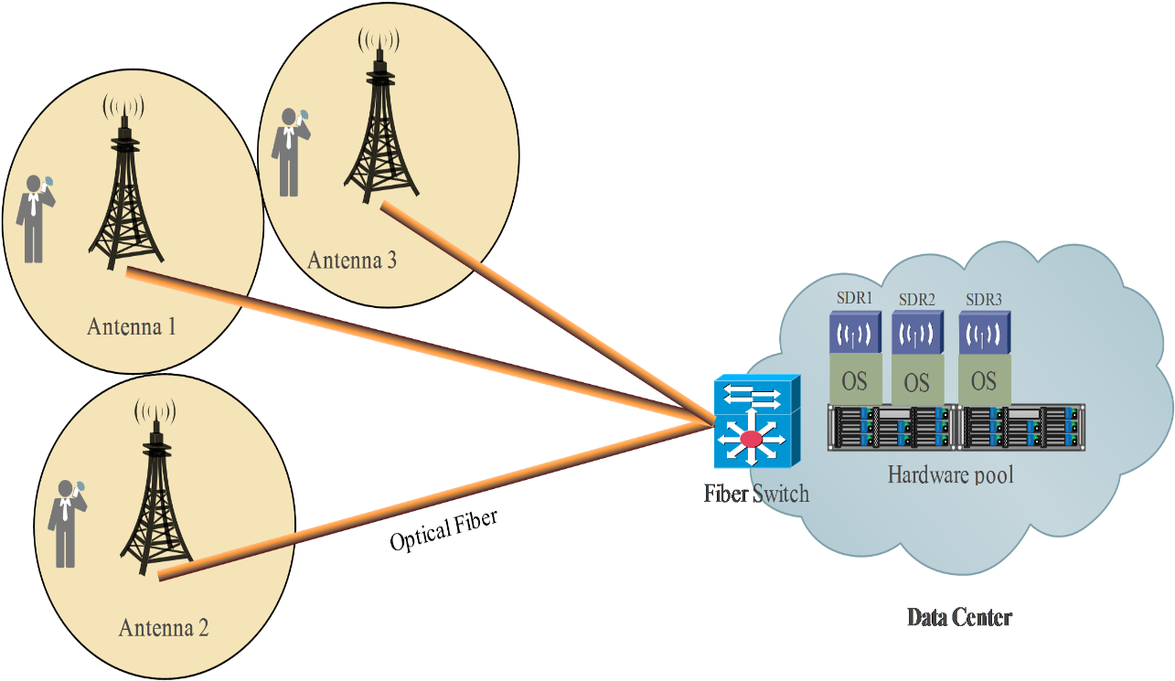
SDR Clouds for metropolitan area
  Distributed antenna system (DAS)
    Connect antenna systems to remote processing unit.
Notes:
An infrastructure operator providing computing resources to radio operators (infrastructure as a service [IAAS])
facilitates a more efficient and scalable computing- resource deployment and management by centralizing storage, memory, processing,
and bandwidth resources; the power supply, cooling, security, maintenance, and software licensing costs scale correspondingly.
High user density.

Slide 4
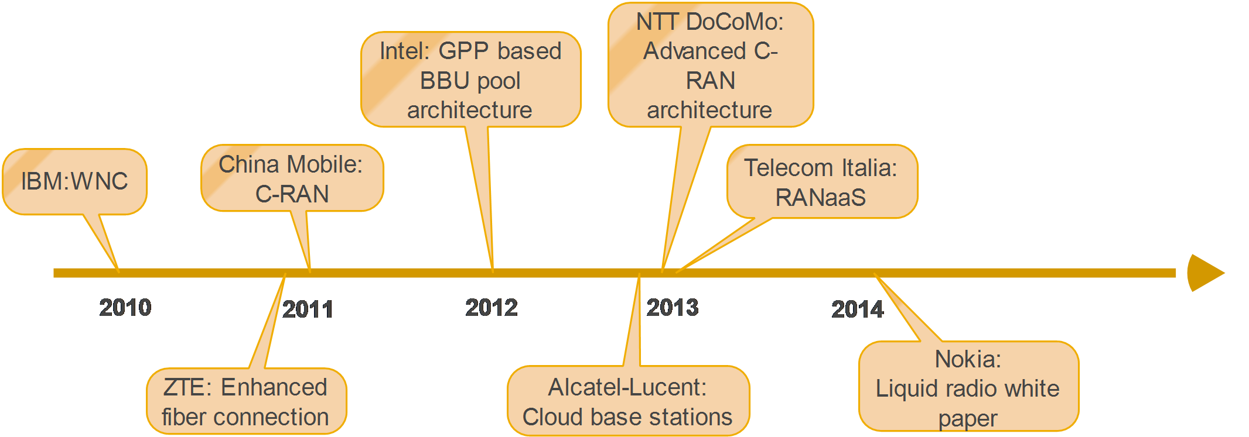
Industry trend

Slide 5

SDR Clouds for metropolitan area
14-bit A/D creates 1 giga-sample per second
14 Gbps
Notes:
Newer ADC generates maximum 3Gsps
The baseline ADC resolution is 12-bit at a conversion rate of 80 MSPS

Slide 6

SDR Clouds for metropolitan area
Fiber distance= speed of light / refractive index ≈ 205 m/µs
Fiber latency for 100km ≈ 488 µs
Core network
380 ns switch latency
Notes:
Distance= 299.792 m/us / 1.47 = 204 m/us
Ideally LTE latency is more than 20 ms
The transmission time of uplink and downlink in LTE is 2 ms
screen refresh rate in film is 24 fps or 41.66 msec, which the eye does not detect

Slide 7
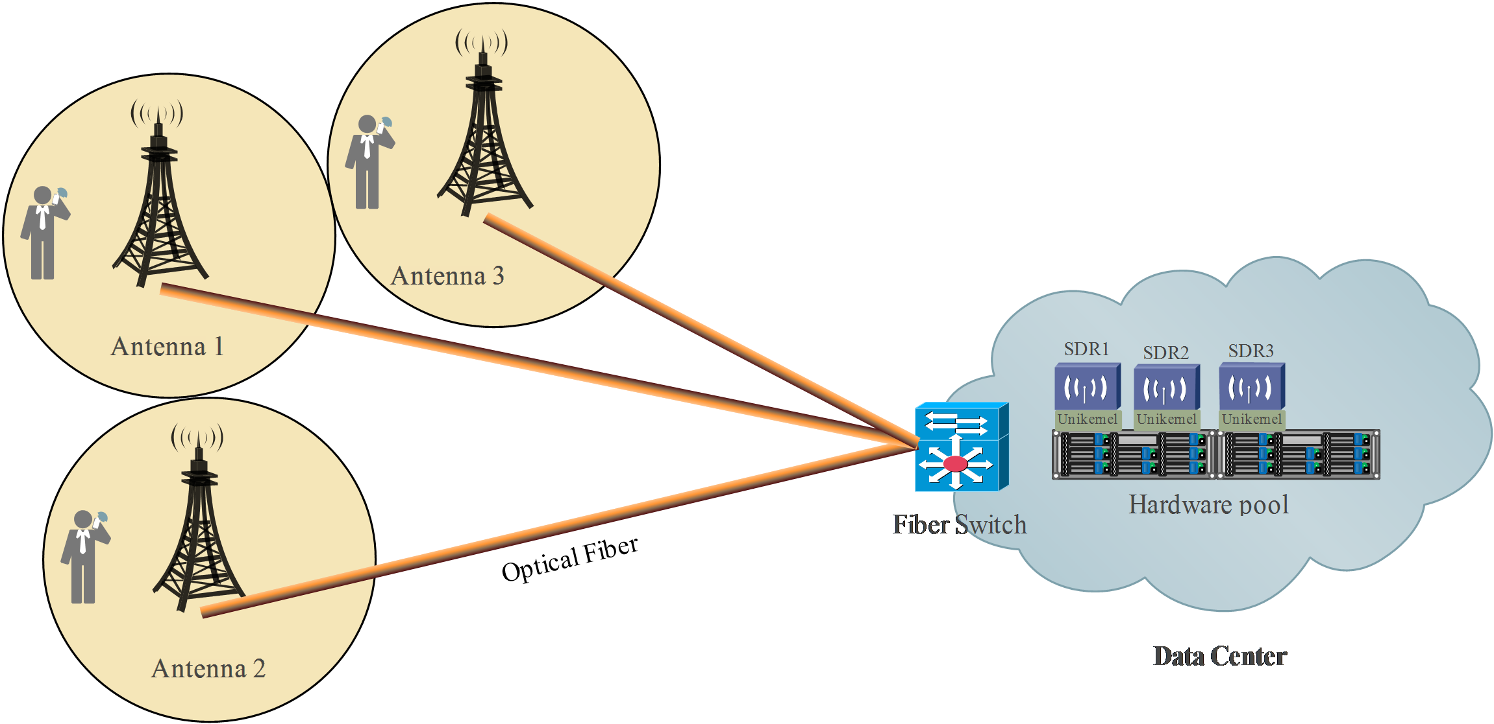
SDR Clouds for metropolitan area
Core network

Slide 8
References
[1] Gomez, I., Marojevic, V., & Gelonch, A. (2012). Resource management for software-defined radio clouds. IEEE micro, 1(32), 44-53.
[2] Peng, M., Sun, Y., Li, X., Mao, Z., & Wang, C. (2016). Recent Advances in Cloud Radio Access Networks: System Architectures, Key Techniques, and Open Issues. [3] A. Berger and M. Hefeeda, “Exploiting sip for botnet communication,” in Proc. 5th IEEE Workshop Secure Network Protocols, 2009, pp. 31–36

Slide 9

Thank you

