Slide 1
Indoor MVNO Simulation
ITU indoor propagation model
Path Loss modeling
Received power modeling
Capacity modeling
Received power measurement (UNIK)
Measured & modeled power comparison.
Mounting APs to building (FFI)

Slide 2
ITU Model (Path Loss)
International Telecommunication Union (ITU)
Modeled frequency 2400 MHz
Examined the position of the Access Point (AP) and the WLAN cards
Ltotal = 20 log10 f + N log10 d + Lf (n) – 28
where:
  N: distance power loss coefficient
  f : frequency (MHz)
  d : separation distance (m) between the base station and portable
  Lf : floor penetration loss factor (dB)
  n : number of floors between base and portable.

Slide 3
Indoor Path Loss

Slide 4
Received Power Modeling
Meru AP1010 Transmitted power (TS) -12 db
Transmitter Antenna Gain (GT) 4 db
Receiver Antenna Gain(GR) 9 db
Received Power= TS + GT +GR –Path loss

Slide 5
Received Power

Slide 6
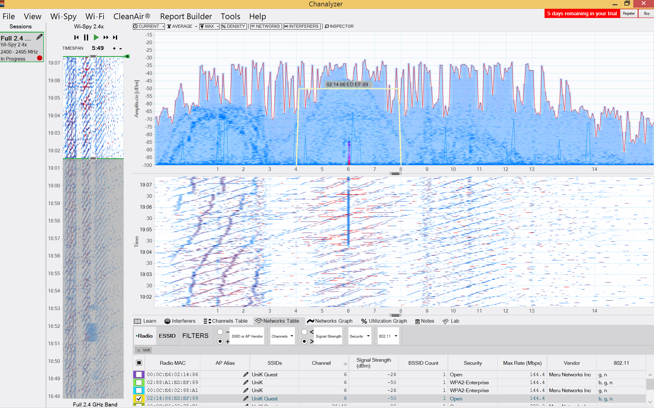
Measured Power (UNIK)
Power measuring using Wi –Spy
Difficulities:
Access point correspondence MAC address.
Distance measureing(pythagorean theorem)
Measured signal strength changeing.

Slide 7
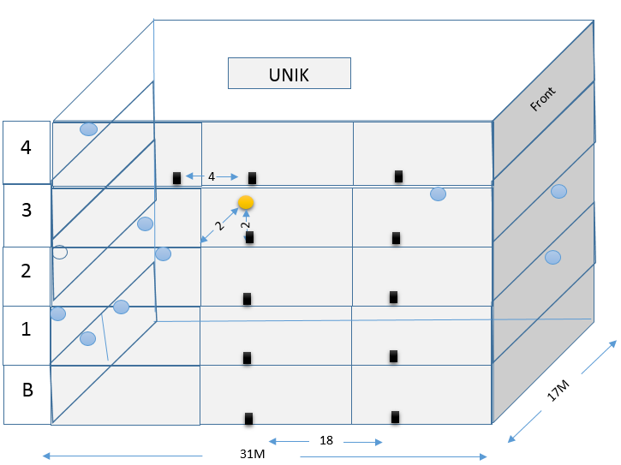
UNIK Building

Slide 8
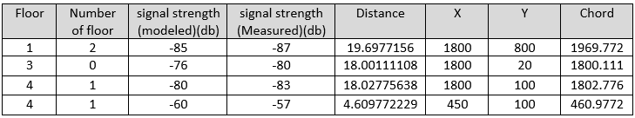
Measured & Modeled Values

Slide 9

Channel Capacity Modeling
C Capacity
B Channel bandwidth 20
S signal strength
N noise
Goal: Minimum objective capacity is 50 in FFI building

Slide 10
Capacity & Range

Slide 11
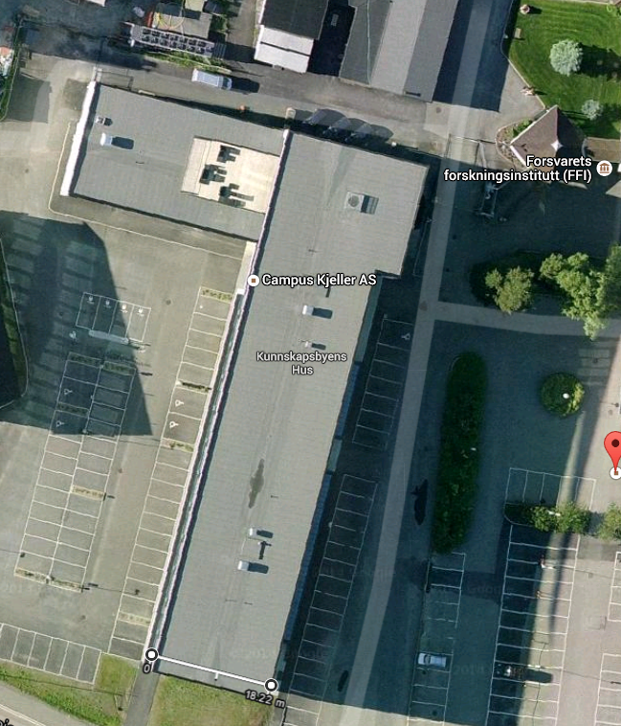
FFI Building

Slide 12
AP mounting
Some factors
AP characteristics (Antenna Gain,…. ).
Building characteristics (Dimensions,..).
Objective capacity.
Communicated devices characteristics(Antenna Gain,.. ).

Slide 13
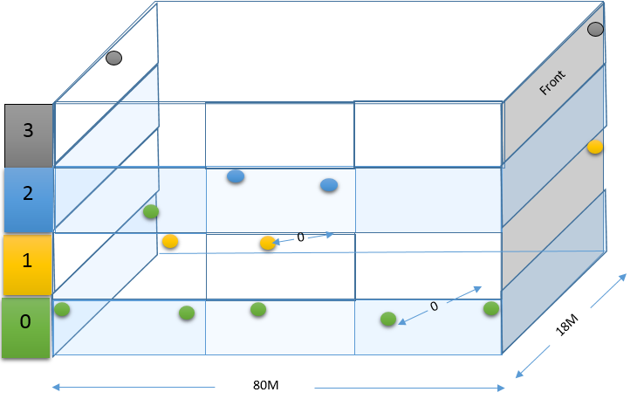
FFI Building AP Distribution

Slide 14
References
T. S. Rappaport, Wireless Communications: Principles and Practice, 2nd ed. Singapore: Pearson Education, Inc., 2002.
K. Feher, Wireless Digital Communications: Modulation and Spread Spectrum Applications. Upper Saddle River, NJ: Prentice Hall, 1995.
S.HaykinandM.Moher, Modern Wireless Communications. Singapore: Pear- son Education, Inc., 2002.
J. W. Mark and W. Zhuang, Wireless Communications and Networking. New Delhi: PHI, 2005
Digital Transmission Systems, Third Edition, David R. Smith
http://www.rfcafe.com/references/electrical/wireless-comm-specs.htm

Slide 15
References
From coverage to quality: building the future network Δ,
Femtocells Building the Quality Network for Mobile Operations ­ Oslo, 28 Oct 2010.
Ayaz Khan Afridi, "Macro and Femto Network Aspects in Realistic LTE Usage Scenarios Δ", Master Thesis, Network Services and System in Department of Electrical Engineering, Royal Institute of Technology (KTH), Stockholm, Sweden, May 2011.
http://www.metageek.net/products/wi-spy/, 18/12/2014
Presentation: Josef Noll, From coverage to quality: building the future network, Femtocells - Building the Quality Network for Mobile Operations - Oslo, 28 Oct 2010
[9]http://en.wikipedia.org/wiki/ITU_Model_for_Indoor_Attenuation, 18/12/2014
http://www.merunetworks.com/, 18/12/2014

