Slide 1
WiMAX

Slide 2
What will be discussed
What is WiMAX
  General concept about WiMAX
  End to End Architecture
  Technical Points and Prominent Features
Why is WiMAX
  WiFi vs. WiMAX
  Why WiFi cannot move like 3G
  Why not 3G but another technology
  We need WiMAX
How is WiMAX
  Performance evaluation
  Future
Notes:
In this presentation, I will not focus on the technique detail, like frame structure, operation process or something else. Because all of this thing can be found directly in the standard of 802.16m or 802.16e.
I will discuss the WiMAX from three directions, what is wimax, why is wimax, and how is wimax. At the first, we will give some general concepts about the wimax, talk about the application scenario and the figure out some prominent new features. And then we will discuss about why we need wimax, because we cant make out a standard without any use. It should be produced based on specific requirements. At the end, we will show a future about wimax

Slide 3
What is WiMAX ?
General Concepts
End to End Architecture
Technical Points and Prominent Features

Slide 4
General Concepts
Acronym for Worldwide Interoperability for Microwave Access
Based on Wireless Metropolitan Area Networks(MAN) technology
A wireless technology optimized for the delivery of IP centric services over a wide area
A scalable wireless platform for constructing alternative
A certification that denotes interoperability of equipment built to the IEEE 802.16 or compatible standard. The IEEE Working Group develops standards that address two types of usage models:
  Fixed/Nomadic WiMAX (IEEE 802.16d-2004)
  Mobile WiMAX (IEEE 802.16e-2005)
Notes:
So let’s start the first topic, what is WiMAX. WiMAX is the acronym for worldwide interoperability for microwave access. Let’s analysis this definition. Worldwide is very easy to understand. This is a standard which can be used as criterion or can be studied as basic theory. What is interoperability? Interoperability means this standard is ability of communicating and exchanging data with other different systems and platforms. It means we may have WiMAX upon mobile phone, WiMAX upon local wireless access or so-called Wi-Fi, WiMAX upon personal wireless network or so-called zigbee or wirelsshart, and something else. And then, what is Microwave access? When we come to microwave, we will think about the wavelength and frequency. The frequency for microwave is from 300MHz to 300GHz. And defined by the standard IEEE 802.16, the frequency of WiMAX is designed to operate between 2 to 11 GHz. Commercial implementations are in the 2.3 GHz in some countries in Asia like south Korea and Ghana in Africa, 2.5 GHz is used in America and Zimbabwe in Asia , 3.5 GHz ranges in Europe and Eastern Europe some contries in Asia and Latin America. And Taiwan used 2.6 GHz. because we are in Europe, and actually in Norway, based on my knowledge, there are two companies working in WiMAX, one is Hafslund operated in ostfold, and working in 2.6 GHz based in 802.16e (mobile Wimax) and the other one is Telenor operated in Trondelag coast, and working in 3.5 GHz based on 802.16 (stubborn Wimax)
And then …. , we have to notice, it is a IP centric services technology which means it can be very fluently connected with global Internet. And the equipment is build based on mac address.
Next one tells from two sides, one side is from wimax base station, the other side is from subscriber stations

Slide 5
Commercial implementations
2.3 GHz in some countries in Asia like south Korea and Ghana in Africa,
2.5 GHz is used in America and Zimbabwe in Asia ,
3.5 GHz ranges in Europe and Eastern Europe, some countries in Asia and Latin America.
And Taiwan used 2.6 GHz.

Slide 6
WiMax in Norway?
Hafslund
  operated in ostfold
  working in 2.6 GHz based in 802.16e (mobile Wimax) and the other
Telenor
  operated in Trondelag coast
  working in 3.5 GHz based on 802.16 (stubborn Wimax)

Slide 7
About WiMAX
2001, first 802.16 standard
  Single-carrier (SC) modulation in the 10-66 GHz band
  Targets Line-of-Sight (LOS) scenarios.
2003, 802.16a amendment
  Support for non-LOS environment
  OFDM and OFDMA were introduced as options for the implementation of the PHY
2004, 802.16d
  Followed 802.16c and superseded all previous 802.16 standards
2005, 802.16e
  Mobile WiMAX
Notes:
The first 802.16 standard was approved in 2001. It employs Single-Carrier (SC) modulation in the 10-66
GHz band and targets Line-of-Sight (LOS) scenarios. 802.16a,
the first amendment, was ratified in 2003. It added support
for non-LOS environments in order to support last-mile fixed
broadband access. For this reason, Orthogonal Frequency
Division Multiplexing (OFDM) and Orthogonal Frequency Division
Multiple Access (OFDMA) were introduced as options
for the implementation of the physical (PHY) layer. 802.16d
that followed 802.16c, a minor amendment, superseded all
previous 802.16 standards (in the form of 802.16-2004) and
is frequently referred to as Fixed WiMAX [12]. The success of
OFDM-basedWLANs and the gradual appearance of 802.16d based
products triggered work on a new amendment that would support constant mobility in cellular networks that
resulted in 802.16e-2005, commonly referred to as Mobile
WiMAX [7], [13].

Slide 8
 | 802.16 | 802.16a | 802.16-2004 | 802.16e
Frequency range | 10-66Ghz | 2-11Ghz | 2-11Ghz, 10-66Ghz | 2-6Ghz
Channel conditional | LOS | NLOS | NLOS | NLOS
Channel Bandwidth | 20, 25 and 28 Mhz | 1.25-28 Mhz | 1.25-28 Mhz | 1.25-20Mhz
Bit rate | 32-134Mbps | Up to 75 Mbps | Up to 75 Mpbs | Up tp 15 Mbps
Typical cell radius | 1-3 miles | Maximum range is 30 miles on the basis of antenna height, antenna gain, and transmit power | Maximum range is 30 miles on the basis of antenna height, antenna gain, and transmit power | 1-3 milse
Reference from: S. Ahson, M. Ilyas, “WiMAX-- Application”, Taylor & Francis Group

Slide 9
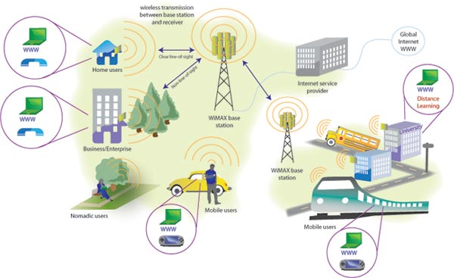
End-to-End Architecture
A declaration from Airspan
http://www.airspan.com/solutions/by-industry/frequency/2-5-ghz/
Notes:
This is an architecture picture from Airspan. I like it, because it explain a lot the application we can implement with wimax. First of all it is a connection between the Wimax and global internt WWW. It is connected through a cable but not statelite, or something else. And then, is a conection between wimax base stations. We can see they are connected with each other through wireless, which means the connection is inflexible and the setup is very simple. Then we come to the starbbon terminate connection part which can be business enterprice and home user. Next is the connection between outside moving terminate. This moving terminate is single user who may walking in the park or may stand in a street. He may use it to talking with people or may use it surf online or playing online game.
Finally is the connection with group moving terminates or independent receving terminates which may a running bus or train. Or may be sensor network.

Slide 10
Technical Points and Prominent Features
Point-Multipoint
Metropolitan Area Network
Connection-oriented
Supported user environments
  High bandwidth, hundred of users per channels
  Continuous and burst traffic
  Very efficient use of spectrum
Protocol independent core
Balance between stability of contentionless and efficiency of contention-based operation
Flexible QoS offererings
  UGS, rtPS, nrtPS, BE, with granularity within classes
Support multiple 802.16 PHYs
Reference from: R. B. Marks, C. Eklund, K. Stanwood, S. Wang, “The 802.16 WirelessMAN MAC: It’s done, but what is it?”, 12th, November, 2001. [On line:] Avalable: http://www.ieee802.org/16/docs/01/80216-01_58r1.pdf
Notes:
Connection-oriented (CO-mode^{[1]}) communication is a network communication mode in telecommunications and computer networking, where a communication session or a semi-permanent connection is established before any useful data can be transferred, and where a stream of data is delivered in the same order as it was sent.
Why we say very efficient use of spectrum
OFDM is based on the traditional frequency division multiplexing (FDM), which enables simultaneous transmission of multiple signals by separating them into different frequency bands (subcarriers) and sending them in parallel. However, in FDM, guard bands are needed to reduce the interference between different frequencies, which causes bandwidth wastage. OFDM removes all the guard band but keeps the modulated signals orthogonal to mitigate the interference level.
And because OFDM uses fast fourier transform (FFT) and inverse FFT to convert serial data to multiple channels. FFT size is 256, which means a total number of 256 subchannels (carries) are defined for OFDM. And what’s more, OFDM is more robust against multipath propagation delay.
Protocol independent core
Because of the way most distributed systems encapsulate the protocol details of interprocess communication, it can be difficult to update your system when protocols change. You should build protocol independence into every aspect of your system.
The uplink traffic flow area grouped into four types:
Unsolicited grant services ( support constant bit rate services), real-time polling service(MPEG video,VoIP), non-realtime polling services(non real time variable bit rate services, such as FTP), best-effort (packets are forwarded on a first-in-first-out services)
802.16e use OFDMA which is a multiple-user version of OFDM and is a more flexible way to manage different user devices with various antenna types and form factors. And OFDMA allows multiple users to transmit data simultaneously. A number of users can communicate at the same time using the subchannels allocated to them.

Slide 11
Why WiMAX ?
We have 3G. We have Wi-Fi. Why we don’t just combine these two things together but make a new standard?

Slide 12
Questions
What is the difference between Wi-Fi (Wireless Fidelity) and WiMax
Why we cannot just only put some Wi-Fi access point in some place to instead the 3G base station?
Why no 3G but another technique
We need a techniques like Wi-MAX

Slide 13
WiMax and Wi-Fi
WiMax
Wi-Fi (802.11n)
Standard
Range
Scalability
Bit rate
Frequency band
Channel Bandwidth
Radio technology
Modulation
Mobility
Access Protocol
802.16
50km (at the maximum range)
From one to hundreds consumers
Between 34 Mbit/s and 1 Gbit/s
Licensed/Unlicensed 2G to 11GHz
Adjustable from 1.25M to 20, 25, 28MHz,
OFDM (256-channels)
Mobile WiMax (802.16e)
Request/Grant
802.11n, 802.11ac
Indoor 70m, outdoor 250m
From one to tens
150 Mbit/s (1 spatial stream)
2.4GHz/5GHz
Per channel 40Mhz
OFDM
Cannot move fast
CSMA/CA or AP-uncontention
Reference from: H. Labiod, H. Afifi, C. DE SANTIS, “WI-FI, Bluetooth, Zigbee, and WiMAX”, published by Springer,
Notes:
Why bandwidth is from 1.25 to 28MHz?
A problem existing in the original 802.16 standard is that it is often very difficult for some power-sensitive devices, such as laptops and handheld equipments, to transmit to the BS over long distances if the channel bandwidth is too wide. And using flexible bandwidth choices, we solve this problem. Because it provides the flexibility to operate in different frequency bands with varying channel requirements around the world.
OFDM which allows high-speed bidirectional wireless data transmission in a mobile environment.

Slide 14
Why Wi-Fi can’t move like 3G
FHSS (Frequency Hopping Spread Spectrum)
  More susceptible to narrowband noise and interference
  Do better indoors and multipath environments
  Cheaper and easier
DSSS (Direct Sequence Spread Spectrum)
  Much more useful in outdoor environment and non-cluttered environments
  Use bandwidth much more efficiently and give a much higher data throughput than FHSS
Reference from: Earl McCune, “DSSS vs. FHSS narrowband interference performance issues”, RF signal processing, September, 2000, p.90 – p.104

Slide 15
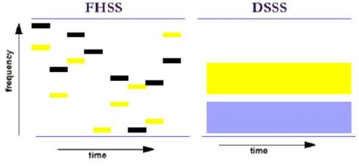
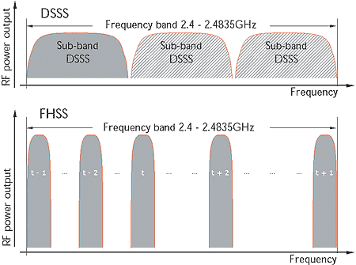
If in an indoor environment, you are using Skype to take a call with your friends.
You are using a smart phone through Wi-Fi, and you are walking around.
What will happen?
Or if you are in an outdoor environment and
You are using your smart phone playing a real-time online game.
What will happen?
Reference from: http://www.helifreak.com/showthread.php?t=347351
Figure reference from : http://www.iebmedia.com/index.php?id=4466&parentid=74&themeid=255&hft=19&showdetail=true&bb=1&PHPSESSID=lvnbqfjqir53bhuru4us4qntk3

Slide 16
Why no 3G but another technique
Expensive spending on mobile base station set-up
  Constructing a tower costs around $200,000 or $250,000 (data from 2009)
Rough environment give bad condition to build up a base station
Not economy with a base station but may be one terminate user and who may even not your customer
3G need the customer to choose an operator and a bad internet access experiments if you cannot afford enough money. And most of time you cannot use it play real-time games
You can do everything you like, but first of all you have your flow.
Notes:
Cell tower costs vary widely, depending on what kinds of deals the constructor has with various vendors. Generally, constructing a tower costs around $200,000 or $250,000. About $150,000 of that is for "civil installation" which includes pouring concrete, the mast and its erection, backup generators, fencing, tiny air-conditioned shack, and security systems. The telecommunications guts (baseband processors, transceivers, power supplies, amplifiers, etc) will run a minimum of $20,000 to $50,000 for the equipment -- and another $25,000 for installation ($75,000 for equipment and installation). There may also be about $5000 worth of costs to connect the tower to the core network, depending on its location and infrastructure. I got these price estimates in January of 2009, so some of the telecommunications equipment may be a little cheaper today -- but bear in mind the bulk of the cost is for "civil installation" (standard building materials, construction, and installation costs). Also bear in mind that costs may be less in urban areas, where some of the civil infrastructure costs can be avoided by placing equipment on tops of buildings or other tall structures. Also of note: there will be ongoing costs for maintenance, diesel fuel (for generators), etc that may be tens of thousands of dollars per month, depending on the location of the tower.

Slide 17
We need a techniques like Wi-MAX
We need a much more free access to the global internet
We need a much more convenient network environment which can be connected and worked among my home, my working place, supermarket, bus station, park, everywhere I stand on.
We need a much higher quality of service when I am enjoying multimedia service
We need a stable and trustable network access function when I am in a totally unfamiliar environment.
We need a network connection even I am in a desert

Slide 18
How is WiMAX
Performance has gained
Future direction

Slide 19
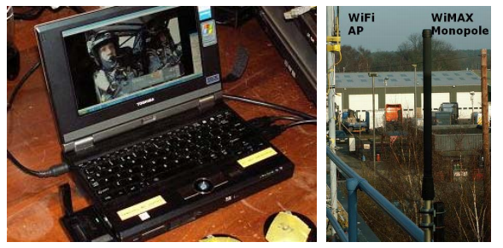
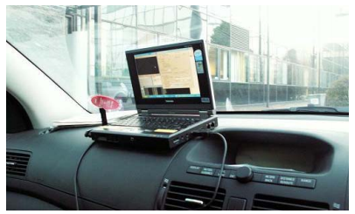
The experimental data was captured using a laptop computer and a mobile WiMAX data card
The BS used time division duplex (TDD) with scheduling based on a Round-Robin technique.
A video server was used to compress a composite video source into an IP encapsulated H.264 stream.
the laptop was placed inside a GPS enabled vehicle and driven in the vicinity of the WiMAX BS at speeds of up to 35 km/h.
The H.264 video was received in the moving vehicle and decoded on the laptop. The drive test
involved passing through the radio shadow of numerous tall buildings.
Mobile laptop and Base station
Mobile WiMAX enabled laptop in vehicle
Reference from: M. Tran, G. Zaggoulos, A. Nix and A. Doufexi, “Mobile WiMAX: Performance Analysis and
Comparison with Experimental Results ”, in Conf. Vehicle Technology, pp. 1 – 5, 21-24 Sept. 2008
Notes:
(see left-hand side
of Fig. 5) connected to a commercial carrier-class WiMAX
base-station (BS) operating at 2.3GHz. The BS used time
division duplex (TDD) with scheduling based on a Round-
Robin technique. The PHY layer used 1024 sub-carriers
configured in a 10 MHz bandwidth. The ratio between the
downlink and uplink was 80:20 in favour of the downlink. The
BS power amplifier was connected via 30m of RF cable to a 2
dBi dipole antenna. This was then mounted on the roof of a
two-storey building (see right-hand side of Fig. 5). An EIRP of
32dBm (including cable losses) was used at the BS.
A video server was used to compress a composite video
source into an IP encapsulated H.264 stream. This was then
sent over the WiMAX network via an Ethernet connection to
the BS. As shown in Fig. 6 the laptop was placed inside a GPS
enabled vehicle and driven in the vicinity of the WiMAX BS at
speeds of up to 35 km/h. The H.264 video was received in the
moving vehicle and decoded on the laptop. The drive test
involved passing through the radio shadow of numerous tall
buildings. The experiment also included the logging of PER,
data throughput and signal level in addition to GPS location
(which was used to determine the BS-MT separation distance).

Slide 20
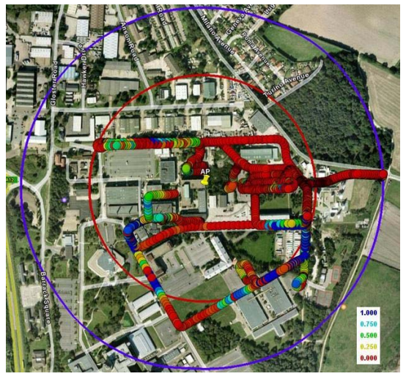
Reference from: M. Tran, G. Zaggoulos, A. Nix and A. Doufexi, “Mobile WiMAX: Performance Analysis and
Comparison with Experimental Results ”, in Conf. Vehicle Technology, pp. 1 – 5, 21-24 Sept. 2008
The propagation environment around the BS could be classified as urban micro. It consisted mainly of large office and industrial buildings (with heights ranging from 5m to 30m).
Several housing developments and a number of open fields were located around 400m from the BS.
The BS antenna was located at the center of the circles shown.
This location was chosen due to its close proximity to the rack of BS equipment. The outer blue circle indicates a range of 400m from the base-station. The inner red circle indicates a range of 260m from the base station.
PER vs. location and distance for WiMAX downlink

Slide 21

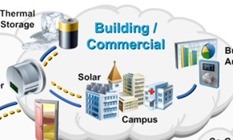
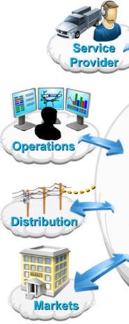
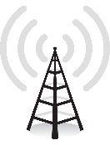


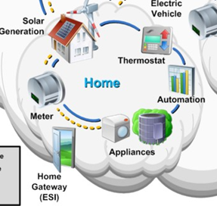
Vehicle Tracing, WiMax and Internet of Thing(IoT)
Reference from: http://www.dreamreport.net/reporting-as-a-service-raas-a-subset-of-software-as-a-service-saas-for-the-internet-of-things-iot/

Slide 22
Thanks

