Slide 1
SP3 - Technology Line
WP22 - Development and Implementation of Technologies
Progress Summary M27-M42
Josef Noll (UiO), Maunya D. Moghadam (UiO), Maghsoud Morshedi (EyeNetworks)

Slide 2
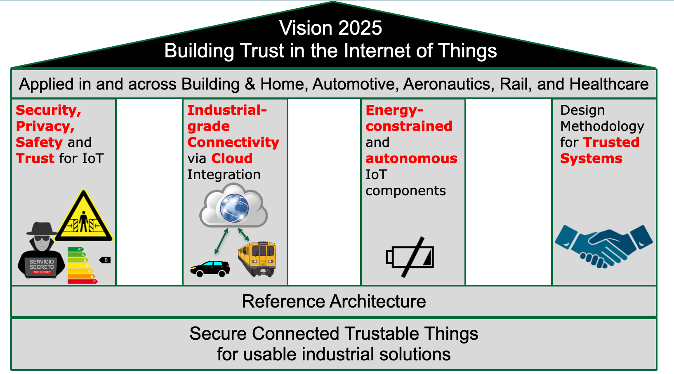
Main Objectives WP22
Overall
  Overview of developments in the technology lines
  (helicopter perspective)
  High level perspective
  Roadmap to Market Introduction -
  “Managed Wireless”
  Market Innovations
M27-M42 - Innovative Aspects & Market perspective
  Market roadmap for selected products
    Example: “Guarantee 500 Mbit/s everywhere”
  Innovative Aspects
    identification from technology development
  Tangible innovations with clear market perspective

Slide 3



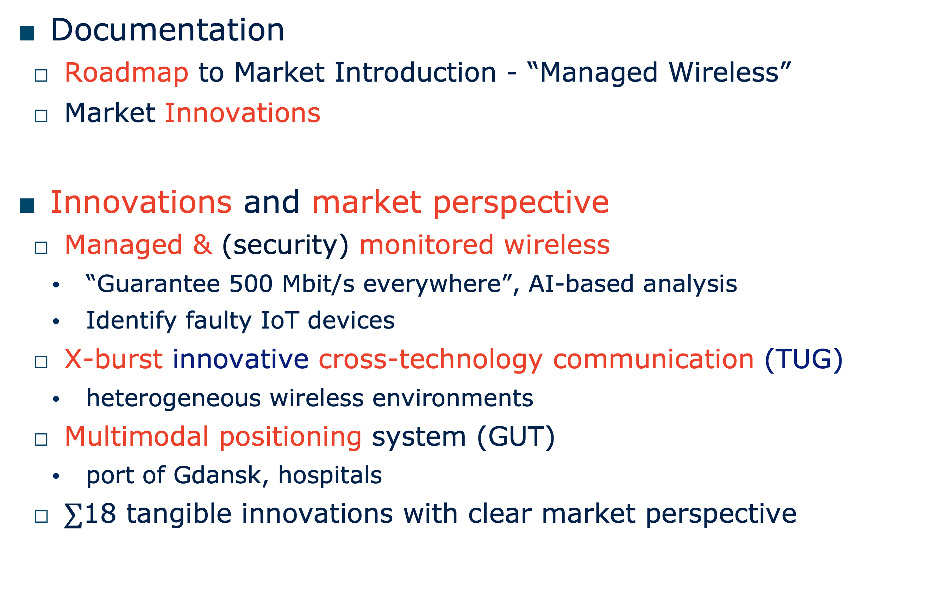
WP22 Achievements and main results M27-M42
Documentation
  Roadmap to Market Introduction - “Managed Wireless”
  Market Innovations
Innovations and market perspective
  Managed & (security) monitored wireless
    “Guarantee 500 Mbit/s everywhere”, AI-based analysis
    Identify faulty IoT devices
  X-burst innovative cross-technology communication (TUG)
    heterogeneous wireless environments
  Multimodal positioning system (GUT)
    port of Gdansk, hospitals
  $∑$18 tangible innovations with clear market perspective
Example: Managed and Secured Wifi
SW update
guaranteed
1 Gbit/s Wifi
access
monitoring

Slide 4
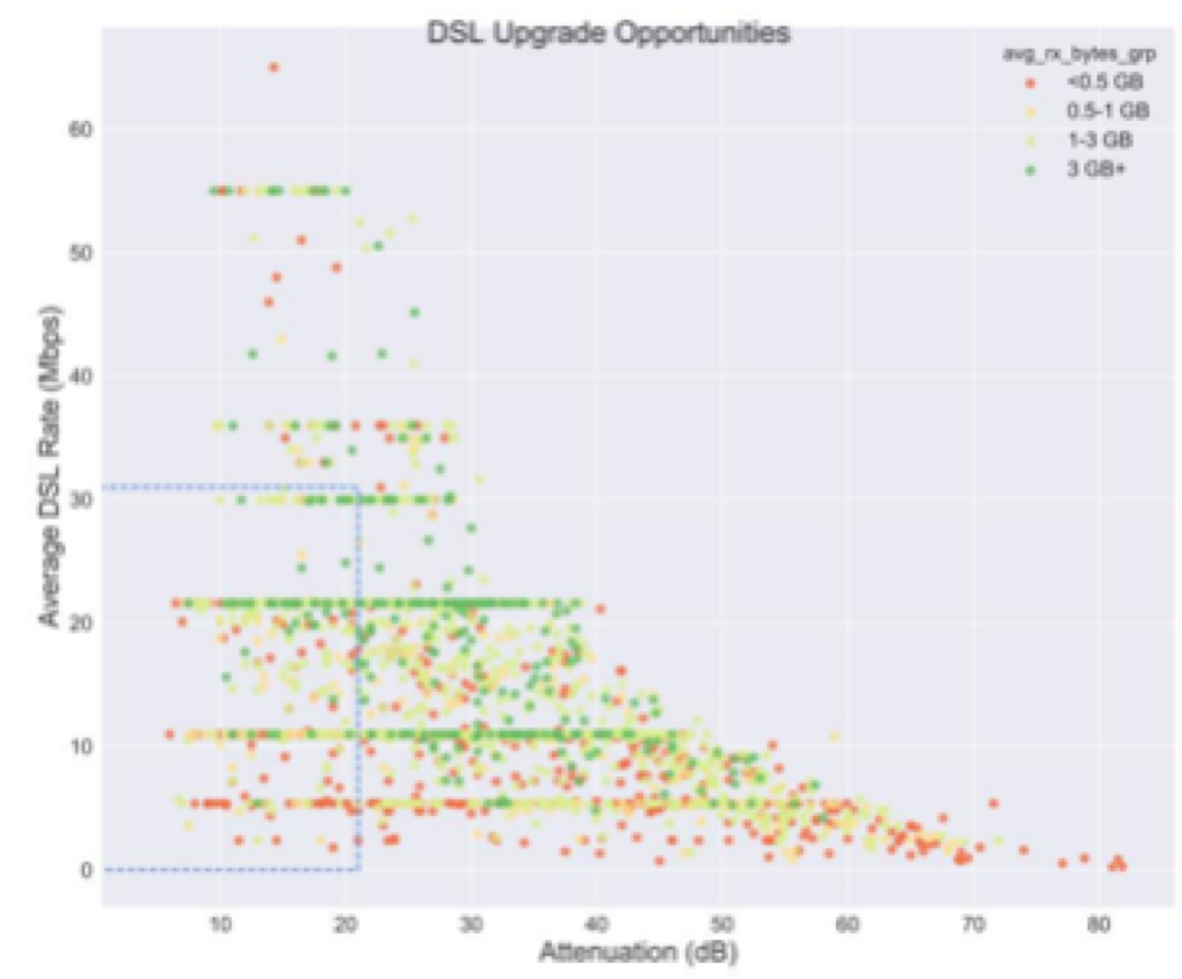
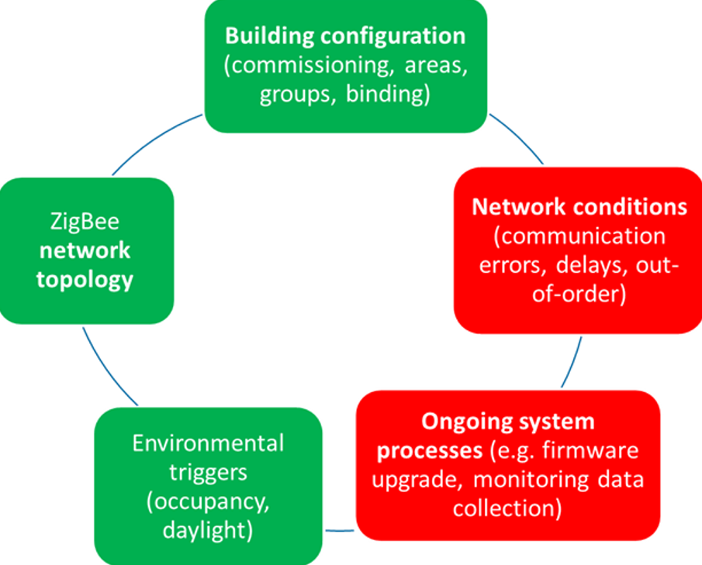
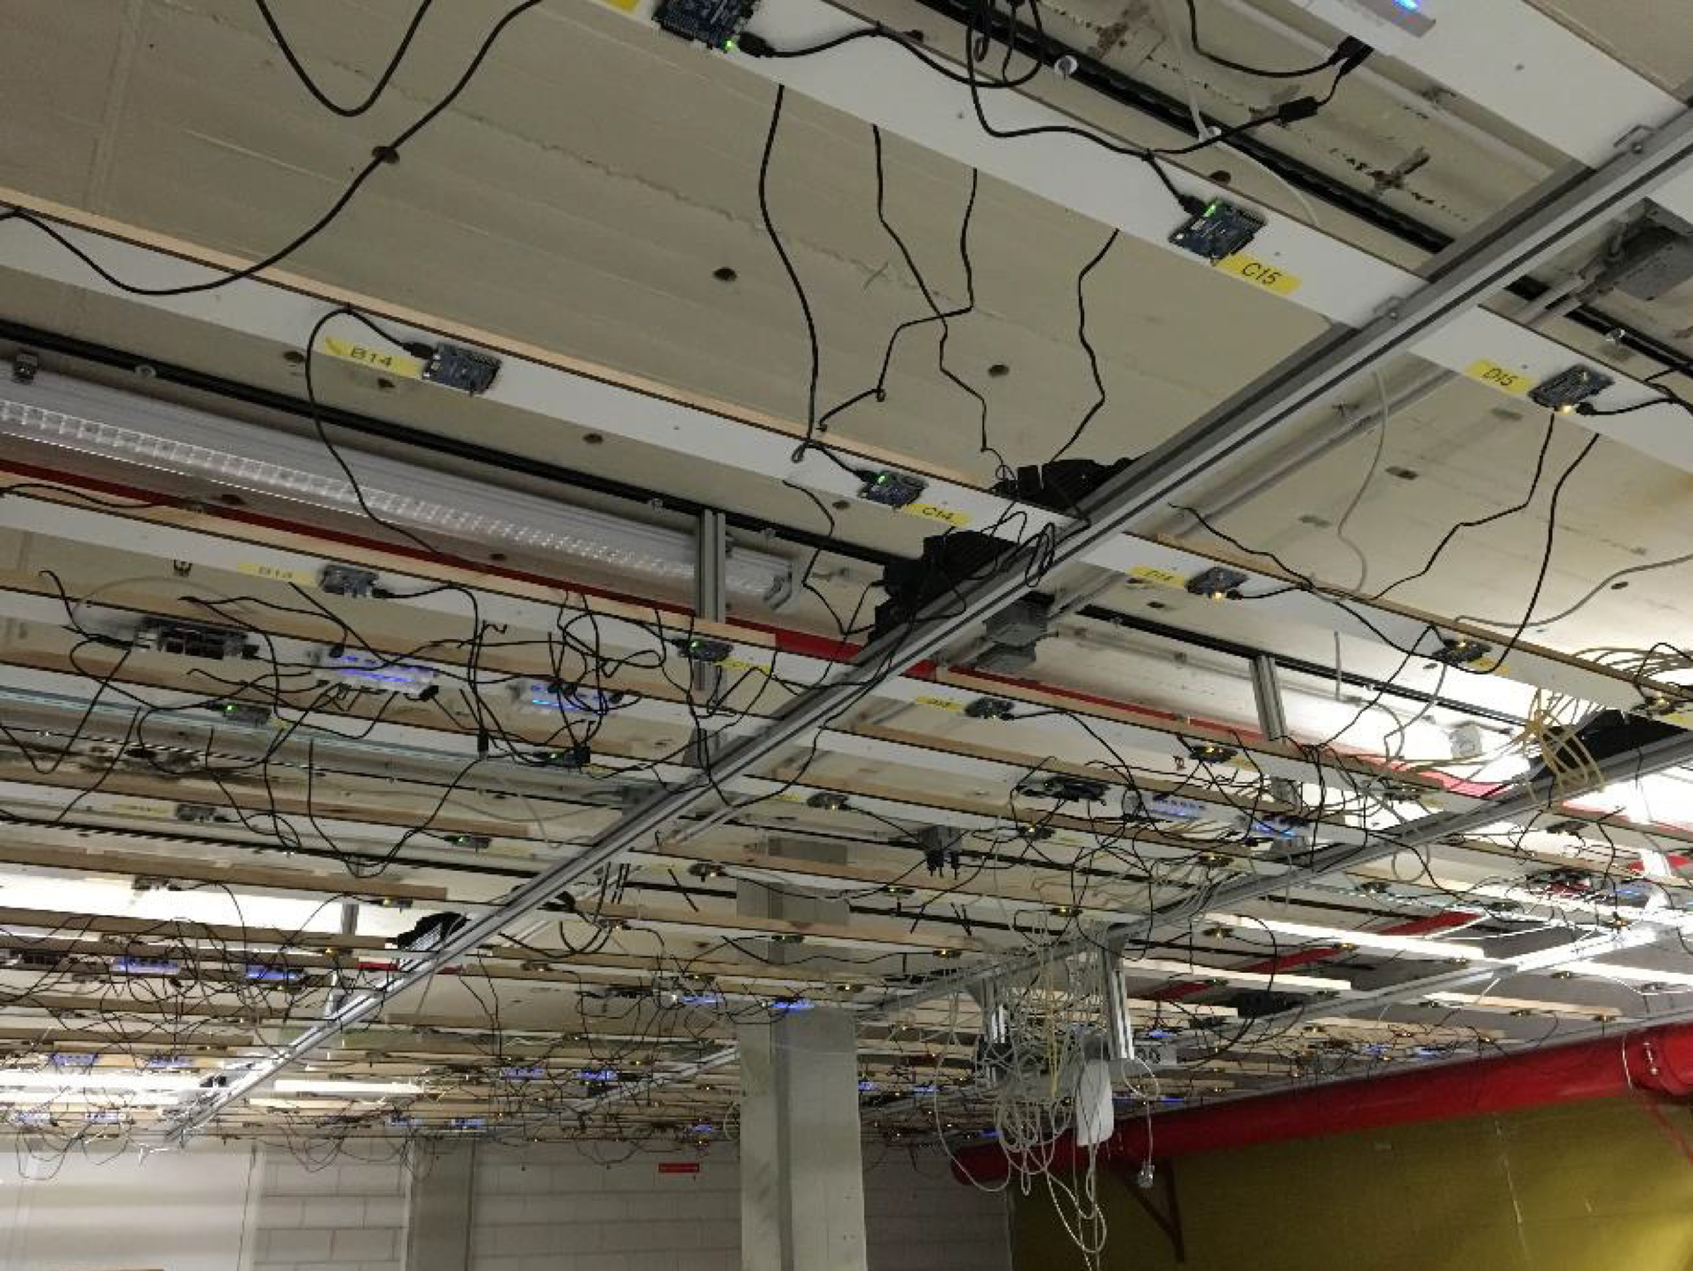
WP22 - Conclusion and Potential (M1-M42)
Boosting Security, Privacy, Safety and Trust for IoT through 18+ tangible market innovations
Planned exploitation after SCOTT
  Managed & (security) monitored wireless
    “Guarantee 1Gbit/s everywhere”
  Fault injection techniques
    Novel stress testing

Slide 5
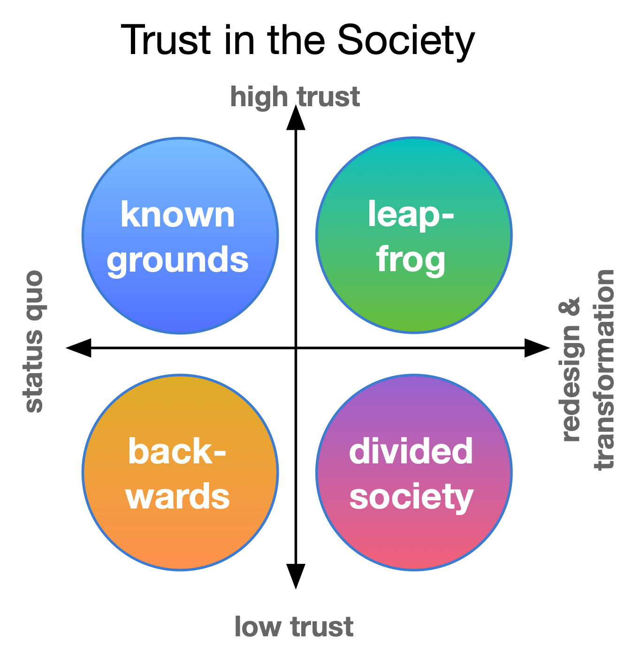


Novel topic in the discussion
Norway
2040
Societal Security
Trust in Society
6G and SDGs

Slide 6

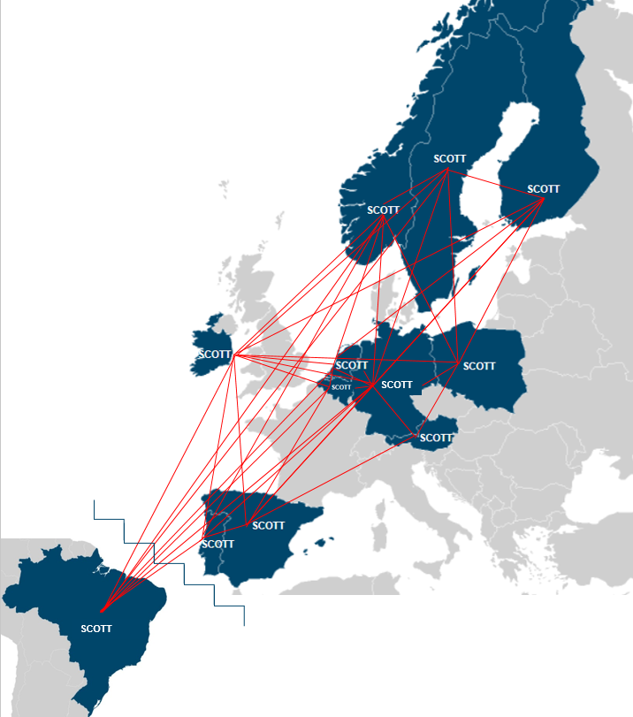



www.scott-project.eu

