Slide 1
Managed Wifi – AirTies4920
Muhammad Qammar Shehzad

Slide 2
What are Wifi Challenges ?
Limited range
Interference
Security is a concern
High power consumption

Slide 3
Problem Statement
Wifi coverage without compromising on capacity.

Slide 4
What should be considered
Technology overview
Simulation results
Conclusion

Slide 5
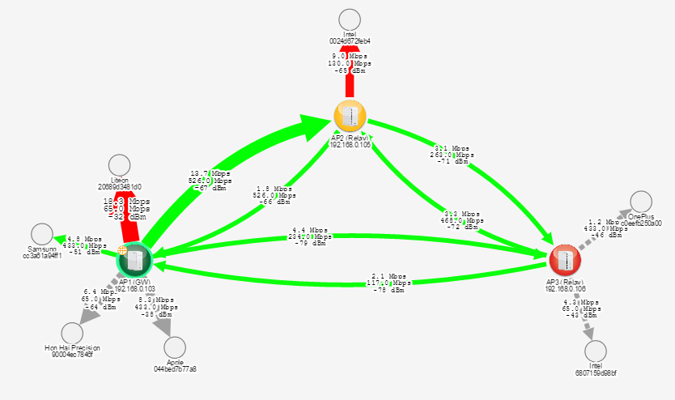
AirTies Cloud
Signal-to-noise ratio: SNR = signal power / noise power

Slide 6
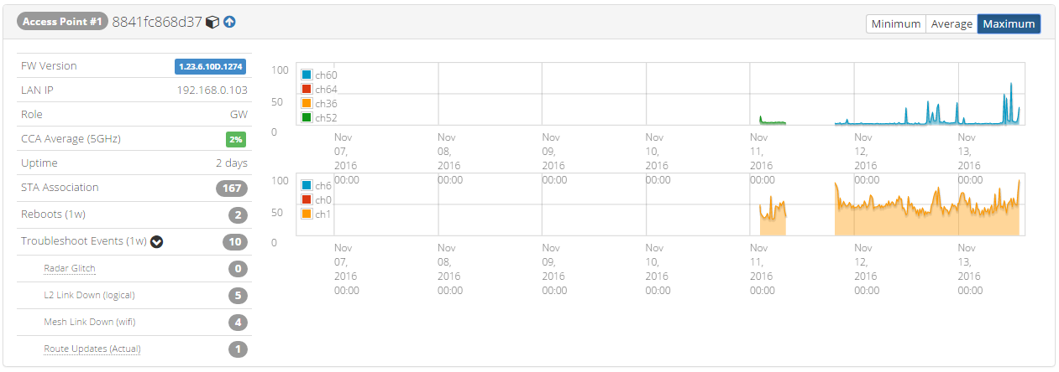
AirTies Cloud

Slide 7
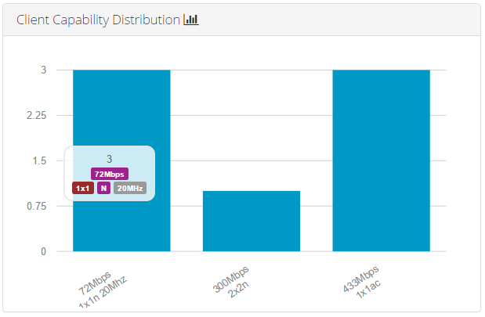
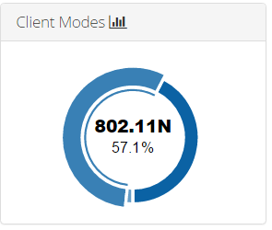
AirTies Cloud

Slide 8
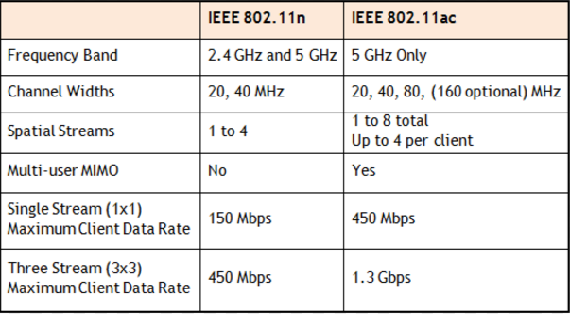
802.11n vs 802.11ac

Slide 9
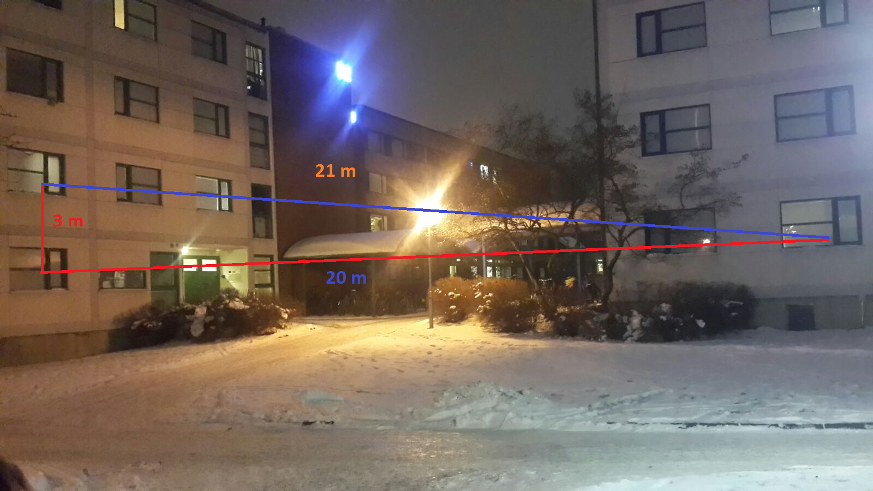
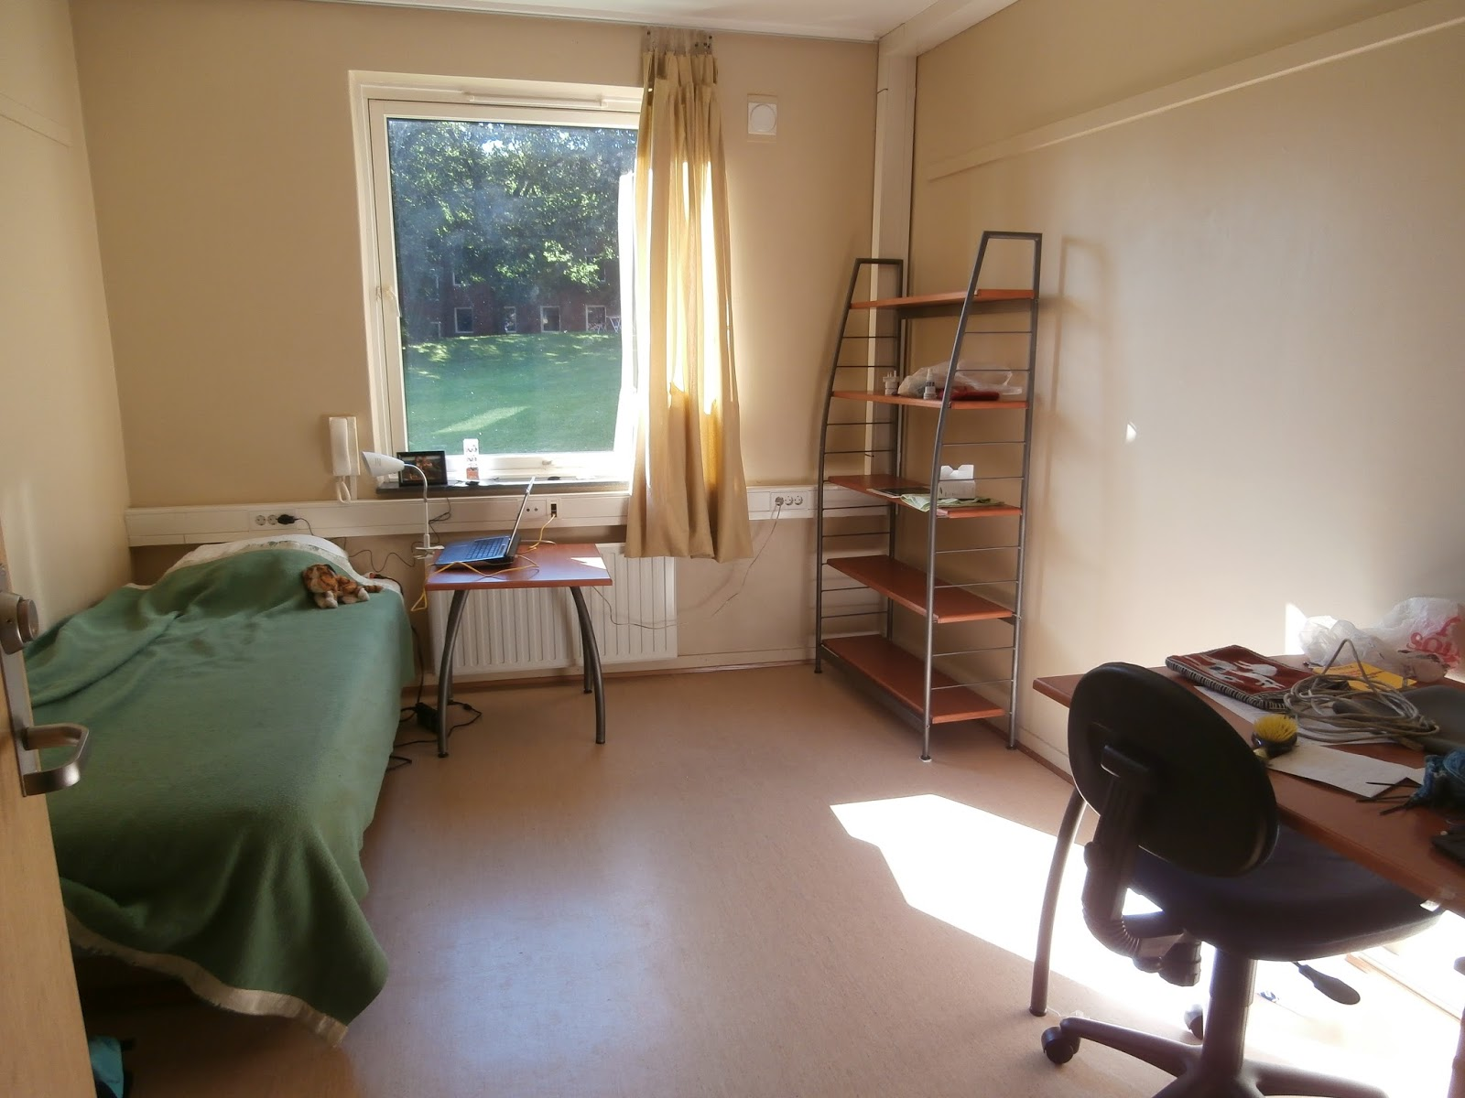
Use Case

Slide 10
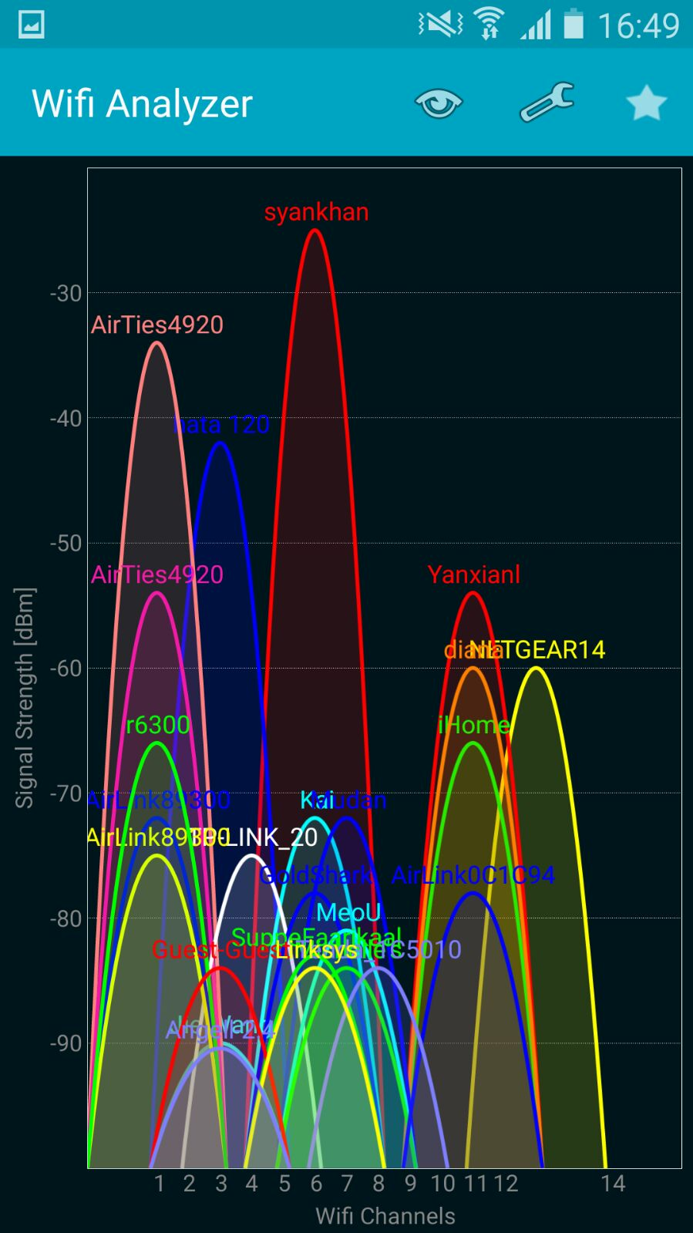
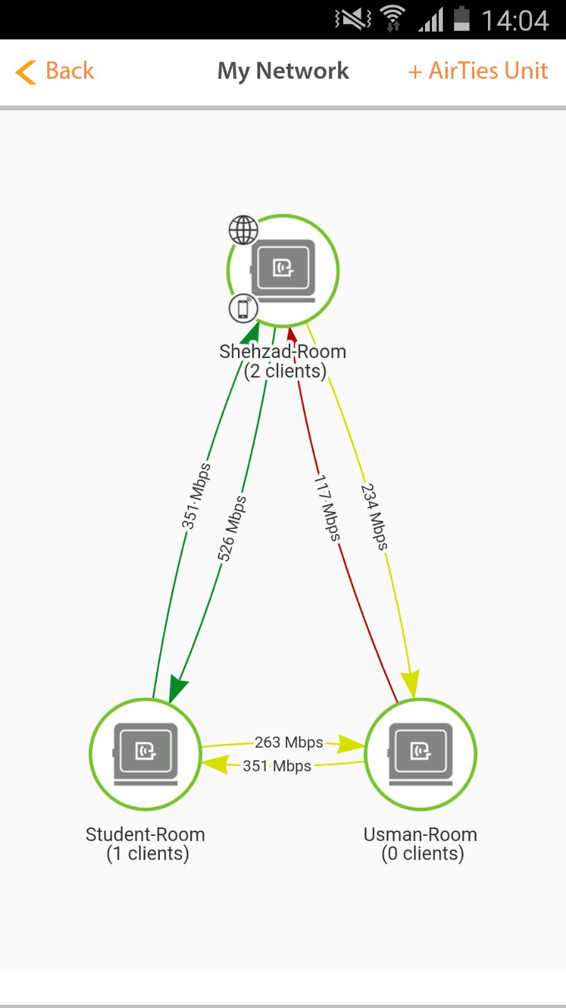
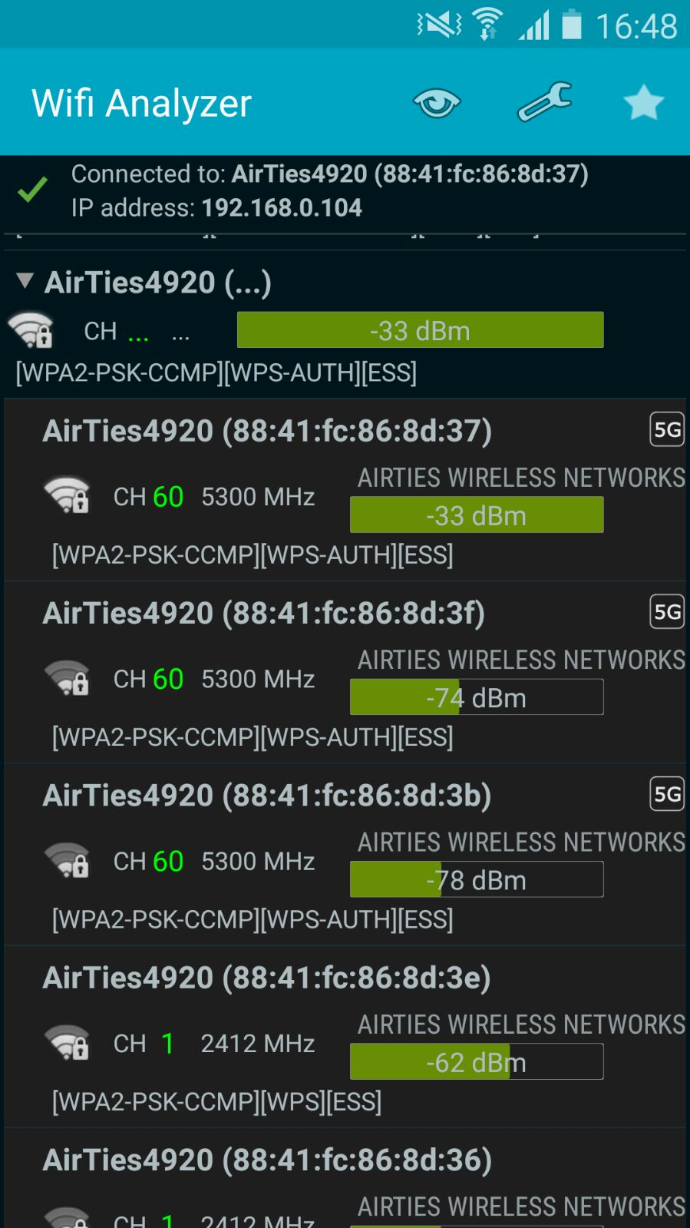
Use Case

Slide 11
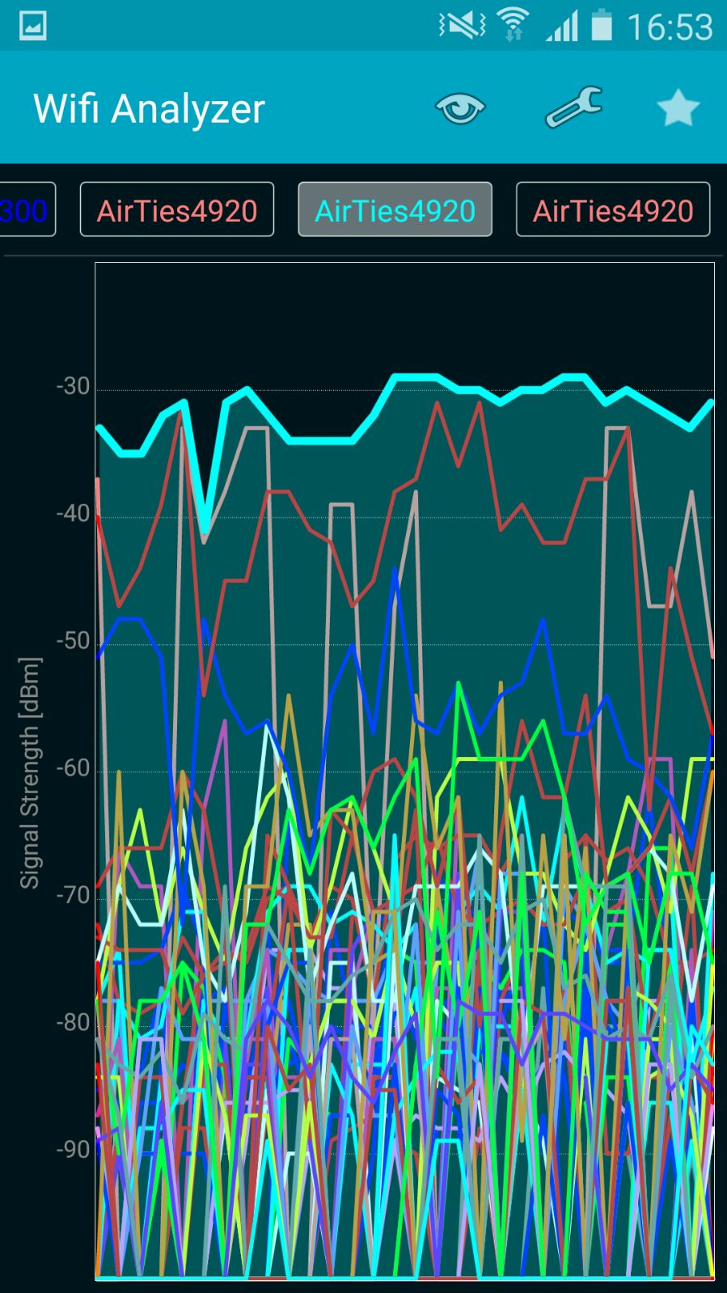
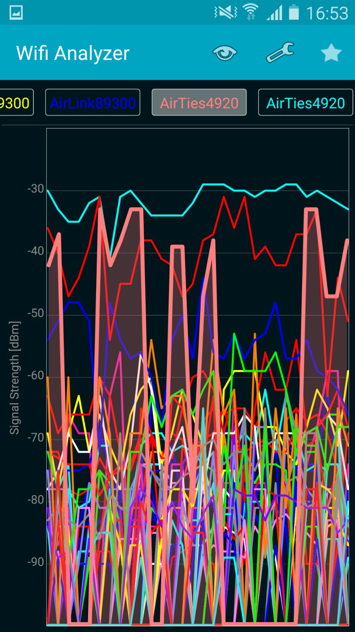
Use Case

Slide 12
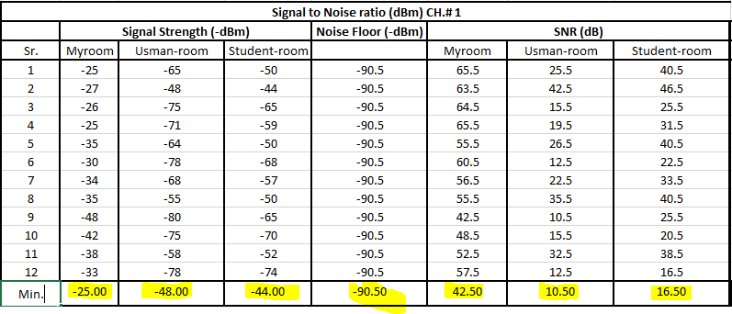
Shanon Capacity
Signal-to-noise ratio: SNR = signal power / noise power

Slide 13
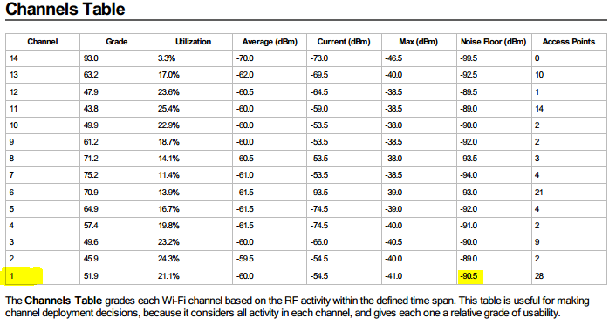

Slide 14
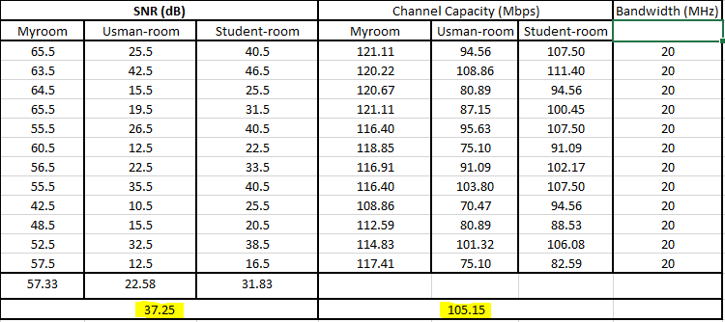
Shanon Capacity
Shannon formula: C = B.log₂ (1 + SNR)

Slide 15
Bandwidth: 20 MHz

Slide 16
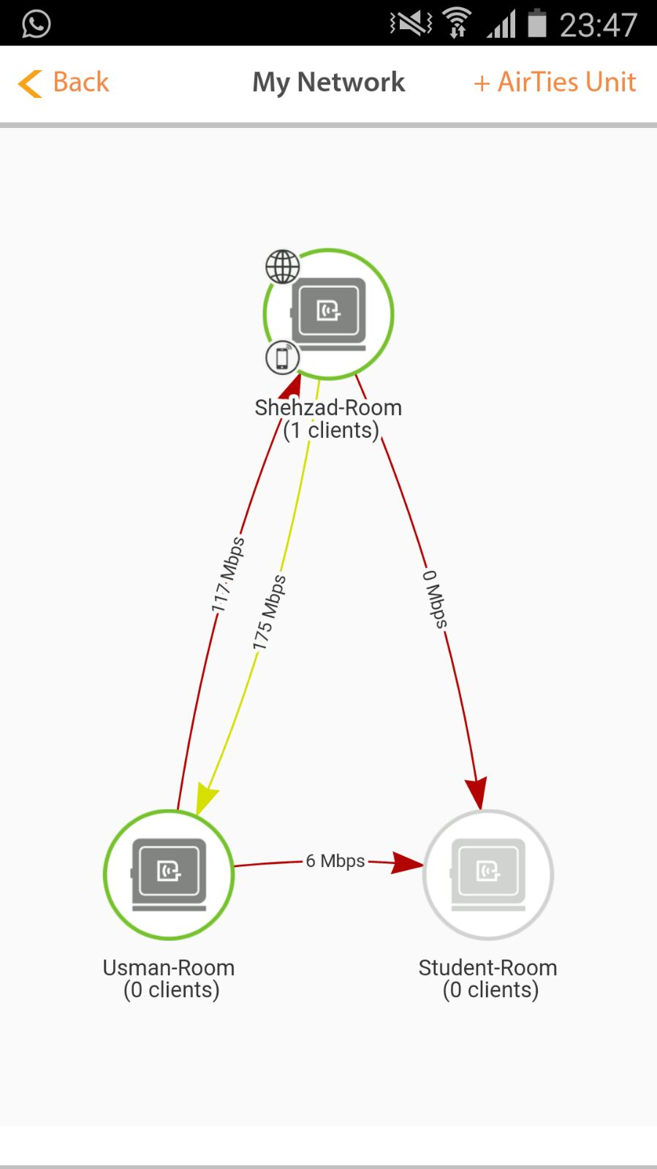
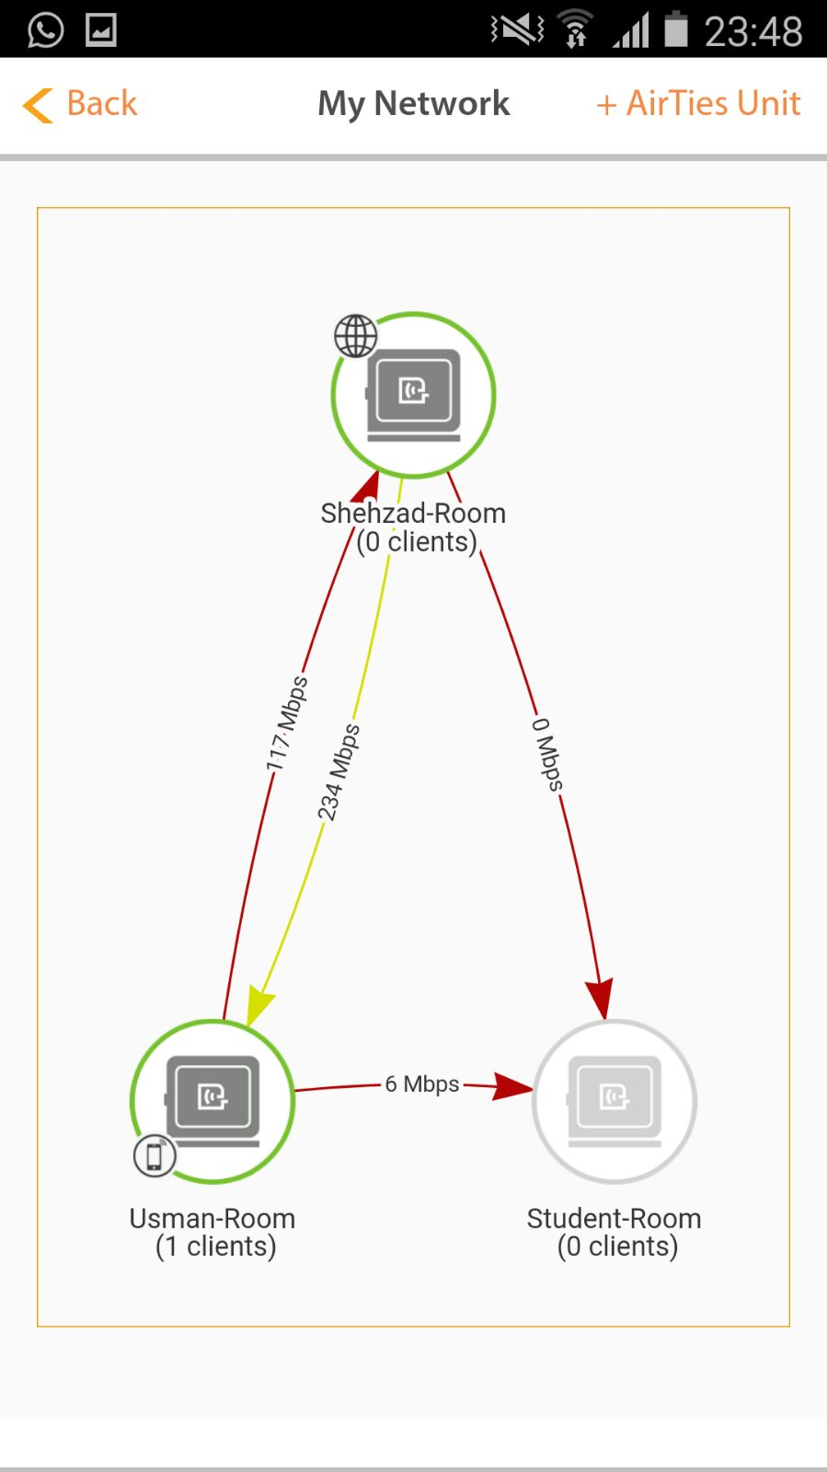
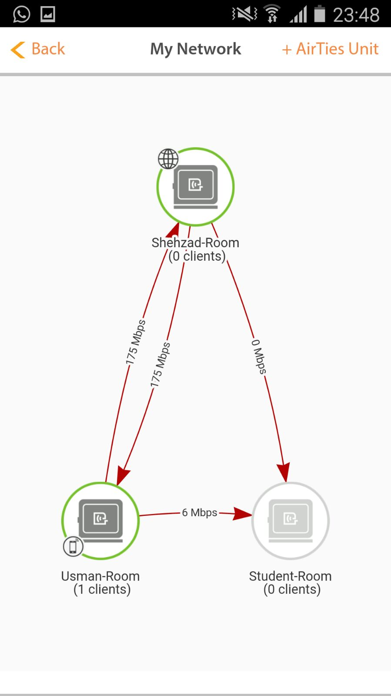
Only 2 devices

Slide 17
Propagation models
Environments (indoor, outdoor, vehicular)
ETSI Indoor Office test environment
  This environment is characterized by small cells and low transmit powers. Both base stations and users are located indoors.

Slide 18
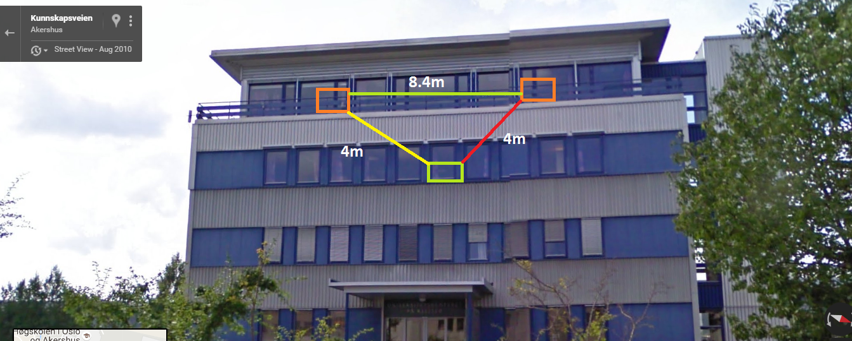
Use Case 2

Slide 19
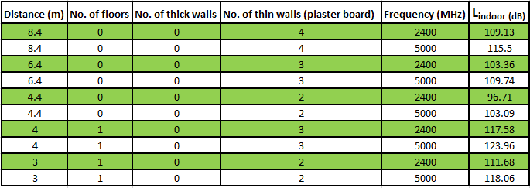
ETSI Indoor Office Propagation
Path loss model:
Where r is transmitter- receiver distance, n is no. of floors.

Slide 20
Benefits of AirTies4920
Dual band (2.4 GHz and 5GHz)
Mesh Nodes talks to each other
Backward Compatibility (802.11 a/b/g)
Remote management (TR-069)
No sticky clients

Slide 21
Other parameters to explore
Open wifi
Interference
Weather
Outdoor to Indoor
Range versus SNR

Slide 22
References
http://www.wirelesscommunication.nl/reference/chaptr03/indoor.htm
http://ciscorouterswitch.over-blog.com/2015/03/802-11ac-solution-benefits-migration.html

