Slide 1
Sensor Energy Characteristics
voltage range is 12V DC
Power consumption 10W
10/12= 833 milliampere (~1 Amp) to run the Sensor.
Option1: New battery:
Drawbacks of option 1 are:
Additional weight on the bicycle.
Separated key to turn the sensor on.
Occupation of additional space in bicycle.
Battery Charging.

Slide 2
Sensor Energy Characteristics
Option2: Using bicycle battery:
This eliminate the drawbacks of the option1.
we have to address below questions:
Which cables could provide us with needed energy ?
1- Classify cables plugin (color and size).
white 2, Black 1, Black2, Black3 and Black4
Which one is white2? (biggest white plugin)

Slide 3
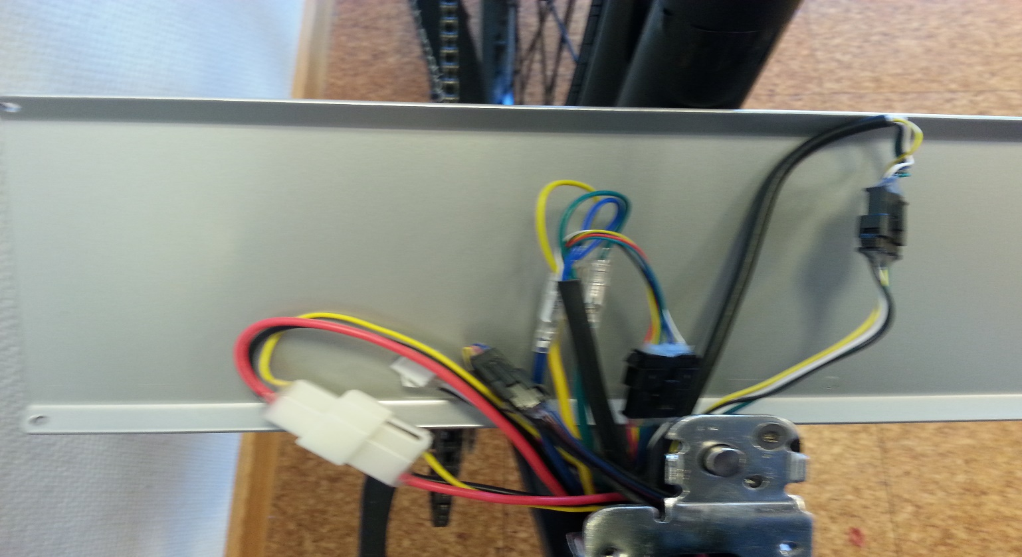
Bicycle Battery Cables Plugins
2
3
1
1
2

Slide 4

Plugin White 2
Battery off | Black(-) | White(-)
Black
Red (+) | 40 V | 40V
White (+) | Zero
Battery ON (Light off ) | Black(-) | White(-)
Black |  | Zero
Red (+) | 40 V | 28 V
White (+) | 12 V

Slide 5
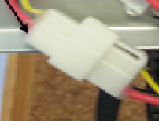


Plugin White1, Black1, Black2
(white 1)Battery ON | Black(-) | Yellow(-)
Black
Red (+) | 40V | 31V
Yellow (+) | 9V
Black 1 no values were measured in all cases
(black 2)Battery ON | Black(-) | Blue(-) | White(-)
White(+) | 0,2V
Blue(+) | 12V |  | 12V
Yellow(+) | Zero | -7V | Zero
Green(+) | Zero | -12V | Zero

Slide 6

Plugin Black3
(Black 3)Battery ON (with/without light) | Black(-) | Brown(-)
Brown (+) | 4V
Blue(+) | Zero | -4V
Note: Black 3 measure nothing when the battery is off. Black 3 is the display data cable. Black 3 for sensor triggering.

Slide 7
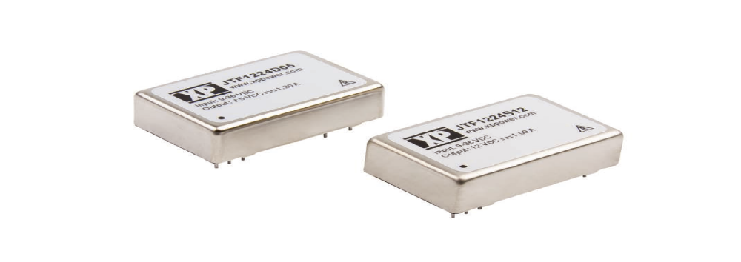
Checking Results
Black2 could be the suitable one!
Unfortunately it give 160 mA =>not enough.
What about White 1?
Voltage is 40v => voltage converter is needed.
(JTF1524S12) Delivery in 1 week.

Slide 8
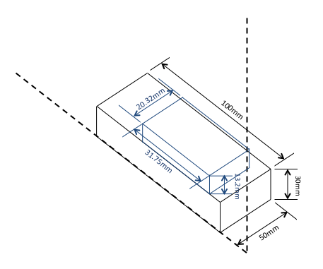
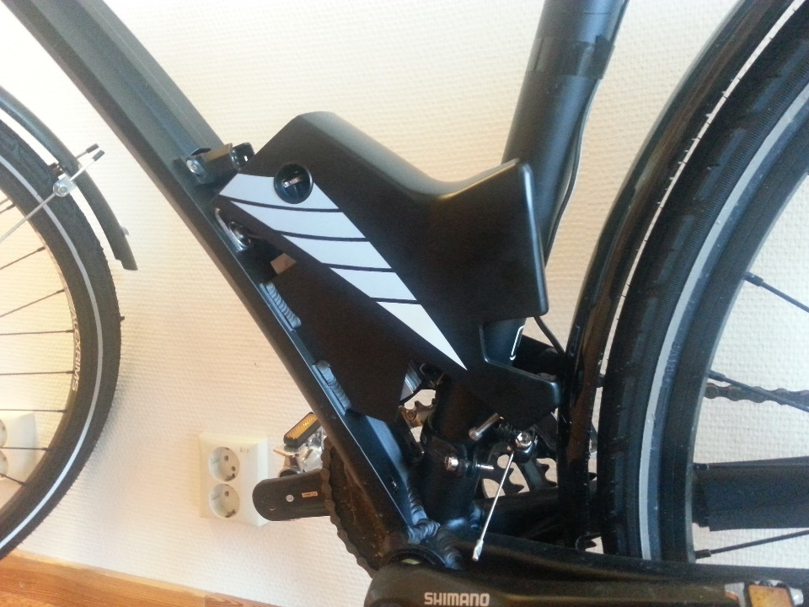
Checking Results
Selection Factors:
Suitable electricity.
Size fit in cables box

Slide 9
Access Dunavnet DB
Two VPN connection to Dunavnet network (linux and Windows)
Success, unfortunately DB machine not reachable.
Suggestion was sent to Dunavnet is to give us public access to the DB machine.

Slide 10
Stability of sensor
No sending after approx. 4 hours
Sensor stable read (15 min)

