Slide 1
The Distribution of Waves in Microcell

Slide 2
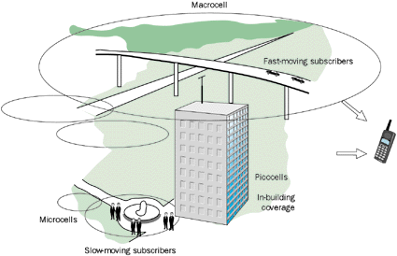
Big Picture
Source: harriscommunications.net

Slide 3
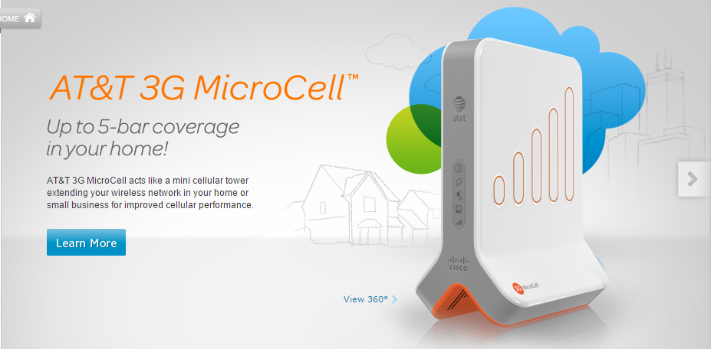
Microcell
A microcell is a cell in a mobile phone network served by a lower power cellular base station (tower), covering a limited area such as a shopping mall, a hotel, or a transportation hub. (Source: wikipedia)
Source: AT&T

Slide 4
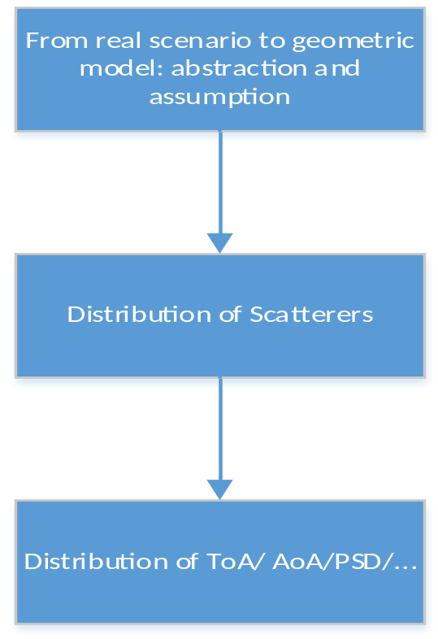
Modeling Approach and Assumptions
Scatterers uniform/Gaussian/exponentially/…… distributed
Single-bounce reflection
Omni-directional antennas/directional antenna

Slide 5
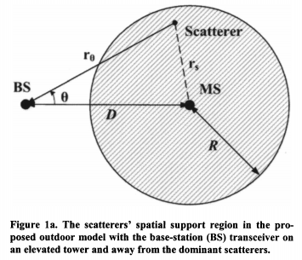
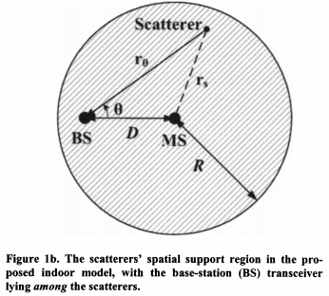
Geometric approach
Macro-cell geometry
Micro-cell geometry
Source: Yue Ivan Wu and Kainam Thomas Wong, ‘A Geometrical Model for the ToA Distribution of Uplink/Downlink Multipaths, Assuming Scatterers with a Conical Spatial Density’.

Slide 6
Challenge Parts
Region of scatterers not a circle
Complex distribution of scatterers
No closed-form solution for the answer

