Slide 1


eHLF / eHLQ
eHealth literacy framework/ eHealth literacy questionnaire

Slide 2
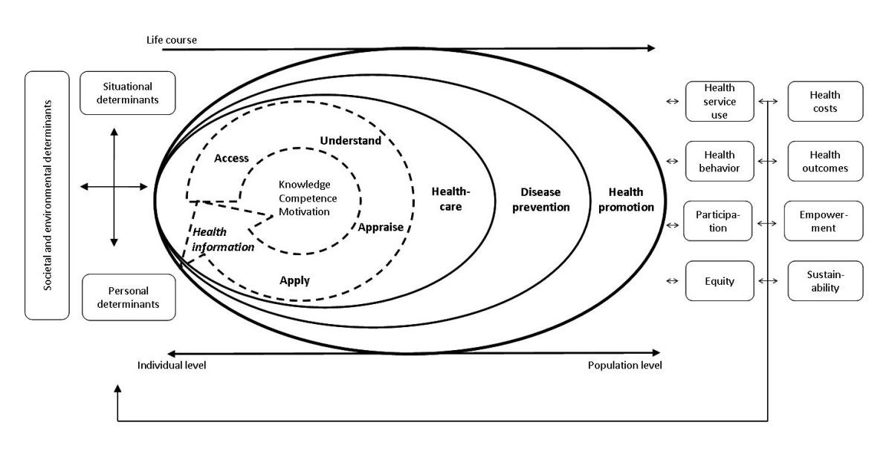
Health literacy
Sørensen et al., 2012

Slide 3



Digital health literacy / eHealth literacy
“the ability to seek, find, understand, and appraise health information from electronic sources and apply the knowledge gained to addressing or solving a health problem”
Norman and Skinner, 2006

Slide 4
eHealth literacy comprises of six subtypes of literacy
 | eHealth literacy
Traditional literacy and numeracy | - the ability to understand text and number
Health literacy | - the ability to process and understand health information
Computer literacy | - the ability to use computer hardware and software
Science literacy | - the ability to understand scientific texts, facts, and correlations
Media literacy | - the ability to process media content and assess its quality
Information literacy | - the ability to process information, to know how knowledge is organized, and to know how to use the gained information

Slide 5
Updated definition of eHealth literacy
“eHealth literacy includes a dynamic and context-specific set of individual and social factors, as well as consideration of technological constraints in the use of digital technologies to search, acquire, comprehend, appraise, communicate, apply and create health information in all contexts of healthcare with the goal of maintaining or improving the quality of life throughout the lifespan”
Griebel et al., 2017

Slide 6
Why measure eHealth literacy
To understand the users in their interaction with services and technologies
To serve as a design input, e.g. be used as a model or be used to understand user’s performance in usability tests
To evaluate the effect of interventions directed at either the users competence or at the service design

Slide 7
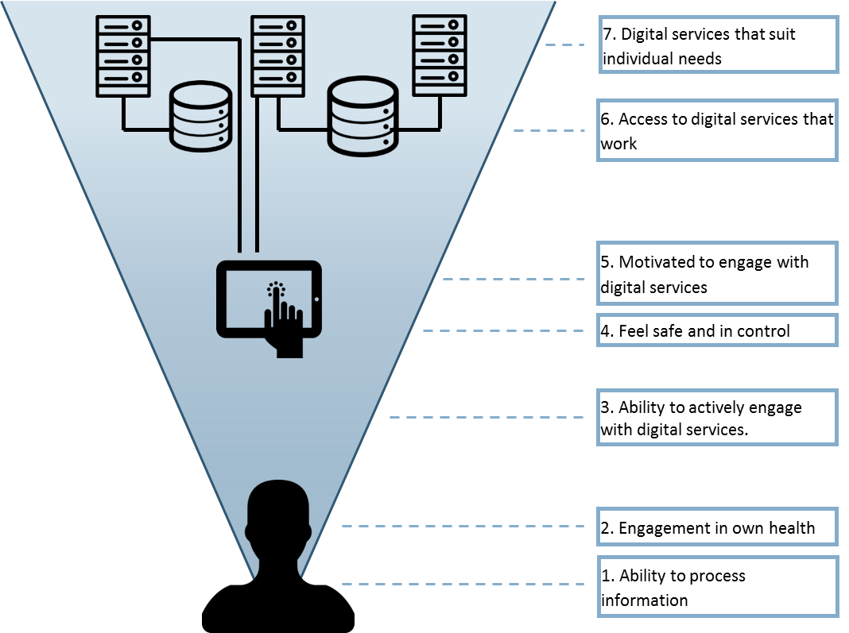
eHealth literacy framework
Nordgaard et al. 2015
Notes:
• 1-3: User dimension / Capabillities: 1-3
• Ability to use information / Able to read, write and remember, apply basic numerical concepts, and understand context-specific language (e.g., health, IT or the user’s native language, as well as critically appraise information. Do people know now when, how and what information to use.
• Knowledge about one's own health / Understanding of health concepts and language. Know about the body’s basic functions and structure and own current health status. Aware of risk factors and how to avoid them or reduce their influence on own health.
• Ability to actively engage with digital services. Ability to engage with technology / Uses of e-health technologies. Being comfortable using computers and other digital media for handling information.
• 4-5: Interface / Experience using technologies
• Feel in control and secure when using technology / Feel that you have the ownership of personal data stored in the systems and that the data are safe and can be accessed only by people to whom they are relevant (own doctor, own nurse etc.).
• Feel that technology is beneficial / Feel that engaging in the use of technologies will help them to manage their health more effectively than by other means.
• 6-7: aask dimension / Access to technologies
• Access to technologies that work. Have access to technologies (e.g. computers and other digital media) that the users trust to be working when they need it and as they expect it to work.
• Access to technologies that suit individual needs. Have access to technologies that are adaptable to the specific needs and preferences of the users. This includes responsive features of both
technologies and the healthcare system (including carers) as well as adaptation of devices and interfaces to be used by people with physical and mental disabilities.

Slide 8
eHLF / eHLQ
Seven dimensions. In total: 35 items
  Understanding of health concepts and language
  Uses of e-health technologies
  Ability to actively engage with digital services
  Feel safe and in control
  Motivated to engage with digital services
  Access to digital services that work
  Digital services that suit individual needs
Notes:
• User dimension / Capabillities:
• Knowledge about one's own health / Understanding of health concepts and language. Know about the body’s basic functions and structure and own current health status. Aware of risk factors and how to avoid them or reduce their influence on own health.
• Ability to use information / Ability to actively engage with digital services. Able to read, write and remember, apply basic numerical concepts, and understand context-specific language (e.g., health, IT or the user’s native language, as well as critically appraise information. Know when, how and what information to use.
• Ability to engage with technology / Uses of e-health technologies. Being comfortable using computers and other digital media for handling information.
• Interface / Experience using technologies
• Feel that technology is beneficial / Motivated to engage with digital services . Feel that engaging in the use of technologies will help them to manage their health more effectively than by other means.
• Feel in control and secure when using technology / Feel safe and in control . Feel that you have the ownership of personal data stored in the systems and that the data are safe and can be accessed only by people to whom they are relevant (own doctor, own nurse etc.).
• Task dimension / Access to technologies
• Access to technologies that work. Have access to technologies (e.g. computers and other digital media) that the users trust to be working when they need it and as they expect it to work.
• Access to technologies that suit individual needs. Have access to technologies that are adaptable to the specific needs and preferences of the users. This includes responsive features of both
technologies and the healthcare system (including carers) as well as adaptation of devices and interfaces to be used by people with physical and mental disabilities.

Slide 9
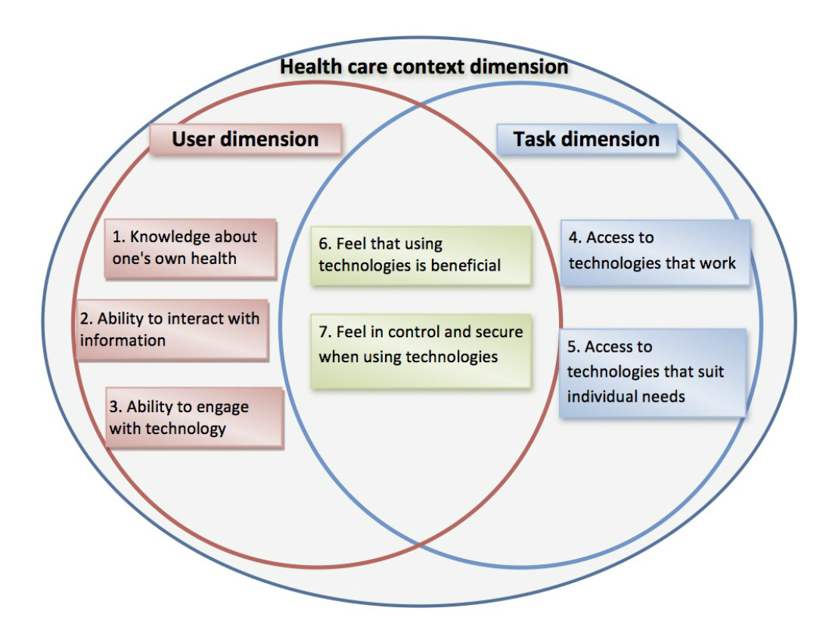
Kayser et al. 2015

Slide 10
Example of “User dimension” questions
How do you get most of your information about health?
What kinds of technologies do you use? Internet? Mobile phone?

Slide 11
Examples of Interface questions
Did you think the app was beneficial?
How do you feel when you use technology? When you used the app?

Slide 12
Task dimension questions
How did you use the app?
What do you think about how it worked?
Did the app meet your needs?

Slide 13
eHLQ
A value generating model with focus on person-centered health care
Includes cross disciplinary teams and work across sectors
Development of life skills

