Slide 1
IoTSec/SmartGrid Security Center – Getting an overview
Rune Winther
Smart Innovation Norway/Multiconsult

Slide 2
Who am I?
Rune Winther
Dr.Scient., UiO 1996, mathematical statistics, specialized in risk- and reliability analysis
Work experience
  UiO (PhD), UiS/HiS (associate prof.), HiØ (associate prof.), IFE (part time researcher), various consultancy/engineering companies
Main research area: Analysis, design and development of critical programmable systems
Consultancy: ICT, rail/transportation, industry, buildings, aeropace, telecom, critical infrastructure, power supply systems, and more
Currently employed by Multiconsult, and hired 20% by Smart Innovation Norway to work with SGSC
Part-time position at Østfold University College

Slide 3
The task – And some of its challenges
The task in short, according to the IoTSec web page:
To transfer the scientific results into an operational environment
Going deeper into WP-descriptions, it is clear that the ambitions for SGSC are high – and in many cases quite specific
It is not obvious (to me) how the ongoing research is related to the goals of the SGSC
Hence: (I have) a need to get an overview, in order to relate the research activities to an operational environment

Slide 4
A way to get an overview – And a basis for the SGSC?
The most basic operational need is to provide a means for SmartGrid/IoT companies to document acceptable levels of security, privacy and dependability (SPD)
Thus, a possible way to organize an overview of the research would be to describe how the results from the various research activities could be used to support the claim that a SmartGrid/IoT system has an adequate SPD-level

Slide 5
A possible approach
To apply the principles from safety cases, dependability cases, assurance cases, etc.
A dependability case is
a structured argument providing evidence that a system meets its specified dependability requirements.
It is not a formal argument, in the sense of being a mathematical proof
Can be established using various notations and tools
  CAE, GSN
  ASCE (Adelard), NOR-STA (Argevide)

Slide 6
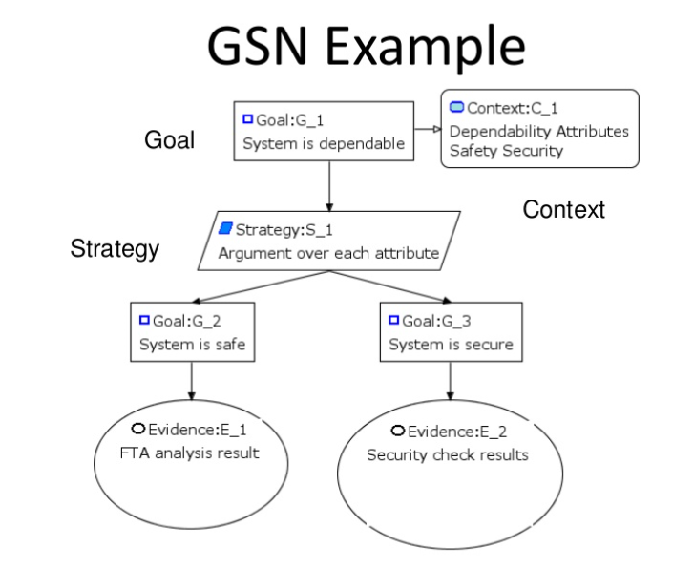
The principle

Slide 7
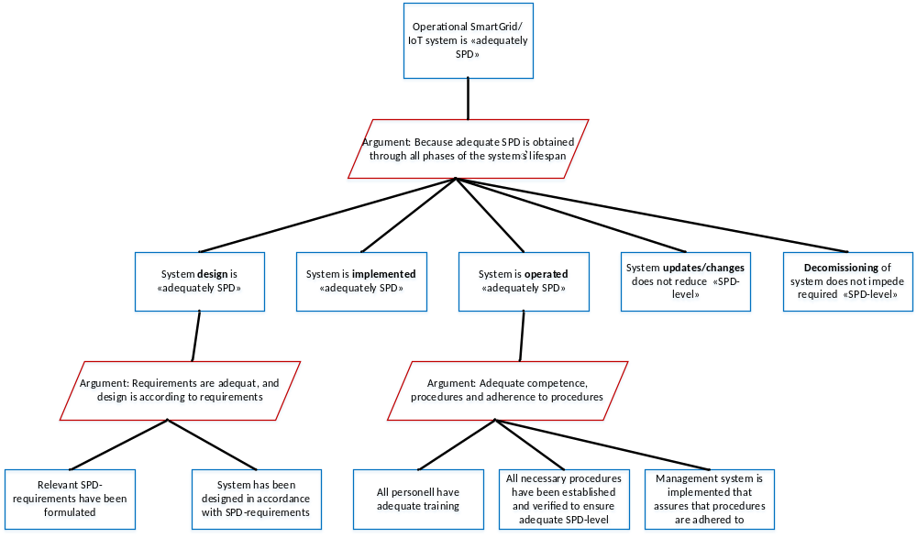
The start of an SPD-case?

Slide 8
Comments
The IoTSec project can’t be expected to address the complete SPD-case
Nor can all IoTSec activities be expected to be applicable in an operational setting
By relating research results/goals to the various sub-claims of the SPD-case we could get a better overview of how IoTSec research fits in with the goal of the SGSC
It would be beneficial to the SGSC if we indicate which existing methods that fit in as well
  Because an operational SGSC wouldn’t only use results from IoTSec

Slide 9
What would we need to do, and what would be the gain?
To be done
Develop an SPD-case
    Dependability case patterns are available as a starting point
    Done by me, with support from others
Relate the IoTSec research activities to the SPD-case
    Workshop?
The gain
We will know which (and how!) research results/goals of IoTSec are relevant for SGSC
We will identify what is lacking to achieve complete coverage of the SPD-case
  Basis for future research activities?

Slide 10
Comments/Discussion?

