Slide 8
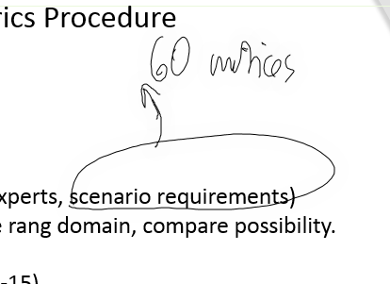

Slide 10
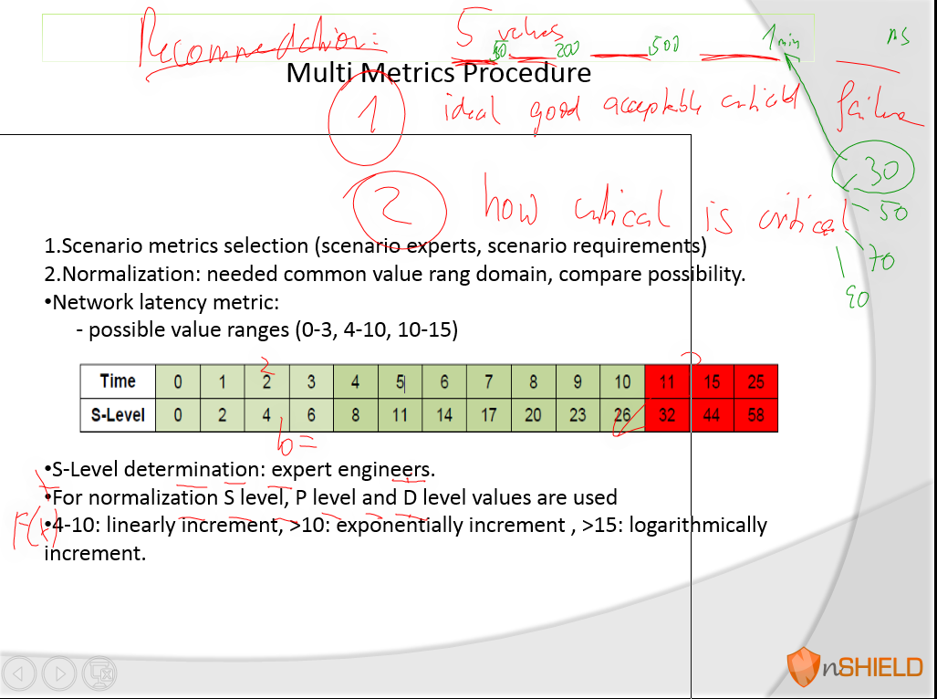

Slide 16
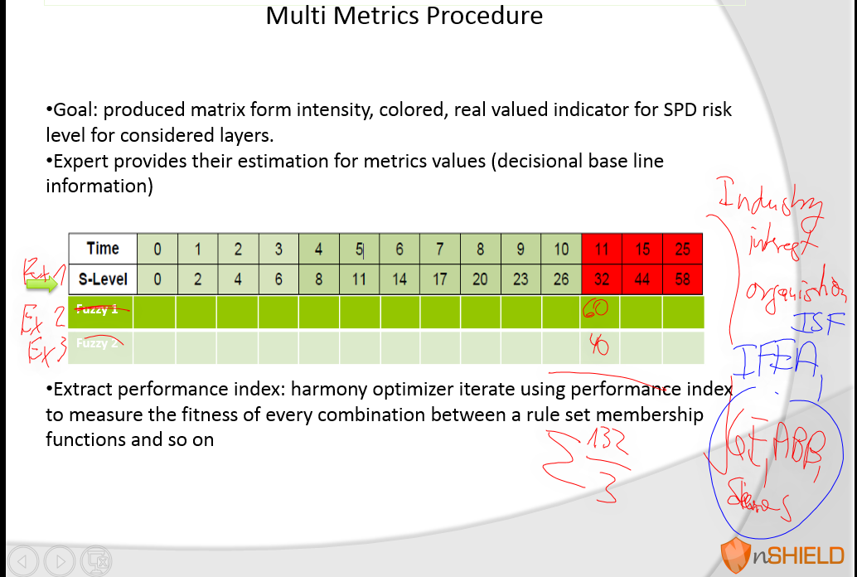
The Association for Electrotechnics and Automation in Industry - IFEA
Industriens Sikkerhetsforum - Industries Security Forum - ISF

Slide 17
Paper B- Journal: for Cooperative Optimized Innovative Intelligent Infrastructure networks

