Slide 1
NFC Security
What is NFC?
NFC Possible Security Attacks.
NFC Security Attacks Countermeasures.
Conclusion.
References.

Slide 2
What is NFC
NFC (Near Field Communication).
Short range contactless communication between devices (at least one transmission device, e.g. public transport card readers).
NFC communication configuration
Active - Active: RF field are alternatively generated.
Active-Passive: RF field generated by first device.
Passive-Active: RF field generated by second device

Slide 3
What is NFC
NFC operational mode :
Read/write mode: active device links up with another device to read information (smart mobile - NFC tag)
Peer-to-peer mode: both devices switch between active (sending data), and passive (receiving data).
Card emulation: using NFC device as credit card.

Slide 4
NFC Possible Security Attacks
Smart Poster URL Spoofing.
RF signal eavesdropping attack.
Data Corruption and data insertion.
Data stealing.

Slide 5
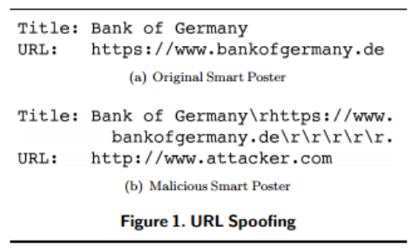
Smart poster URL spoofing
Possible countermeasure: mark the URL in special way

Slide 6
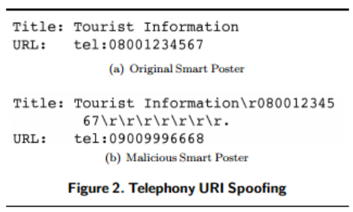
Smart poster URL spoofing Consequences
Run man in the middle attack by loading a malicious website => and steal credential or inject malicious contents.
Attacking The Mobile Telephony Service.

Slide 7
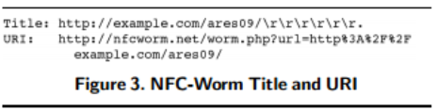
Smart poster URL spoofing Consequences
NFC Worm injection
Denial-of-Service Attacks: touch NFC-Tag => mobile crash

Slide 8
RF signal eavesdropping
RF Signal eavesdropping:
How close an attacker need to be, based on many things:
  RF characteristics of sender device, attacker antenna, attack receiver, attacker signal RF decoder, power send by NFC device, attacker location.
In general, sending device in active mode => 10m, when it in passive mode => 1 m.
Possible countermeasure: establish a secure channel.

Slide 9
Data corruption and insertion
In data corruption transmit valid frequency of data spectrum at correct time.
corruption power is bigger than sender power => detectable.
In data insertion: only, inserted data transmitted before the original device starts with the answer
data streams overlap => data corruption

Slide 10
Data insertion possible countermeasures
Answering device answers with no delay.
Answering device listen (monitor) channel during communication time.
Secure channel between devices (Diffie-Hellmann).

Slide 11
Data Stealing
Data of card integrated with passive NFC chip could be stolen using related application.
E.g. credit card data.
Attack need to be within card communication range.
Countermeasures: using of special card case, cover it with aluminum and installation Antivirus on the mobile phone.

Slide 12
Conclusions
NFC is not full secure.
Recommendation: smart credit card should be replaced with old fashion one.
Antivirus should be installed on NFC enabled devices.
Smart poster distribution should be controlled.
NFC security countermeasures have to be considered parallel to enabling NFC.

Slide 13
References
E. Haselsteiner and K. Breitfuß. Security in near field communication. Workshop on RFID Security, 2006.
http://www.androidauthority.com/what-is-nfc-270730/, 10-09-2014
C. Mulliner, "Vulnerability Analysis and Attacks on NFC-enabled Mobile Phones," in Proceedings of the International Conference on Availability, Reliability and Security (ARES '09), pp. 695-700, 2009

Slide 14
Thank you for your attention

