Slide 1
Diversification for Resilient and Trustworthy IoT-systems
Arnor Solberg
Notes:
Bildet illustrerer:
· bredden i SINTEFs ekspertise, fra havrom til verdensrom.
· hvilke områder og bransjer vi jobber innen for å realisere visjonen Teknologi for et bedre samfunn.
Bildestilen er basert på stikkordene fremtidsrettet, teknologi og norsk natur (naturressurser). SINTEFs visuelle univers er utviklet for SINTEF av Headspin Productions AS.

Slide 2
09:30 welcome (Arnor)
  09:45 Arnor Solberg (SINTEF)
    on "DiversIoT plans"
  10:30 break
  11:00 Christian Johansen (ITS-UiO)
    on "UiO planned activities"
  11:30 Knut Eilif Husa (Tellu)
    on "Tellu planss"
  12:00 Lunch

Slide 3
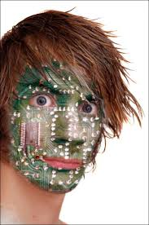

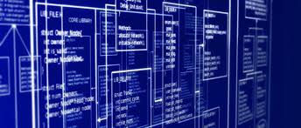


Smart IoT Systems
Who we are
Scientists in (Model Driven) Software Engineering
Mission
  Provide methods and tools supporting software developers and software system operators in developing, operating and evolving complex software systems.
    More efficient
    Handle/manage complexity
  Eventually support End User ease of use
    Flexible and dynamic system
    End user control, end user in the loop
SE analysis
Design
Implementation
Execution

Slide 4
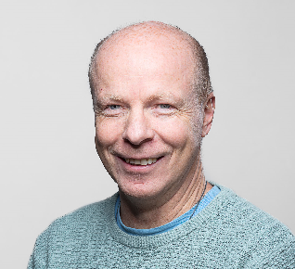
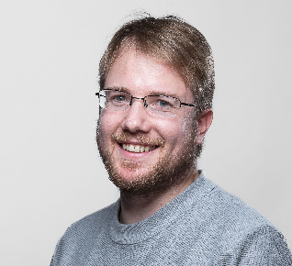
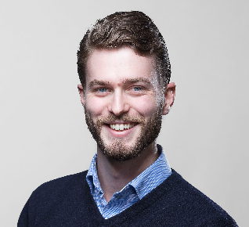
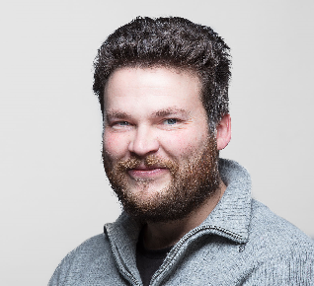
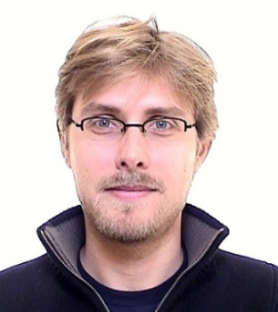
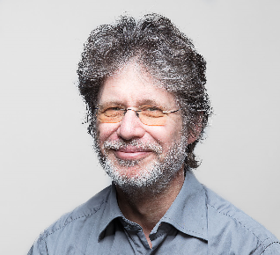
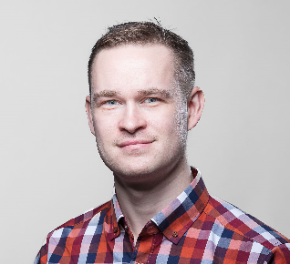
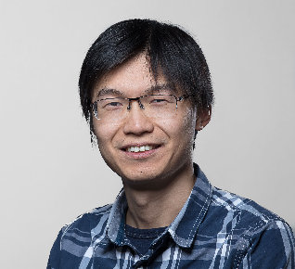
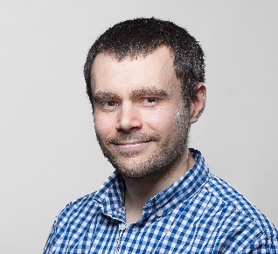
Smart IoT Systems

Slide 5
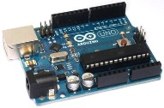
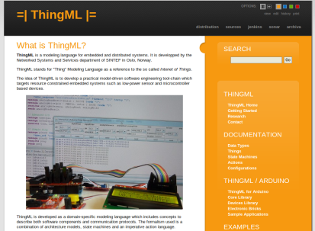
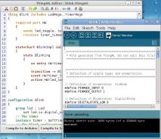
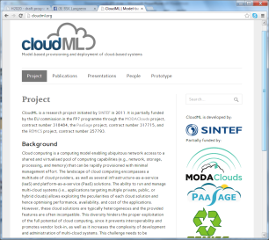



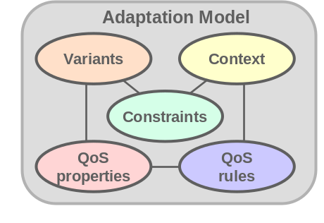


What we do
Apply our (MD)SE competence to develop languages, methods and open source tools addressing specific complex tasks in:
  IoT
    Heterogeneity and code distribution
    ThingML/ThingMF
    www.thingml.org
  Cloud Computing
    Monitoring, deployment and resource provisioning
    CloudML/CloudMF
    www.cloudml.org
  Big Data
    Data management Data Mgmt workflows
    BigML/BigMF
  Cross cutting
    Run time Adaptation (DiVAML/DiVAMF)
      www.modelbased.net
    Variability/PL (BVR)
      www.modelbased.net
    Advanced Software Architectures (UML, SoaML)
Service
Service
Services
VD
VD
CLOUD
Service
VD
VD
VD
VD
Reconfigurable
RSS & sensor firmware

Slide 6




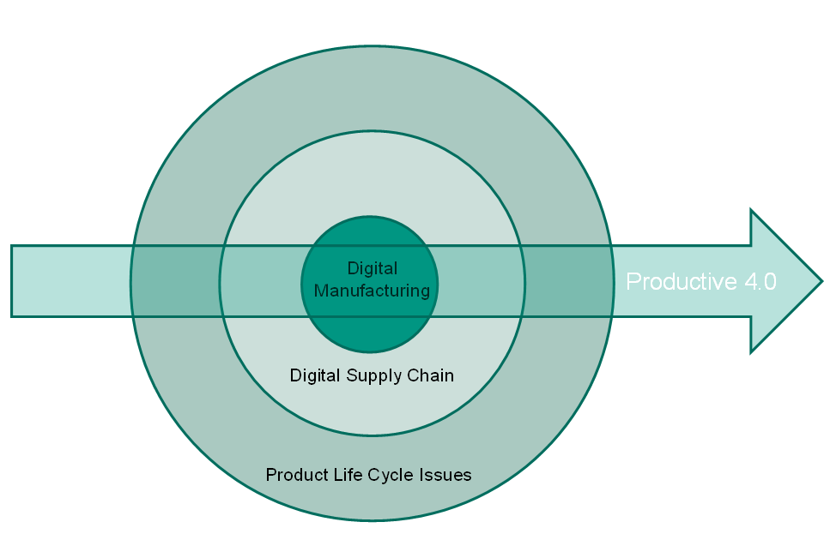


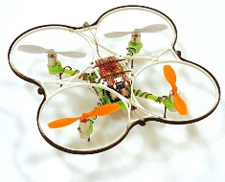







SIS Project Portfolio
Cloud
Big Data
Things
Automated SME factory
digitalisation and
roadmaps towards industry 4.0
MA Sense
Cineldi
Open Transport Data
AutoActive
DiversIoT
Cross
Cutting
Adaptation, Variability
Notes:
ProaSense
Aker, SINTEF
Proactive enterprises, real time Big Data
CEP, Observe-Orient-Decide-Act
proDataMarket: Open market for property data
EVRY, StatsBygg, SINTEF
DaPaaS:
BigData management and publication
DaaS, unified Linked Data access.
CitiSense: Env monitoring in cities
Lead by NILU
Norsk institutt for luftforskning

Slide 7
Outline
Context and initial idea
Baseline, Diversification in cloud context
  Diversify EU FET project
DiversIoT overall objectives
Phase 1 objectives, tasks, deliverables and planning
Inputs to planning
  Letter and ESR from NFR
  NFR webinar
  Phase 1 report template

Slide 8

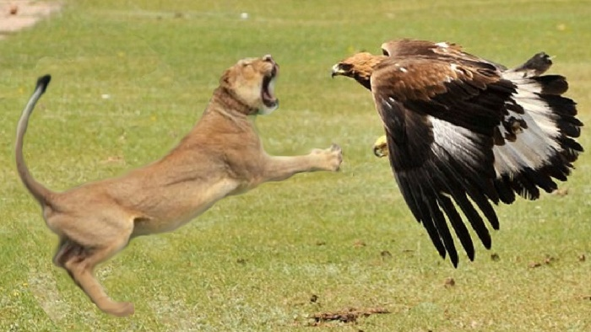
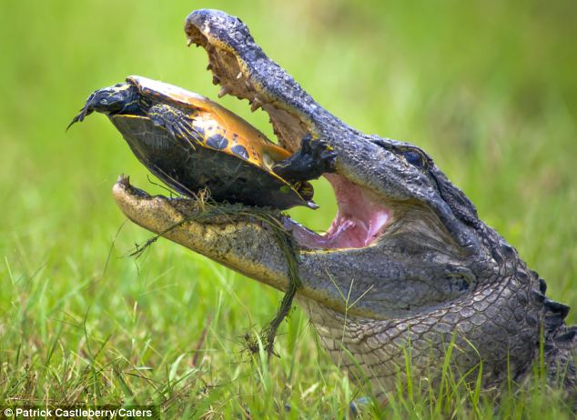
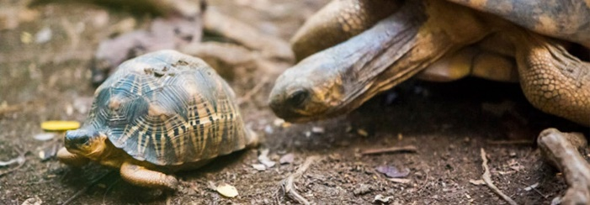
Context and initial idea
In nature, diversity has been a key mechanism for resilience for all forms of life, by enabling them to adapt to changes in the environmental conditions and evolve immunity to perturbations.
Want to avoid cases that if a system can break into one “keyless” car, it allows to steal any car that uses the same “keyless” system,
(reported in R. Verdult et al., «Dismantling Megamos Crypto:Wirelessly Lockpicking a Vehicle Immobilizer,» i 22nd USENIX Security Symposium, 2015)
Or break one BMW car system can break every BMW car system…
By 2020, more than 25% of the cyber attacks against enterprises will originate from the IoT. This is already a reality: 150,000 IP cameras running the same firmware and configuration (including default root/xc3511 credentials) were recently involved in the largest D-DoS attack until now, which blocked the Internet in North America for several hours, by “sending debilitating levels of network traffic”.
http://www.gartner.com/newsroom/id/3291817

Slide 9
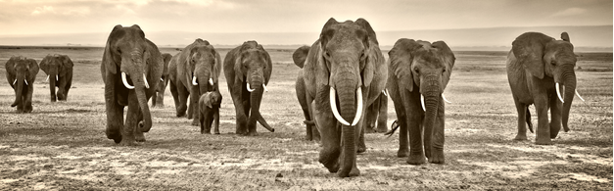
Context and initial idea
Recent multidisciplinary research on software engineering and ecology suggests that a promising way to approach resilience in software systems is to diversify software
Laperdrix et al., «Beauty and the Beast: Diverting modern web browsers to build unique browser fingerprints,» i IEEE Symposium on Security and Privacy (S&P'16), 2016.
F. Fleurey et al., «Multi-tier diversification in Web-based software applications,» IEEE Software, 32 (1), pp. 83-90, 2015.

Slide 10
Context and initial idea
Each instance of a service has a different implementation and operates differently, still ensuring that its global behavior is consistent and predictable.
  Thus, instead of exposing the very same code in millions of instances, each individual instance will be unique, making the overall system more resilient

Slide 11
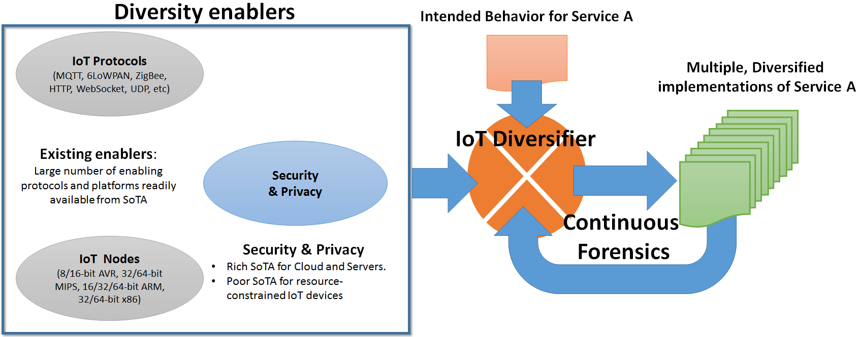
Context and initial idea,
Additional Diversity enablers

Slide 12
Context and initial idea
Produce a set of diversified implementations for the service.
Each service instance will be semantically equivalent to the intended service, but different instances will differ in particular by their:
  topology: e.g., the different components, and security mechanisms, can be distributed in multiple ways on the different nodes involved in an IoT service, and even the node topology can vary
    Intuitively, a very distributed topology will be more difficult to attack, as data is fragmented across multiple node but is communication-intensive, and thus less power efficient
interface: e.g., diversification in terms of serialization (JSON, XML, binary etc), diversification in bit ordering, diversification in transport protocols (MQTT, UDP)
coding: a given logical operation can be implemented in multiple ways. A simple example; 2 can indeed be represented as 2, or 1+1 or -2+3, etc.

Slide 13
DiversIoT
The vision of this project is to make the IoT ecosystems resilient and trustworthy by diversifying IoT service implementations, enabling companies, public authorities and people to exploit and use IoT-based services, with low risk for privacy and security breaches and significantly reduced impact in case of cyber attack infringes
Partners: SINTEF,
UiO,
and TellU

Slide 14
DiversIoT, main objectives
Propose automated mechanisms to diversify IoT services, while preserving the specified behaviour
Propose a diversified set of privacy and security mechanisms
Enable continuous diagnosis and forensics of IoT systems

Slide 15
Phase 1

Slide 16
Goal Phase 1
Show the feasibility of the project's vision (software diversity-driven resilient and trustworthy IoT ecosystems) by demonstrating semi automatically-generated diversified IoT services, as a proof of concept to verify the idea and concept of DiversIoT and by surveying relevant approaches and technologies to clarify the unique contribution of DiversIoT and identify the baseline for the project. Moreover, a concrete plan for how to achieve scientific and industrial impact will be specified.

Slide 17
Secondary objectives
Provide a survey of existing privacy and security mechanisms applicable to IoT ecosystems, in particular focusing on the resource-constrained end of the IoT (gateways and devices), as numerous and convincing solutions are already available for larger nodes (PCs, server, cloud).
Provide a survey of diversity enablers applicable to IoT ecosystems able to yield technically and technologically diversified implementations of a given IoT service specification.
Provide a Proof-of-Concept version of a diversified IoT service in the privacy- and security-demanding domain of eHealth, i.e., 5-10 semi-automatically diversified versions of a simple eHealth service involving a) a cloud back-end (TellU Cloud), b) a gateway, and c) a set of medical devices.
Provide a concrete impact plan and initiate activities to ensure high impact of the project results, both in terms of industrial and scientific impact.

Slide 18
Main activities Phase 1
Main Activity 1: Diversity enablers for the IoT [UiO, SINTEF] During Phase 1, this activity will focus on surveying existing privacy and security mechanisms that can be adapted to the IoT and to the most resource-constrained node in particular (gateways, devices), as well as surveying other diversity enablers for the IoT e.g., different ways of implementing similar features, different way of communicating across nodes. The results of those two surveys will be delivered in D1.1 and D1.2.
Main Activity 2: Automated Software Diversification for the IoT [SINTEF, TellU, UiO] During Phase 1, this activity will implement a family of 5-10 diversified services i.e., 5-10 different implementations of a given abstract eHealth service. This task will leverage on the existing capabilities of the ThingML language and compilers, as well as the knowledge acquired in FP7 FET Diversified to provide a semi-automatic way of deriving those 5-10 implementations from a common abstract specification of the service. This Proof-of-Concept of the DiversIoT idea will be delivered in D2.1.
Main Activity 5: Interaction, Dissemination and Exploitation [SINTEF, UiO, TellU] During Phase 1, this activity will focus preparing the ground to ensure high impact of DiversIoT and make a concrete plan for dissemination and exploitation in terms of both academic and industrial impact. The impact plan and the report of current activities and achievements will be delivered in D5.0 in Phase 1.
Main Activity 6: Management [SINTEF] This activity will be responsible for the proper management and follow-up of the above-mentioned tasks, and will be responsible for communications with the Research Council. This activity will also prepare a set of KPIs related to the general technical and non-technical requirements, use case requirements as well dissemination and exploitation. At the end of Phase 1 this will be delivered in a draft of D6.1. The final D6.1 will be delivered early in Phase 2.

Slide 19
Deliverables Phase 1
Two survey reports and one Proof-of-Concept demonstrator, reporting respectively on the three first secondary objectives described above. They are respectively delivered as deliverables D1.1, D1.2 and D2.1 at the end of Phase 1.
A dissemination and exploitation plan and report on activities and achievements in Phase 1 to ensure high scientific and industrial impact of the project, in deliverable D5.0. In particular, a reference group, composed of industries and academics in Norway and abroad, will be established to ensure the interest and relevance of the project across academia and industry. SINTEF, UiO and TellU will leverage their networks to establish this group, e.g. by contacting Norge 6.0 (in particular involving Kongsberg Group, and FFI), NCE Smart Innovation Østfold, the IoTSec community, as well as IoT service providers in TellUs customer and partnership portfolio (e.g,, Telenor and Prediktor).
A project quality plan and a set of detailed KPIs (including KPIs related to ethnography) to ensure the proper management and smooth progress monitoring of Phase 2. This project quality plan will be delivered as D6.1 at the beginning of Phase 2, but a coherent draft will be available at the end of Phase 1.
Detailed PhD/PostDoc topics are prepared, and potential candidates have been identified. The positions are ready to be advertised as soon as Phase 2 funding is decided. Topics will be presented at the review at the end of Phase

Slide 20
Partner responsibilities Phase 1

Slide 21
SINTEF
SINTEF is conducting the project management and is responsible for Main Activities 2, 5 and 6, all starting in Phase 1. SINTEF Digital and the group for Smart IoT Systems brings expertise in Software Engineering and IoT. In particular, it has developed the ThingML approach, a modelling language together with a code generation framework, supporting the design and implementation of IoT services on top of heterogeneous platforms. This group at SINTEF has also been involved in EU-FET Diversify project, investigating future technologies for embedding diversity for resilient software systems in collaboration with biology scientists. ThingML and expertise in software diversity will be two key pillars for this project enabling a rapid kick-starting of Main Activities 1 and 2 during Phase 1. In phase 1, SINTEF will also lead Main Activity 5 and the impact planing, UiO and TellU will also provide significant contribution to this activity.

Slide 22
UiO
Responsible for Main Activities 1. UiO will be represented by the Institute for Informatics (IFI) and Institute for Technology Systems (UNIK). UiO will bring expertise on IoT in general and security for IoT in particular. This expertise in IoT security is another key pillar for this project and for the proper execution of Main Activity 1. In Phase 1 the focus of the Main Activity 1 is to do technology surveys.

Slide 23
TellU
TellU: TellU is a spinoff from Ericsson Reasearch funded in 2006 and develops and delivers services and software through TelluCloud, an IoT platform for data gathering, processing and presentation. Their markets are in the domains of assisted living, e-health and personnel safety. A main business for TellU is to deliver eHealth and welfare services for the public and home care market in Norway, they also have services for personnel security in particular through a Dutch partner During Phase 1, TellU, as a end user representative, will provide requirements, use cases and KPIs for the project and will take part in the impact preparations and planning.

Slide 24
Specific plans SINTEF
Describe the concrete Proof of concept scenarios (exploiting the HEADS Tellu Case)
  Use case scenario and technology stack
  What to diversify (code, communication, and/or (probably not) deployment structure..)
  What are the challenges
  Initial ideas of how to solve
  Prove consistent behavior
Survey on Diversity Enabler (as a feature diagram)
  Code, (with languages)
  Communication Network protocols
  Deployment structures
  Platforms
  Security mechanisms and protocols

Slide 25
Papers
Survey paper on security Mechansims (UiO)
Other papers from UiO related to IoT sec (acknowledging DiversIoT)
Diversify paper with INRIA and Franck F
Position paper (ICSE NIER) (SINTEF) based on:
  Proposal
  Proof of concept implementation/scenario
  Diversity Enablers (Feature tree)
Popular Science paper based on
  Proposal + application domains
  Arnor contact Gemini to ask how this may be done

Slide 26
Other Dissemination activities
IoT Gemini centre (kick off 28/8)
DiversIoT workshop in Sweden (UiO)
Web site (UiO)
IoT Sec (UiO)
Seminar at UiO in May

Slide 27
Context,
Gemini Centre on IoT
A Gemini centre is a centre/network of science excellence.
The Gemini Centre will be exploited to impact development and innovations in Norwegian industry and society as well as excellence in science.
UiO, NTNU and SINTEF are partners in this centre. SINTEF is leading
  SINTEF 10 forskere (1 sjefsforsker, 7 seniorforskere, 2 forskere)
  UiO, 5 professorer, 5 PhD kandidater, 4 post doc og forskere
  NTNU, 9 professorer og førsteamanuensis, 5 PhD kandidater, 4 post doc og forskere
DiversIoT is one of the project that will be coupled to this centre

Slide 28
Specific concerns to address in Phase 1 report
See letter + ESR

Slide 29
End

